Slide 1


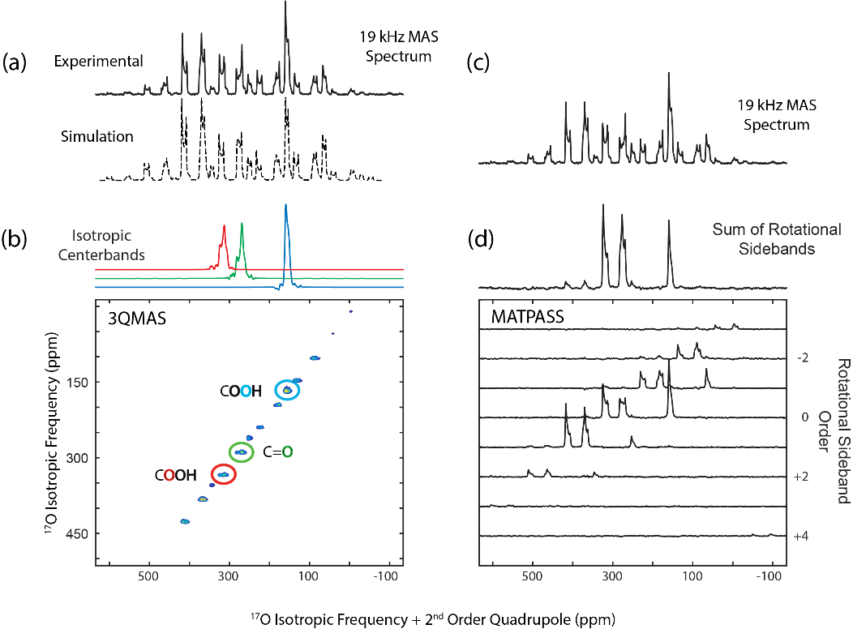
¹⁷O Magic-Angle Spinning NMR using 36T Series-Connected-Hybrid Magnet
Eric G. Keeler, Vladimir K. Michaelis, Michael T. Colvin, Robert G. Griffin (MIT)
Zhehong Gan, Ivan Hung, Xiaoling Wang, Joana Paulino, Ilya M. Litvak, Peter L. Gor’kov,
William W. Brey, Mark D. Bird, Timothy A. Cross (NHMFL)
Funding Grants: G.S. Boebinger (NSF DMR-1157490); M.D. Bird and W. Brey (DMR-1039938 and DMR-0603042)
T.A. Cross (NIH P41 GM122698); R.G. Griffin (NIH EB-001960, EB-002804, and EB-002026)
Oxygen is one of the most important elements in chemistry, biology and material sciences due to its active role in reactions. The potential of ¹⁷O NMR for obtaining detailed structural, dynamic and functional information has yet to be fully realized, primarily due to ¹⁷O having a low gyromagnetic ratio (γ = −5.774 MHz T⁻¹), low natural isotopic abundance (0.037%) and an I = 5/2 spin which produces complex quadrupolar NMR spectra. High magnetic fields are critical to fully enable ¹⁷O NMR because they dramatically enhance spectral resolution and sensitivity, particularly when coupled with a reduction of the residual second-order quadrupolar broadening under magic-angle spinning (MAS).
The MagLab has recently commissioned a 36T Series-Connected-Hybrid (SCH) magnet that offers 50% higher magnetic fields than the highest superconducting NMR magnet available today. The magnetic field is homogeneous and stable to better than 1 ppm over 1cm³ DSV. This field quality enables high-resolution multi-dimensional NMR experiments for ¹⁷O and, in future experiments, for other quadrupolar nuclei throughout the periodic table.
Researchers from MIT partnered with MagLab scientists to record the first ¹⁷O NMR spectra of biological samples taken in a 35.2T magnetic field (corresponding to a 1.5GHz resonance frequency for ¹H). The results demonstrate the field qualities of the SCH magnet and advantages of the 35.2T field for ¹⁷O NMR. The SCH magnet is now open to researchers from around the world.
NMR from the SCH magnet: a) 1D ¹⁷O magic-angle spinning, b) two-dimensional 3-quantum magic-angle spinning, c) and d) magic-angle turning phase-adjusted separated sideband spectra of N-acetyl-L-valyl-L-leucine
Facility: DC Field and NMR Facilities, 36 T Series Connected Hybrid
Citation 1: Keeler, E.G.; Michaelis, V.K.; Colvin, M.T.; Hung, I.; Gor’kov, P.L.; Cross, T.A.; Gan, Z. and Griffin, R.G., ¹⁷O MAS NMR Correlation Spectroscopy at High Magnetic Fields. J. Am. Chem. Soc. (2017), 139, 17953−17963.
Citation 2: Gan, Z.; Hung, I.; Wang, X.; Paulino, J.; Wu, G.; Litvak, I.M.; Gor’kov, P.L.; Brey, W.W.; Lendi, P.; Schiano, J.L.; Bird, M.D.; Dixon, I.R.; Toth, J.; Boebinger, G.S. and Cross, T.A., NMR spectroscopy up to 35.2 T using a series-connected hybrid magnet, Journal of Magnetic Resonance 284 (2017) 125–136.

Slide 2
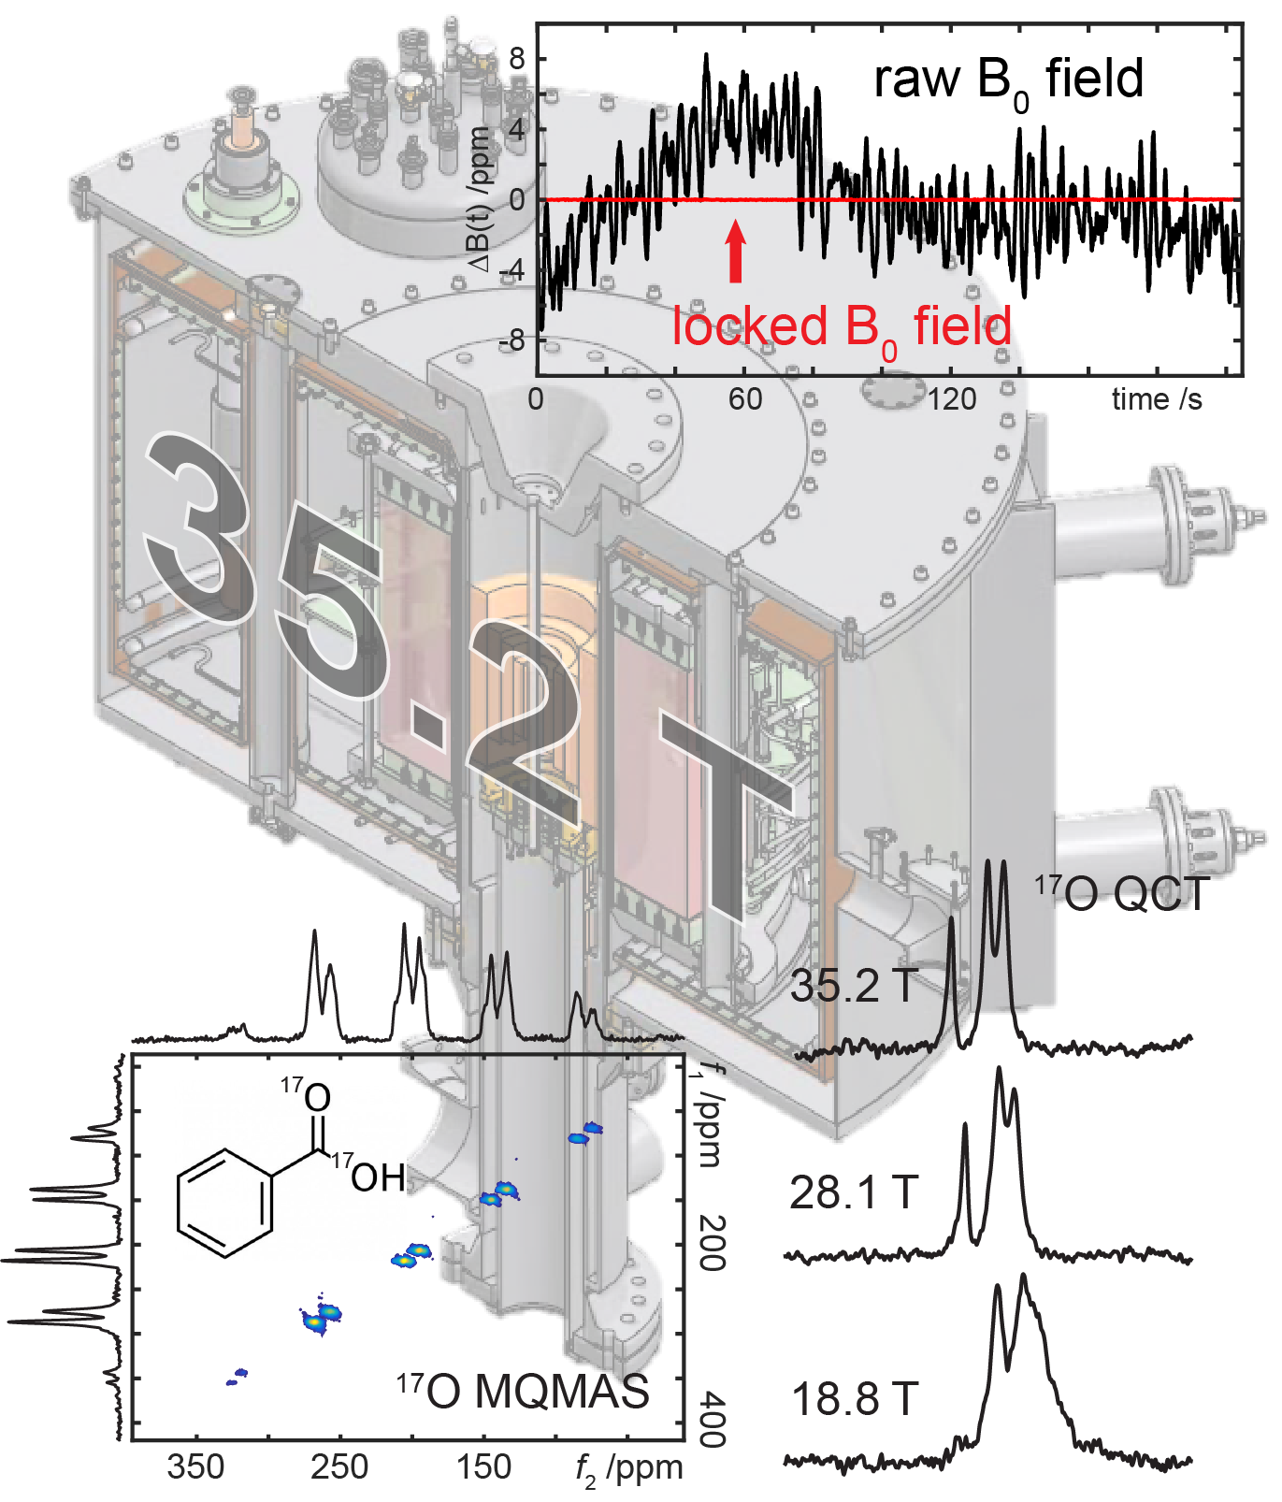
¹⁷O Magic-Angle Spinning NMR using 36T Series-Connected-Hybrid Magnet
Eric G. Keeler, Vladimir K. Michaelis, Michael T. Colvin, Robert G. Griffin (MIT)
Zhehong Gan, Ivan Hung, Xiaoling Wang, Joana Paulino, Ilya M. Litvak, Peter L. Gor’kov,
William W. Brey, Mark D. Bird, Timothy A. Cross (NHMFL)
Funding Grants: G.S. Boebinger (NSF DMR-1157490); M.D. Bird and W. Brey (DMR-1039938 and DMR-0603042)
T.A. Cross (NIH P41 GM122698); R.G. Griffin (NIH EB-001960, EB-002804, and EB-002026)
What is the finding? The MagLab’s new Series-Connected-Hybrid (SCH) Magnet combines superconducting and resistive coils to generate magnetic fields up to 36T, which is 50% higher than the highest superconducting NMR magnet available today. The magnet has a standard 40 mm bore for NMR probes and has been shimmed to better than 1 ppm field homogeneity over 1 cm³ DSV. The magnetic field has been regulated within 0.1ppm using a custom-made magnetic-field/frequency lock (red line in figure). The stable and homogeneous magnetic field enables high-resolution and multidimensional NMR spectroscopy.
Why is this important? The initial NMR spectra show the high spectral quality of ¹⁷O NMR, with gains in resolution and sensitivity from the high field illustrated by the two-dimensional multiple-quantum magic-angle spinning (MQMAS) spectrum and quadrupolar central-transition (QCT) of slow tumbling molecules in solution. This work illustrates the great advantage of ultra-high magnetic fields to extend NMR spectroscopy to a much broader range of nuclei throughout the Periodic Table.
Why did this research need the MagLab? The SCH magnet realizes a novel design that was conceived, engineered and built at the MagLab. The SCH has been added to the suite of unique MagLab magnets that attract users from around the world.
Facility: DC Field and NMR Facilities, 36 T Series Connected Hybrid
Citation 1: Keeler, E.G.; Michaelis, V.K.; Colvin, M.T.; Hung, I.; Gor’kov, P.L.; Cross, T.A.; Gan, Z. and Griffin, R.G., ¹⁷O MAS NMR Correlation Spectroscopy at High Magnetic Fields. J. Am. Chem. Soc. (2017), 139, 17953−17963.
Citation 2: Gan, Z.; Hung, I.; Wang, X.; Paulino, J.; Wu, G.; Litvak, I.M.; Gor’kov, P.L.; Brey, W.W.; Lendi, P.; Schiano, J.L.; Bird, M.D.; Dixon, I.R.; Toth, J.; Boebinger, G.S. and Cross, T.A., NMR spectroscopy up to 35.2 T using a series-connected hybrid magnet, Journal of Magnetic Resonance 284 (2017) 125–136.

