Slide 1
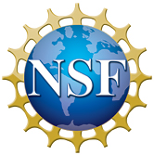
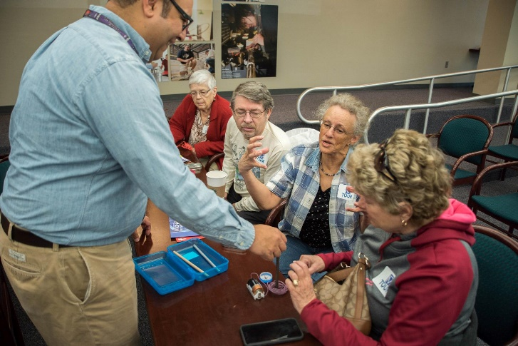
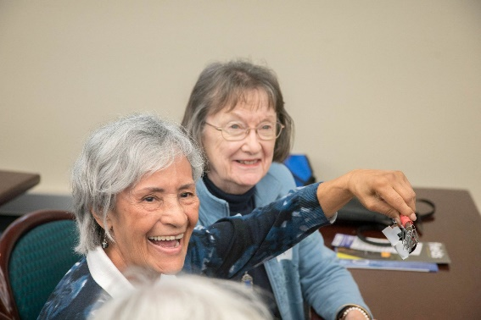
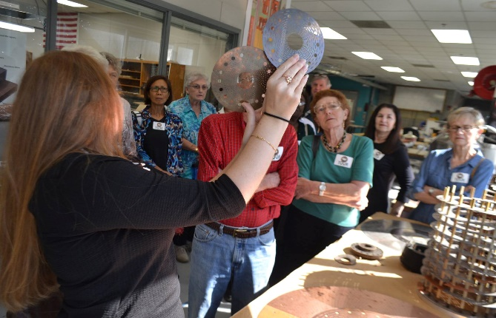
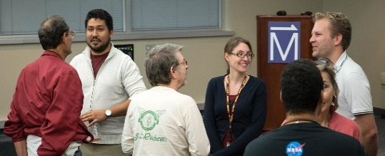
Accessing a Different Demographic: Educational Outreach to Seniors
K. Roberts, C.R. Villa
National High Magnetic Field Laboratory, Florida State University
Funding Grants: G.S. Boebinger (NSF DMR-1157490)
The MagLab recently hosted a half-day visit for several dozen visitors aged 65 or older in partnership with the Tallahassee Senior Center. These retirees built their own magnets, had a comprehensive tour of the MagLab’s facilities, and learned about scientific research during a panel discussion with MagLab scientists. The event gave the seniors a richer understanding of how electromagnets work, what the MagLab is about, and the groundbreaking materials, energy, and life-related discoveries that are made in the MagLab’s international user program.
Baby boomers started turning 65 in 2011 and will constitute 20% of the population by 2030. According to “The Longevity Revolution”, a report prepared for a June 2006 NSF-supported conference, older Americans are living longer, healthier and more engaged lives than at any other time in history. Life-long learning and hands-on engagement contributes to successful aging and can also translate into active support for scientific research and innovation.
The MagLab is a leader in providing hands-on science outreach and education across our local communities and beyond. Our lab has committed to going beyond traditional K-12 educational outreach in order to actively engage a variety of groups in outreach activities, including public tours, science café’s, bookstore events, and our annual Open House, which attracts more than 8,000 visitors to the MagLab on a single Saturday in February.
The MagLab’s Florida locations make it an ideal place to reach seniors with scientific life-long learning opportunities, since people aged 65 or above already make up nearly 20% of Florida’s population, a percentage that will increase in the coming years.
Left: Senior citizen “students” at the MagLab building an electromagnet.
Below: Participants tour the MagLab.
Bottom: A panel discussion over lunch with MagLab scientists.
Facility: The MagLab’s Public Affairs Department and its Center for Integrating Research & Learning

