Slide 1


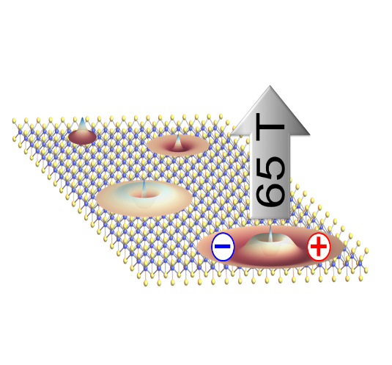
Exciton States in a New Monolayer Semiconductor
Andreas V. Stier¹, Nathan P. Wilson², Kirill A. Velizhanin³, Junichiro Kono⁴, Xiaodong Xu², Scott A. Crooker¹
1. NHMFL-Los Alamos; 2. University of Washington; 3. Los Alamos National Lab; 4. Rice University
Funding Grants: G.S. Boebinger, A.V. Stier, S.A. Crooker (NSF DMR-1157490); N.P. Wilson, X.Xu (DOE DE-SC0018171)
The monolayer transition-metal dichalcogenides, such as WSe₂ or MoS₂, are members of a new class of atomically-thin direct-gap semiconductors exhibiting very strong coupling to light, making them interesting materials for future ultrathin and efficient optoelectronics. However, in order to rationally design such devices, fundamental material properties such as the mass of electrons, holes, and excitons must be determined.
Historically, fundamental semiconductor properties such as exciton mass, spin, size, and dimensionality have been revealed via laser spectroscopy as a function of magnetic field. In the new monolayer semiconductors, extremely high fields (>50T) are needed to compete with the very large Coulomb interactions of these materials. Researchers encapsulate very clean monolayers of WSe₂ in hBN (hexagonal boron-nitride) a position the sample over the core of single-mode optical fibers. They then measure the polarized transmission spectra in pulsed magnetic fields to 65T. The energy and magnetic field dependence of the resonances revealed for the first time the size and binding energy of the first four Rydberg states of the neutral exciton (1s, 2s, 3s, 4s).
Crucially, the nearly-linear shift of the 3s and 4s Rydberg states at high field directly reveals the exciton’s reduced mass (m_{r}=0.20m_{e}), a fundamental material parameter that will help guide not only theoretical models but also the rational design and engineering of future optoelectronic devices based on this new class of two-dimensional semiconductors.
Circularly-polarized optical spectra from 0-65T of monolayers of WSe₂. The magnetic field dependences of the 1s, 2s, 3s, and 4s Rydberg states of the neutral exciton reveal fundamental excitonic parameters of importance to future optoelectronic applications of this new ultra-thin semiconductor.
Facilities and instrumentation used: NHMFL Pulsed Field Facility, Los Alamos National Laboratory; 65 Tesla capacitor-driven magnet.
Citation: A.V. Stier, N.P. Wilson, K.A. Velizhanin, J. Kono, X. Xu, S.A. Crooker, “Magneto-Optics of Exciton Rydberg States in a Monolayer Semiconductor”, Physical Review Letters 120, 057405 (2018).

Slide 2
Exciton States in a New Monolayer Semiconductor
Andreas V. Stier¹, Nathan P. Wilson², Kirill A. Velizhanin³, Junichiro Kono⁴, Xiaodong Xu², Scott A. Crooker¹
1. NHMFL-Los Alamos; 2. University of Washington; 3. Los Alamos National Lab; 4. Rice University
Funding Grants: G.S. Boebinger, A.V. Stier, S.A. Crooker (NSF DMR-1157490); N.P. Wilson, X.Xu (DOE DE-SC0018171)
What is the finding? The optical spectrum of an atomically-thin semiconductor -- a single atomic layer of tungsten diselenide, or WSe₂ – is measured in extremely strong pulsed magnetic fields up to 65T.
Why is this important? The high magnetic fields allowed us to directly measure, for the first time, the mass of the fundamental particles in this new family of two-dimensional (2D) materials. In all semiconductors, the fundamental optical excitation is the exciton (a bound electron-hole pair), which plays an essential role in technological applications such as solar cells or light-emitting diodes (LEDs). These excitons have a ‘weight’ (i.e., mass), which influences nearly all aspects of device performance. In the recently-discovered class of 2D semiconductors such as WSe₂ or MoS₂, the exciton’s mass had until now only been inferred from theory. In this work, we provide the first experimental measurement of this important and fundamental material parameter. It is widely anticipated that these 2D semiconductors will form the basis of a new generation of ultrathin, lightweight, and efficient optoelectronic devices.
Why did this research need the MagLab? The most reliable way to measure the mass of excitons in a semiconductor is to study their behavior in high magnetic fields. These new materials require much higher magnetic fields than traditional semiconductors like silicon and GaAs.
Circularly-polarized optical spectra from 0-65T from monolayers of WSe₂, showing resonances from the 1s, 2s, 3s, and 4s Rydberg states of the neutral exciton. These states are direct analogs of the Rydberg states in hydrogen. The magnetic field dependences of the resonances reveal fundamental excitonic parameters of importance to future optoelectronic applications of this new ultra-thin semiconductor.
Facilities and instrumentation used: NHMFL Pulsed Field Facility, Los Alamos National Laboratory; 65 Tesla capacitor-driven magnet.
Citation: A.V. Stier, N.P. Wilson, K.A. Velizhanin, J. Kono, X. Xu, S.A. Crooker, “Magneto-Optics of Exciton Rydberg States in a Monolayer Semiconductor”, Physical Review Letters 120, 057405 (2018).
Notes:
1. What is the finding?
Here to be included a short description in layman language of the finding
2. Why this finding is important?
A short description of why the finding is important for scientific community, technology, society, etc…
3. Why NHMFL?
The answer to this question should provide information on why this finding could be achieved (only) at NHMFL (what unique capability of MagLab was essential for this finding).

