Slide 1
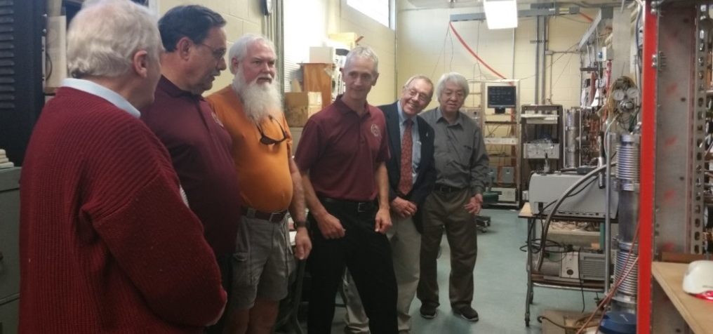
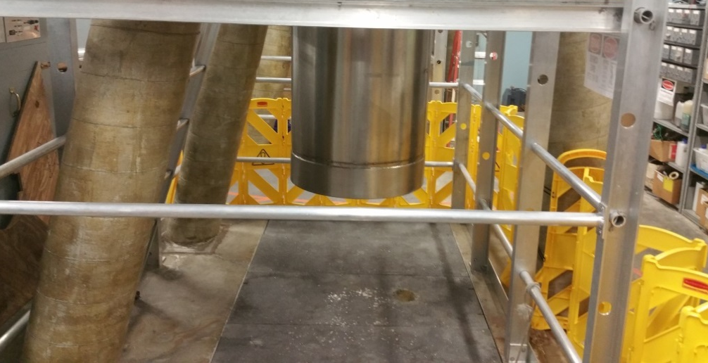
FSU and UF Safety Teams Host Site Visits
Safety Department, National High Magnetic Field Laboratory, Florida State University
Funding Grants: G.S. Boebinger (NSF DMR-1157490)
During November 2017, the Director of Florida State University (FSU) Environmental Health & Safety (EH&S) and the MagLab Safety Director visited the MagLab’s High B/T and AMRIS Facilities located at the University of Florida (UF). They were joined by the UF Director of EH&S. The goal of the visit was to continue and increase coordination and collaboration between FSU and UF Safety Teams.
During the visit they were provided tours by High B/T and AMRIS facility representatives. During the tours, the teams discussed a number of safety topics related to oxygen deficiency, confined spaces, fall hazards, and inspection protocols. Also discussed were opportunities to share safety lessons learned and training best practices between the EH&S teams from the two universities.
In January 2018, two members of the UF Safety Team visited the FSU MagLab Facility in Tallahassee. During the visit, they received a tour of the MagLab’s FSU facilities. In addition to the tour, the UF team received training on the methodology that the MagLab/FSU uses to assess oxygen deficiency hazards. They also reviewed the MagLab’s safety culture and Integrated Safety Management practices and procedures.
All MagLab facilities, including the High B/T and AMRIS facilities at UF and the pulsed field facility at Los Alamos National Laboratory, have representatives on the MagLab’s Safety Committee. Scientists and staff from all MagLab facilities use “safemag”, the MagLab’s safety online reporting system, to bring any safety concern to the attention of the Safety Committee, including via an anonymous report, if desired.
Discussing the operation of the High B/T magnets.
Example of a High B/T magnet pit for which the mitigation of oxygen deficiency and fall hazards were reviewed during the tour.
Acknowledgments: Neil Sullivan (High B/T), James Collins (AMRIS), Laymon Gray (Safety Director MagLab), Tom Jacobson (Director FSU EH&S), Bill Perperzio (Director UF EH&S)

