Slide 1
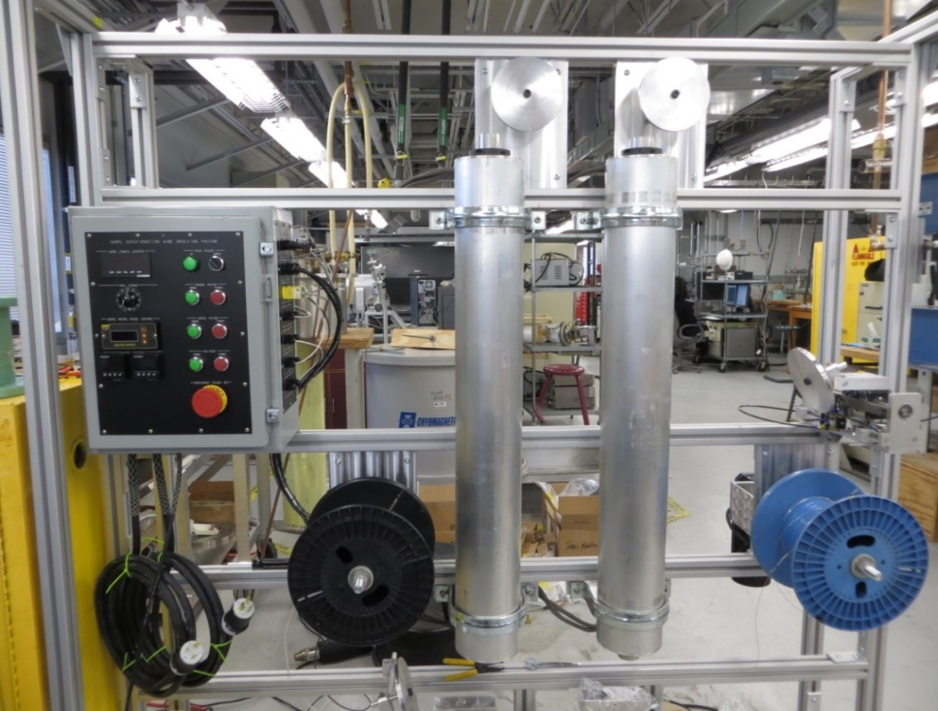
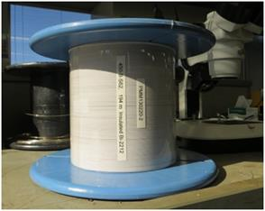
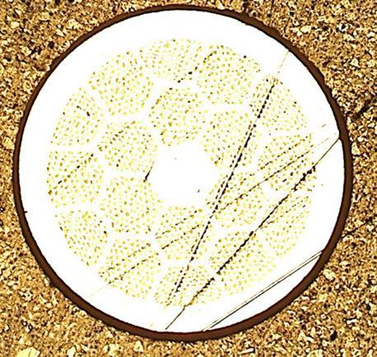
Ceramic Insulation for High-Temperature Superconducting Wire
H.Kandel, J.Lu, J.Jiang, P.Chen, M.Matras, N.Craig, U.P.Trociewitz, E.E. Hellstrom and D.C. Larbalestier
National High Magnetic Field Laboratory
Funding Grants: G.S. Boebinger (NSF DMR-1157490)
Insulation technology is critically important to magnet development. Insulation must be both electrically and mechanically reliable, but it must also be as thin as possible to not waste valuable space better filled with current-carrying conductor. Each new high-temperature superconductor poses many magnet-design challenges, including developing an optimized insulation. The MagLab has developed a TiO₂-based ceramic coating that has proven over several years to be an effective electrical insulation in superconducting magnets made of Bi₂Sr₂CaCu₂O_{8−x} (Bi-2212) superconducting round wire.
The coating has a base layer comprised of TiO₂, polyvinyl butyral (PVB) with a small amount of polysilicate and a top layer made of polyacrylic. The coating is applied on the conductor using a continuous reel-to-reel dip coating process. Arrows in Fig (a) show the path of the wire through the heaters (dashed lines) and twice into the dip vat (not shown, denoted by green arrows at bottom). The insulation shows very good adherence and flexibility suitable for magnet coil winding (Fig b). Small test coils were built with the coated Bi-2212 round-wires (Fig c) and were heat treated at 100 atm pressure. During a 900C heat treatment, the PVB and polyacrylic are evaporated and the polysilicate decomposes to SiO₂ that serves as a sintering aid for TiO₂. After heat treatment, the insulation remains strongly adhered to the conductor, withstands 150V even though it is only 7 microns thick, and, most importantly, does not have a detrimental effect on the superconducting properties of Bi-2212 wire.
This development enables Bi-2212 wire to be used as a conductor in ultra-high field magnets, especially in high field NMR magnets. This technology is the subject of a US patent application.
(a)
(b)
(c)
Figure (a) The Bi-2212 insulation system. (b) Insulated conductor on a spool. (c) Cross-section of the 0.8mm diameter Bi-2212 wire featuring a particularly thick layer of insulation.
Facilities: Magnet Science and Technology and Applied Superconductivity Center
Citation: Kandel, H.; Lu, J.; Jiang, J.; Chen, P.; Matras, M.; Craig, N.; Trociewitz, U.P.; Hellstrom, E.E. and Larbalestier, D.C., Development of TiO₂ electrical insulation coating on Ag-alloy sheathed Bi₂Sr₂CaCu₂O_{8-x} round-wire., Supercond. Sci. Technol. 28 (3) 035010 (2015)
National High Magnetic Field Laboratory
Notes:
1. What is the finding?
Here to be included a short description in layman language of the finding
2. Why this finding is important?
A short description of why the finding is important for scientific community, technology, society, etc…
3. Why NHMFL?
The answer to this question should provide information on why this finding could be achieved (only) at NHMFL (what unique capability of MagLab was essential for this finding).

Slide 2
Ceramic Insulation for High-Temperature Superconducting Wire
H.Kandel, J.Lu, J.Jiang, P.Chen, M.Matras, N.Craig, U.P.Trociewitz, E.E. Hellstrom and D.C. Larbalestier
National High Magnetic Field Laboratory
Funding Grants: G.S. Boebinger (NSF DMR-1157490)
What is the finding? We have developed a titanium-oxide based ceramic coating for high-temperature superconducting round wire made from the superconductor, Bi₂Sr₂CaCu₂O_{8−x} (Bi-2212). This novel coating has proven to be suitable for use as electrical insulation in superconducting magnets. The coating is applied to the wire using a continuous reel-to-reel dip coating process. Arrows in Fig (a) show the path of the wire from the blue spool-off reel, through the heaters (dashed lines) and twice into the dip vat (not shown, denoted by green arrows at bottom), and finally to the black spool-up reel.
Why is this important? Bi-2212 is a superconducting wire that can be used to make a magnet that reaches magnetic fields well beyond any of today’s commercially-available magnets. Round wire is particularly valuable to achieve the highly uniform fields needed by chemists, biologists, and doctors who use magnets for nuclear magnetic resonance (NMR) and magnetic resonance imaging (MRI).
The insulation is particularly challenging in this case, because the insulation has to be flexible during magnet coil winding, yet be able to withstand a 900C heat treatment of Bi-2212, which would cause conventional polymer-based insulations to melt. This technology is the subject of a US patent application.
Why did this research need the MagLab? The MagLab is home to experts in both high-temperature superconductor development and magnet technology development. This insulation development required very close interactions and immediate feedback, only possible when the wire insulation development is carried out as a part of the Bi-2212 magnet technology development team.
(a)
(b)
(c)
Figure (a) The Bi-2212 insulation system. (b) Insulated conductor on a spool. (c) Cross-section of the 0.8mm diameter Bi-2212 wire featuring a particularly thick layer of insulation.
Facilities: Magnet Science and Technology and Applied Superconductivity Center
Citation: Kandel, H.; Lu, J.; Jiang, J.; Chen, P.; Matras, M.; Craig, N.; Trociewitz, U.P.; Hellstrom, E.E. and Larbalestier, D.C., Development of TiO₂ electrical insulation coating on Ag-alloy sheathed Bi₂Sr₂CaCu₂O_{8-x} round-wire., Supercond. Sci. Technol. 28 (3) 035010 (2015)
National High Magnetic Field Laboratory
Notes:
1. What is the finding?
Here to be included a short description in layman language of the finding
2. Why this finding is important?
A short description of why the finding is important for scientific community, technology, society, etc…
3. Why NHMFL?
The answer to this question should provide information on why this finding could be achieved (only) at NHMFL (what unique capability of MagLab was essential for this finding).

