Slide 1
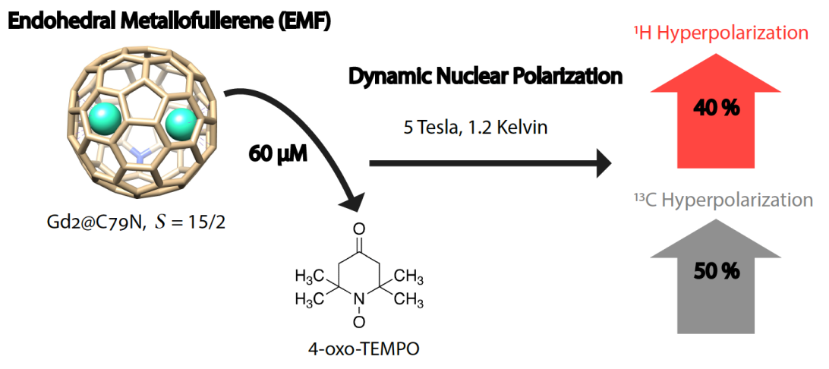
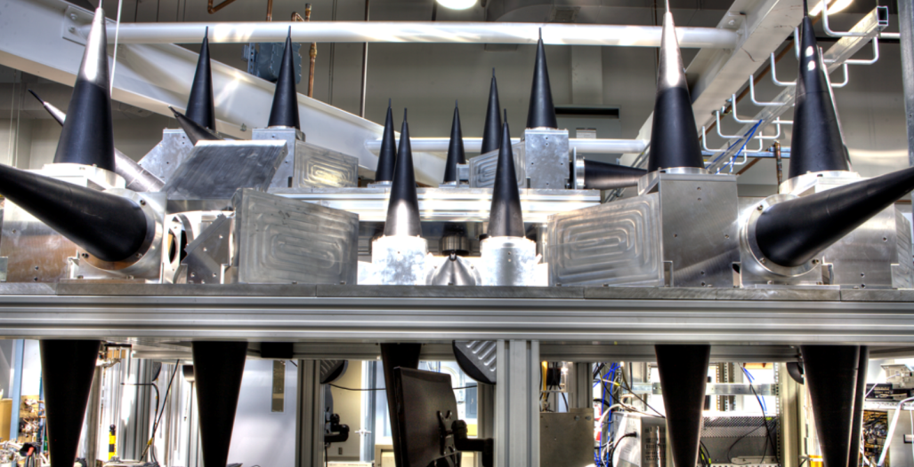
Novel Metallofullerene Boosts Dynamic Nuclear Polarization
X. Wang¹, J. E. McKay¹, B. Lama², J. van Tol¹, T. Li³, K. Kirkpatrick³, Z. Gan¹, S. Hill^{1,4}, J. R. Long², H. C. Dorn³
1. NHMFL, FSU; 2. Biochemistry & Molecular Biology, UF; 3. Chemistry, Virginia Tech.; 4. Physics, FSU
Funding Grants: G.S. Boebinger (NSF DMR-1157490, NSF DMR-1644779)
Dynamic nuclear polarization (DNP) has gained tremendous popularity in recent years as an effective method to greatly boost the sensitivity of NMR and MRI. Upon application of a magnetic field, DNP is achieved by transferring the large electron spin polarization of a paramagnetic dopant to the NMR-active nuclei of interest. This polarization transfer is mediated by the saturation of electron spin resonance (ESR) transitions (e.g. in an organic radical mixed with the sample) via microwave irradiation of the sample. By combining DNP at low temperatures with rapid dissolution, researchers can achieve nuclear spin polarization enhancements that are as much as 10,000-fold over thermal equilibrium for solutions at room temperature. These DNP enhancements enable novel MRI applications, such as monitoring in vivo metabolism in real time.
In this study, researchers added a low concentration of the endohedral metallofullerene (EMF) Gd₂@C₇₉N to DNP samples, finding that ¹H and ¹³C enhancements increased by 40% and 50%, respectively, at 5 T and 1.2 K. Complementary multi-dimensional pulsed high-field ESR studies of the same sample provide important insights into the enhancement mechanism. While Gd reagents have previously been shown to enhance DNP at low fields, albeit at significantly higher Gd concentrations, this is the first time such increases have been observed at 5 T. Importantly, the encapsulation of Gd in the EMF, along with the need for significantly lower concentrations, contribute to a significant reduction in toxicity of MRI for medical applications.
¹H hyperpolarization
¹³C hyperpolarization
(Top) A mixture of Gd₂@C₇₉N with the organic radical 4-oxo-TEMPO is shown to boost DNP efficiency, resulting in both ¹H and ¹³C hyperpolarization. (Bottom) State-of-the-art spectrometer (HiPER) employed in this study, which combines expertise from the MagLab’s EMR and NMR programs.
Facilities used: W-band HiPER ESR Instrument at EMR, MagLab/FSU and the 5 T Dissolution DNP Polarizer at AMRIS, MagLab/UF.
Citation: X. Wang, J. E. McKay, B. Lama, J. van Tol, K. Kirkpatrick, Z. Gan, S. Hill, J. R. Long, H. C. Dorn, Gd based endohedral metallofullerene Gd₂@C₇₉N as a relaxation boosting agent for dissolution DNP at high fields, Chem. Comm. 54, 2425-2428 (2018).

Slide 2
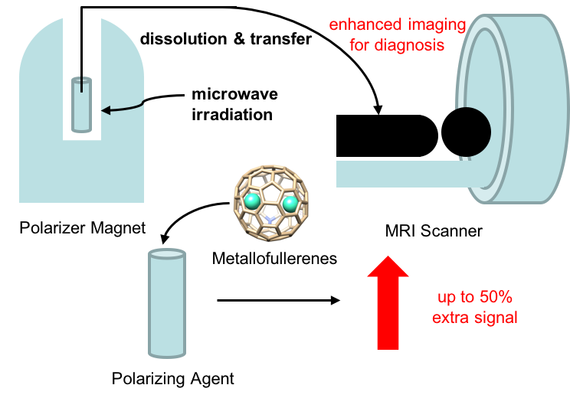
Novel Metallofullerene Boosts Dynamic Nuclear Polarization
X. Wang¹, J. E. McKay¹, B. Lama², J. van Tol¹, T. Li³, K. Kirkpatrick³, Z. Gan¹, S. Hill^{1,4}, J. R. Long², H. C. Dorn³
1. NHMFL, FSU; 2. Biochemistry & Molecular Biology, UF; 3. Chemistry, Virginia Tech.; 4. Physics, FSU
Funding Grants: G.S. Boebinger (NSF DMR-1157490, NSF DMR-1644779)
What is the finding? A low-dosage boosting agent − consisting of two gadolinium atoms trapped in a cage made from a C₇₉N fullerene − enhances dynamic nuclear polarization (DNP) in both hydrogen (¹H) and carbon (¹³C).
Why is this important? This is the first study to demonstrate significant enhancements in dissolution DNP efficiency at high magnetic fields. This translates into increased sensitivity for MRI studies, enabling completely new applications, such as the monitoring of in vivo metabolism in real time. Crucially, the encapsulation of the gadolinium atoms in the fullerene cage, along with the low dosage of the boosting agent, together represent an important breakthrough for medical MRI, due to the reduced toxicity of this new DNP boosting agent.
Why did this research need the MagLab? The main aim of this investigation was to demonstrate the efficacy of a DNP boosting agent at higher magnetic fields than previously demonstrated. The MagLab is the only user facility that provides access to the necessary high-field dissolution DNP magnet system and pulsed electron spin resonance (ESR) instrumentation employed in this investigation. This user collaboration project leverages the unique combination of expertise available through the NMR and EMR user programs at the MagLab’s UF and FSU campuses.
Dissolution Dynamic Nuclear Polarization
Schematic illustrating the dissolution DNP process: The DNP sample containing the Gd₂@C₇₉N metallofullerene boosting agent is polarized via microwave irradiation at 140 GHz in a standalone 5T polarizer magnet. This polarization step is followed by rapid dissolution and transfer of the sample to the patient located within the MRI scanner. This enhances the sensitivity of the MRI signal and enables exciting new MRI capabilities, such as monitoring metabolism in real time.
Facilities used: W-band HiPER ESR Instrument at EMR, MagLab/FSU and the 5 T Dissolution DNP Polarizer at AMRIS, MagLab/UF.
Citation: X. Wang, J. E. McKay, B. Lama, J. van Tol, K. Kirkpatrick, Z. Gan, S. Hill, J. R. Long, H. C. Dorn, Gd based endohedral metallofullerene Gd₂@C₇₉N as a relaxation boosting agent for dissolution DNP at high fields, Chem. Comm. 54, 2425-2428 (2018).
Notes:
1. What is the finding?
Here to be included a short description in layman language of the finding
2. Why this finding is important?
A short description of why the finding is important for scientific community, technology, society, etc…
3. Why NHMFL?
The answer to this question should provide information on why this finding could be achieved (only) at NHMFL (what unique capability of MagLab was essential for this finding).

