Slide 1
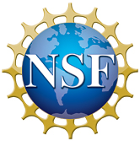
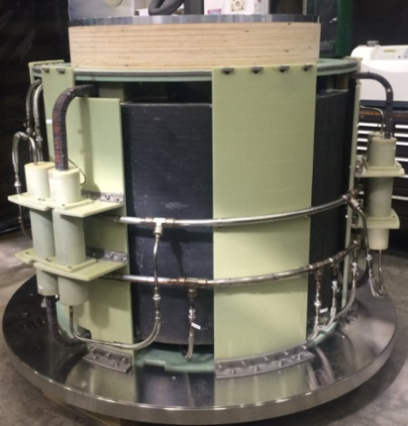
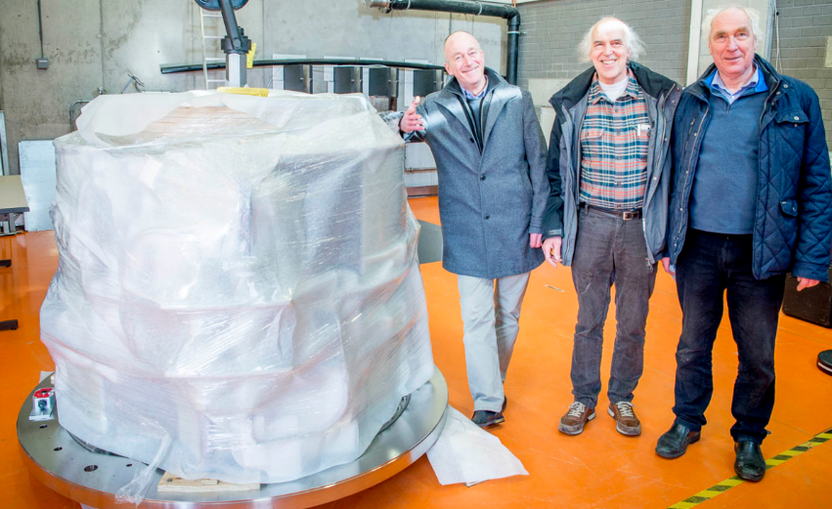
Completion of a Superconducting Nb₃Sn Coil
for the 45 T Hybrid at the High Magnetic Field Lab in Nijmegen
I.R. Dixon¹, M.D. Bird¹, J.A.A.J. Perenboom², A. den Ouden²
National High Magnetic Field Laboratory; 2. Radboud University, Nijmegen, The Netherlands
Funding Grants: G.S. Boebinger (NSF DMR-1157490, NSF DMR-1644779); Dutch FOM and NWO
In March 2018, the MagLab delivered a 7-ton superconducting coil to Radboud University Nijmegen (RUN) which is designed to form the core of a new 45 T hybrid magnet at the Nijmegen High Magnetic Field Laboratory. This is the third Nb₃Sn Cable-In-Conduit (CIC) coil of this complexity and size to be delivered by the MagLab within the past five years.
This coil is the product of a twelve-year collaboration among the MagLab, RUN, the Helmholtz Zentrum Berlin (HZB), Johns Hopkins University, and the Oak Ridge Spallation Neutron Source (SNS). In 2006, the MagLab received funding from the NSF to develop a 36 T, 1 ppm hybrid magnet for ourselves, as well as to design a similar magnet for the SNS. Shortly thereafter, the MagLab received funding from the HZB to develop a similar magnet for their neutron scattering user program. Completing those projects required the MagLab to explain the extreme degradation of Nb₃Sn CIC conductors tested in Europe, as well as to master the science and technology of designing and building these world-record CIC systems. An extensive computational and experimental program resulted in a novel understanding of the thermal strain induced in these multi-scale composites and enabled these systems to be completed. Thirty-six peer-reviewed publications summarize the MagLab’s CIC coil and hybrid magnet expertise. In 2012, RUN appreciated the MagLab’s unique capabilities in this field of applied superconductivity and contracted with the MagLab for development of this latest system.
Completed Nb₃Sn Superconducting Coil shown at the MagLab (left)…
…and upon delivery to the Nijmegen High Magnetic Field Laboratory (below)
The coil winding, reaction, heat-treatment, epoxy-impregnation, and cold-mass assembly occurred in the MagLab’s Large Coil Fabrication Shop. The MagLab’s contribution to the RUN 45T hybrid magnet project also includes conductor design and structural, thermo-hydraulic, and quench analyses.
Facilities used: Magnet Science & Technology’s Large Coil Fabrication Shop
Citation: A. den Ouden, C.A. Wulffers, N.E. Hussey, G. Laureijs, F.J.P. Wijnen, G.F.A.J. Wulterkens, M.D. Bird, I.R. Dixon, J.A.A.J. Perenboom, “Progress in the Development of the HFML 45 T Hybrid Magnet,” IEEE Transactions on Applied Superconductivity, v. 26, n. 4, June 2016.
Notes:
1. What is the finding?
Here to be included a short description in layman language of the finding
2. Why this finding is important?
A short description of why the finding is important for scientific community, technology, society, etc…
3. Why NHMFL?
The answer to this question should provide information on why this finding could be achieved (only) at NHMFL (what unique capability of MagLab was essential for this finding).

Slide 2
Completion of a Superconducting Nb₃Sn Coil
for the 45 T Hybrid at the High Magnetic Field Lab in Nijmegen
I.R. Dixon¹, M.D. Bird¹, J.A.A.J. Perenboom², A. den Ouden²
National High Magnetic Field Laboratory; 2. Radboud University, Nijmegen, The Netherlands
Funding Grants: G.S. Boebinger (NSF DMR-1157490, NSF DMR-1644779); Dutch FOM and NWO
What is the finding? The MagLab has completed a new seven-ton superconducting coil for a laboratory in The Netherlands. It will be part of an eventual 45 T magnet that uses both resistive and superconducting magnet technology.
Why is this important? Completion of this third major cable-in-conduit coil establishes the MagLab as a leader in this important superconducting magnet technology. The completion of the 45 T magnet at the Nijmegen High Magnetic Field Laboratory will make a major contribution to Europe’s scientific infrastructure for high magnetic field research, enabling important experiments for decades to come.
Why did this research need the MagLab? From 2006 to 2012, the MagLab developed computational methods, tested conductors, and developed equipment and procedures needed to design and build magnets based on Nb₃Sn Cable-In-Conduit Conductor. Dozens of papers were published in peer-reviewed journals describing issues as complex as the thermal strain generated in multi-scale composites that result from cooling the material nearly 1300 degrees from fabrication at 840˚F to deployment at -450˚F. When the Nijmegen laboratory was ready to start construction of their 45T hybrid magnet, they spent months examining the capabilities of magnet development groups, searching both commercial and governmental sectors worldwide before choosing the MagLab as having the best technology and highest probability of success.
The completed Nb₃Sn Superconducting Coil shown at the MagLab (left)
…
and upon delivery to the Nijmegen High Magnetic Field Laboratory (below)
Facilities used: Magnet Science & Technology’s Large Coil Fabrication Shop
Citation: A. den Ouden, C.A. Wulffers, N.E. Hussey, G. Laureijs, F.J.P. Wijnen, G.F.A.J. Wulterkens, M.D. Bird, I.R. Dixon, J.A.A.J. Perenboom, “Progress in the Development of the HFML 45 T Hybrid Magnet,” IEEE Transactions on Applied Superconductivity, v. 26, n. 4, June 2016.
Notes:
1. What is the finding?
Here to be included a short description in layman language of the finding
2. Why this finding is important?
A short description of why the finding is important for scientific community, technology, society, etc…
3. Why NHMFL?
The answer to this question should provide information on why this finding could be achieved (only) at NHMFL (what unique capability of MagLab was essential for this finding).

