Slide 1
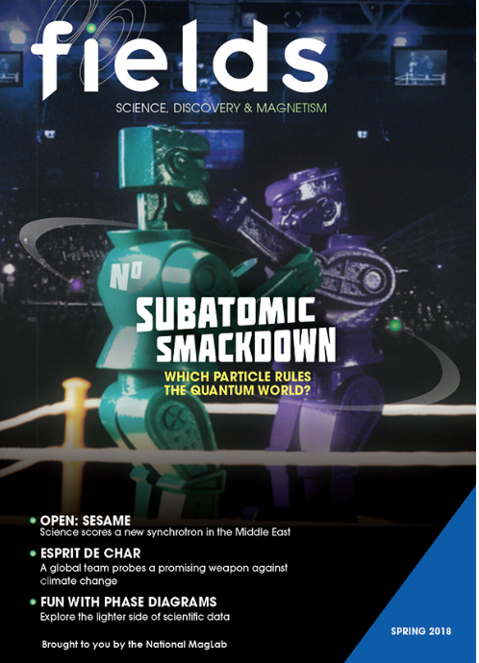
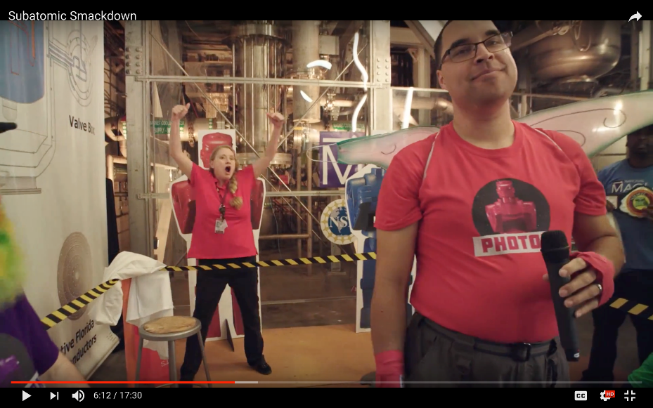
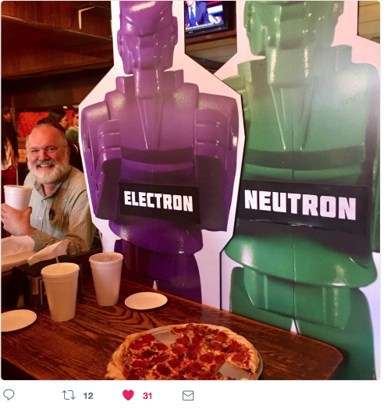
Subatomic Smackdown:
Physics Outreach Reaches a Wide and Diverse Audience
Kristen Coyne¹, Kristin Roberts¹, Caroline McNiel¹, Kathryn Jepsen² 1. National MagLab; 2. SLAC/Fermilab
Funding Grants: G.S. Boebinger (NSF DMR-1157490, NSF DMR-1644779)
The staff of fields, a magazine about high magnetic field research produced at the National MagLab, partnered with Symmetry magazine, a joint publication of Fermilab and SLAC on particle physics, to create content showcasing the properties of subatomic particles and their uses by scientists and society in both research and modern technologies. In February 2018, both magazines concurrently published the “Subatomic Smackdown”, in which each of four subatomic particles argue that they are the most awesome.
Online and in print, more than 10,000 people were reached by the “Subatomic Smackdown” article. A Smackdown performance during the MagLab’s Open House has garnered more than 1,100 YouTube views and a press conference was held at the APS March Meeting. After much particle posturing, a weeklong Twitter war was waged (#SubatomicSmackdown), generating more than 600 Tweets. In the end, a majority of 528 voters named Photon the champ. The Smackdown resulted in more than 9 million impressions on Twitter and attracted followers from around the globe, from women and men in equal numbers, and from numerous national labs, universities and funding agencies.
The Smackdown’s broad reach is a testament to the power of a catchy idea to inspire high levels of engagement that spans countries, genders, institutions, and education levels.
Figures: Clockwise from top left: The cover of issue 3 of fields
Magazine; YouTube screenshot of Smackdown performance at MagLab’s Open House; Two tweets in support of the contenders.

