Slide 1


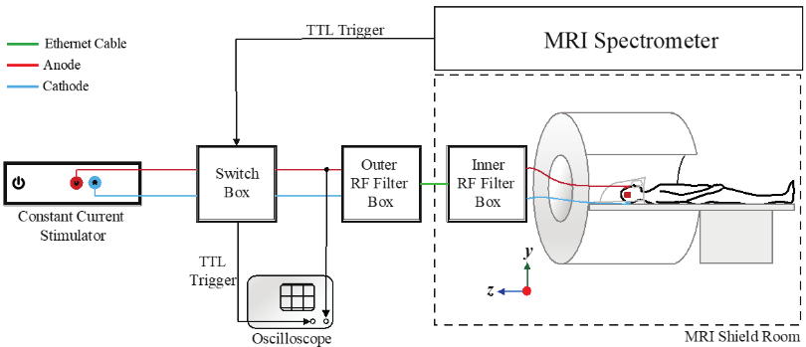
Imaging current flow in the brain during transcranial electrical stimulation
A. K. Kasinadhuni¹, A. Indahlastari², M. Chauhan², M. Schar³, T. H. Mareci¹, R. J. Sadleir²
University of Florida; 2. Arizona State University; 3. Johns Hopkins University;
Funding Grants: G.S. Boebinger (NSF DMR-1157490); R. J. Sadleir (NIH R21 NS081646)
Transcranial electrical stimulation has been observed to improve cognitive, motor, and memory performance in healthy persons. Evidence suggests that it may also offer new treatments for stroke rehabilitation and epilepsy. However, the direct electrical current density distributions induced by transcranial electrical stimulation have not previously been measured in the brains of human subjects. As such, it has not been possible to directly correlate electrical current flow with how nerve activity changes with treatment.
This MagLab user collaboration used magnetic resonance electrical impedance tomography (MREIT) to measure magnetic flux density distributions caused by stimulated currents (see schematic). They then calculated current density distributions in the brain from these data. Using this approach, they were able to present the first in vivo images of electric current density distributions within the brain of subjects undergoing transcranial electrical stimulation.
In general, the new data from MREIT on living brains agreed with computational model predictions. MREIT can further be applied to improve reproducibility, to assess safety, and ultimately to aid our understanding of the mechanisms of electrical and magnetic neuro-modulation resulting from transcranial electrical stimulation.
Images show (left to right for two different stimulations) the standard MR image, measured electrical current distribution overlaid on MR image, measured electrical current density alone, and simulated current distribution. Note the similarity between the third and fourth images (red boxes). [From Brain Stimulation 10 (2017) 764-772]
Facility: 3 T MRI system in the AMRIS Facility at UF
Citation: A. K. Kasinadhuni, A. Indahlastari, M. Chauhan, M. Schar, T. H. Mareci, R. J. Sadleir.
Imaging of current flow in the human head during transcranial electrical therapy. Brain Stimulation 10 (2017) 764-772
Notes:
Images (including figures) are available for download into Microsoft PowerPoint. Please see the Terms and Conditions below.
You may display, download, or print out images associated with this Site for personal, non-commercial and educational use provided that all copyright and other proprietary notices are kept intact. Educational use refers to classroom teaching, lectures, presentations, rounds, and other instructional activities. You will only display, distribute, or otherwise make such images from the applicable Site(s) available to students or other persons attending in-person presentations, lectures, rounds or other similar instructional activities presented or given by You. To use images in a poster presentation, publication or for any other similar use, permission must be requested through the Elsevier Rights Department.
You may not otherwise copy, print, transmit, rent, license, lend, sell or modify any images from this Site or modify or remove any proprietary notices contained therein, or create derivative works based on materials therefrom. You also may not disseminate any portion of the applicable Site(s) subscribed to hereunder through electronic means except as outlined above, including mail lists, electronic bulletin boards or other online communities.

Slide 2
Imaging current flow in the brain during transcranial electrical stimulation
A. K. Kasinadhuni¹, A. Indahlastari², M. Chauhan², M. Schar³, T. H. Mareci¹, R. J. Sadleir²
University of Florida; 2. Arizona State University; 3. Johns Hopkins University;
Funding Grants: G.S. Boebinger (NSF DMR-1157490); R. J. Sadleir (NIH R21 NS081646)
What is the finding? A MagLab user collaboration among three institutions employed a novel application of magnetic resonance imaging (MRI) to measure the first images of the electrical current distribution within the living brain while the brain is experiencing transcranial electrical stimulation.
Why this finding is important? Transcranial electrical stimulation has been shown to improve cognitive, motor, and memory performance in healthy persons. There is evidence that it may also provide new treatments for stroke rehabilitation and epilepsy. However, transcranial electrical stimulation is not well understood, in part because - before this study – no one could image the electrical current distribution in brains experiencing transcranial electrical stimulation. We believe our new MRI method will be useful for improving the reproducibility and safety of transcranial electrical stimulation, as well as for advancing our ultimate understanding of the mechanisms that cause transcranial electrical stimulation to work.
Why the MagLab? MRI research capabilities in the MagLab’s AMRIS Facility developed this imaging method, which required the construction of control hardware interfaced to a 3T MRI system, as well as the development of data acquisition and data processing methodologies.
These images show (i) standard MR image, (ii) measured electrical current distribution overlaid on the MR image, (iii) measured electrical current density alone, and (iv) simulated current distribution. Note the similarity between the third and fourth images (in the red box). [From Brain Stimulation 10 (2017) 764-772]
Facility: 3 T MRI system in the AMRIS Facility at UF
Citation: A. K. Kasinadhuni, A. Indahlastari, M. Chauhan, M. Schar, T. H. Mareci, R. J. Sadleir.
Imaging of current flow in the human head during transcranial electrical therapy. Brain Stimulation 10 (2017) 764-772
Notes:
1. What is the finding?
Here to be included a short description in layman language of the finding
2. Why this finding is important?
A short description of why the finding is important for scientific community, technology, society, etc…
3. Why NHMFL?
The answer to this question should provide information on why this finding could be achieved (only) at NHMFL (what unique capability of MagLab was essential for this finding).

