Slide 1
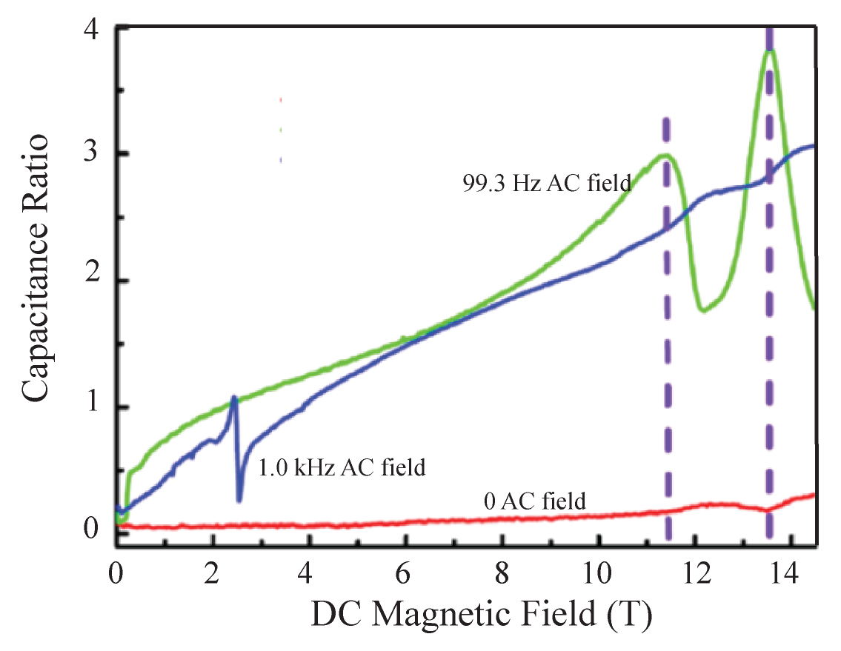
Magneto-Electric Effects in Metal-Organic Quantum Magnet
L. Yin ¹, V. S. Zapf ², A. Paduan-Filho ³, J. S. Xia⁴, N. Sullivan⁴
1. University of California, San Diego; 2. Los Alamos National Laboratory,
3. University of Sao Paulo, Brazil, 4. NHMFL, University of Florida
Funding Grants: G.S. Boebinger (NSF DMR-1644779), N.S. Sullivan (NSF DMR-1303599)
New magneto-electric effects have been observed in molecular-based materials in which the coupling of the magnetization and electrical polarization is very different to that in inorganic oxides. Crystals of the dichloro-tetrakis-thiourea type were recently studied, with a chemical formula of MCl₂-4SC(NH₂)₂ where M = Ni or Co. The magnetization of these metal-organic quantum magnets arises from the M ions and the electrical polarization results from the polarizable thiourea molecules surrounding each metal ion.
Magnetic fields drive Bose-Einstein phase transitions of the spin degrees of freedom, evidenced by changes in the electric and magnetic susceptibilities at ultra-low temperatures. If disorder is introduced, new Bose glass states are formed [1].
The green curve the figure shows the strong magnetic-field-induced changes in the dielectric constant observed at 99 Hz for a single crystal of a Br doped dichloro-tetrakis-thiourea-nickel (DTN) crystal: NiCl_{1.85}Br_{0.15} - 4SC(NH₂)₂. The quadratic magnetic field dependence of the electric polarization in the magnetically ordered state, from 0.9T < B < 11.3T, is consistent with the observations of Ref. [2]. A sharp drop occurs at the transition to the Bose Glass state from 11.3 < B < 12.4 T. The second peak at B ~ 13.6T is attributed to a transition to the Mott insulator state [1].
There is great interest in systems with large magneto-electric effects, due to potential applications as high sensitivity sensors. Understanding the magneto-electric effect in a well-studied material, such as DTN, is important for establishing the fundamental physics of the far more complex systems at higher temperatures.
Magnetic field induced changes in the dielectric constant of Br-doped DTN at very low temperatures as a function of applied DC magnetic field at 20 mK [3]. Three changes are observed; (i) a sharp dispersive response at the low critical field (B~2.2T), (ii) a peak at the upper critical field (B~11.4T), and (iii) a peak at B~13.6 T, corresponding to the onset of a Mott insulator state.
Facility used: Bay 3 of the MagLab’s High B/T Facility.
References
[1] Yu R., et al., Bose glass and Mott glass of quasiparticles in a doped quantum magnet, Nature 489,379 (2012).
[2] Zapf V.S., et al., Magnetoelectric effects in an organometallic quantum magnet, Phys. Rev. B83, 140405R (2011).
[3] Xia, J.S., et al., Magneto-electric Effect and Dielectric Susceptibility Measurement Technique at Very Low Temperature, J. Low Temp. Phys. 187,627 (2017).

Slide 2
Magneto-Electric Effects in Metal-Organic Quantum Magnet
L. Yin ¹, V. S. Zapf ², A. Paduan-Filho ³, J. S. Xia⁴, N. Sullivan⁴
1. University of California, San Diego; 2. Los Alamos National Laboratory,
3. University of Sao Paulo, Brazil, 4. NHMFL, University of Florida
Funding Grants: G.S. Boebinger (NSF DMR-1644779), N.S. Sullivan (NSF DMR-1303599)
What is the finding? A distinct change in a materials internal electric, driven by an applied magnetic field, has been observed in a metal-organic quantum magnet known as DTN.
Why is this important? There is great interest in exploring systems that exhibit these large magneto-electric effects due to potential future applications as high sensitivity sensors. Understanding the magneto-electric effect in metal-organic quantum magnets is important for establishing the fundamental physics of the far more complex systems at higher temperatures.
Why did this research need the MagLab? The magnetic-field-driven transitions to the Bose-Einstein condensed phase and the Bose glass state can only be studied in detail at millikelvin temperatures with the sample located at the center of a large superconducting magnet. The MagLab specializes in these sorts of measurements.
Magnetic field induced changes in the dielectric constant of Br-doped DTN at very low temperatures as a function of applied DC magnetic field at 20 mK [3]. Sharp features at B~2.2T, ~11.4T, and ~13.6T signal transitions to a Bose-Einstein condensed phase, a Bose glass state, and a Mott insulator state, respectively.
Facility used: Bay 3 of the MagLab’s High B/T Facility.
Low temperature cell used for magneto-electric studies with sample immersed in liquid ³He for thermal contact.
Reference
Xia, J.S., et al., Magneto-electric Effect and Dielectric Susceptibility Measurement Technique at Very Low Temperature
J. Low Temp. Phys. 187,627 (2017).
Notes:
1. What is the finding?
Here to be included a short description in layman language of the finding
2. Why this finding is important?
A short description of why the finding is important for scientific community, technology, society, etc…
3. Why NHMFL?
The answer to this question should provide information on why this finding could be achieved (only) at NHMFL (what unique capability of MagLab was essential for this finding).

