Slide 1
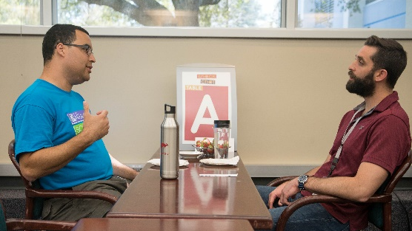
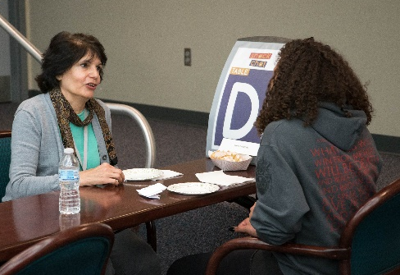
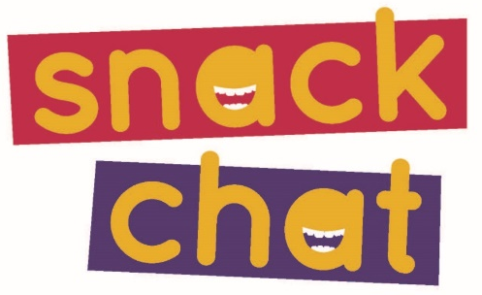
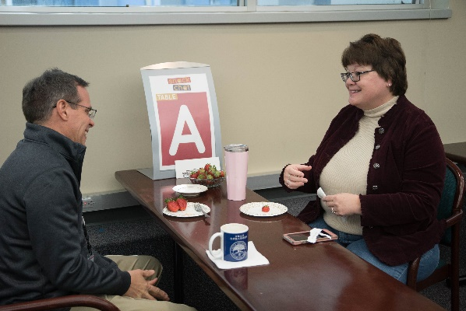
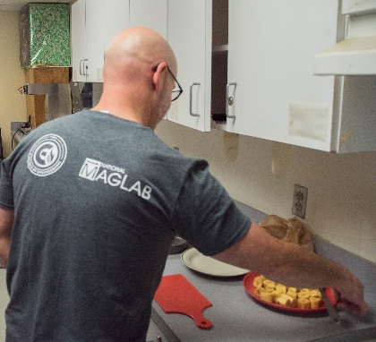
SnackChat: Improving Climate at the MagLab
1. National High Magnetic Field Laboratory;
Funding Grants: G.S. Boebinger (NSF DMR-1644779)
For the last year, MagLab employees Jose Sanchez and Kristen Coyne have been organizing monthly “speed networking” events. For each SnackChat, eight MagLab employees pair up for four 5-minute sessions to learn more about each other. The goal of the program is to improve the climate of the lab by helping people get to know each other across disciplines, facilities, and job types. Because food is a natural draw, we provided snacks, hence the program’s name, SnackChat.
The program is designed to promote inclusion and diversity at a grassroots level. Loosely modeled on speed dating to contribute to the spirit of fun, each participant chats one-on-one with another participant before moving on to meet other participants.
The response of participants has been overwhelmingly positive. A post-event, anonymous online survey finds that 97% of respondents would recommend SnackChat to a colleague, and 97% were interested in attending a future SnackChat to meet a different group of people.
In any community – at home or at work – people feel more connected when they know each other – even just a little bit. The simple act of introducing people to one another in SnackChat, we believe, contributes to a more welcoming environment at the MagLab and creates more positive perceptions of the MagLab as a workplace.
Facilities: MagLab’s Public Affairs Group and
Center for Integrating Research and Learning

