Slide 1
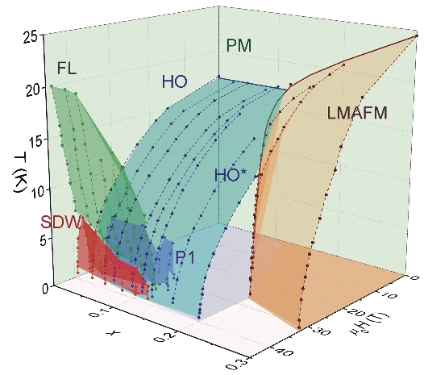
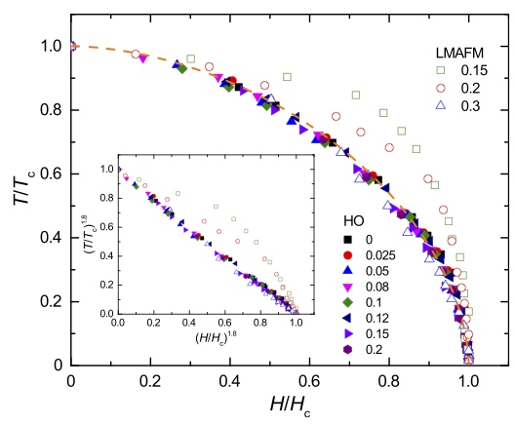
Phase diagram of URu_{2–x}Fe_{x}Si₂ in high magnetic fields
Sheng Ran^{a,b}, Inho Jeon^{b,c}, Naveen Pouse^{a,b}, Alexander J. Breindel^{a,b}, Noravee Kanchanavatee^{a,b}, Kevin Huang^{b,c},
Andrew Gallagher^{d}, Kuan-Wen Chen^{d}, David Graf^{d}, Ryan E. Baumbach^{d}, John Singleton^{d}, and M. Brian Maple^{a,b,c}. ªPhysics, UCSD; ^{b}Center for Advanced Nanoscience, UCSD; ^{c}Materials Science and Engineering, UCSD; ^{d}NHMFL
Funding Grants: A. Gallagher, K.-W. Chen, D. Graf, R.E. Baumbach, J. Singleton (NSF DMR-1157490); N.P. Wilson, X.Xu S. Ran, I. Jeon, N. Pouse, A.J. Breindel, N. Kanchanavatee, K. Huang, M.B. Maple (DOE DE-FG02-04ER46105 and DE-NA0002909, NSF DMR-1206553)
The renowned and mysterious hidden-order (HO) phase in URu₂Si₂ is intimately related to the large-moment antiferromagnetic (LMAFM) phase that is induced under pressure or upon iron (Fe) substitution. MagLab users performed electrical resistivity measurements on single crystals of URu_{2−x}Fe_{x}Si₂ in magnetic fields of up to 45T (Hybrid Magnet) and 65T (Pulsed Magnets). Various phases including HO, LMAFM, HO* (reentrant HO phase), SDW (spin density wave), FL (ordinary Fermi-Liquid metallic phase, recovered at high field), and PM (paramagnetic phase at high temperature) were mapped, along with P1 (a possible new intermediate-field phase), to establish a three-dimensional (3D) field – composition - temperature (H, x, T) phase diagram for this complex material.
The 3D phase diagram establishes a “universal” relationship between the normalized transition temperature T/T₀ and the normalized critical magnetic field H/H₀ for the HO phase: the H/H₀ versus T/T₀ data in the lower figure collapses onto a single curve. This curve provides tight constraints on potential models for the order parameter of the HO phase.
Within a certain range of x values, x~0.17, the HO phase reenters when magnetic fields suppress the LMAFM phase. This is similar to the behavior observed for pure URu₂Si₂ crystals within a certain range of pressures.
Upper: Three-dimensional phase diagram for URu_{2−x} Fe_{x}Si₂ single crystals, with temperature T, magnetic field (parallel to c) H, and Fe concentration x as the three axes. The labels for the phases are defined in the text.
Lower: Normalized critical-field H/H₀ as a function of normalized critical temperature T/T₀ for URu_{2−x}Fe_{x}Si₂ single crystals, with x=0, 0.025, 0.05, 0.08, 0.1, 0.12, 0.15, 0.2, and 0.3. The solid and open symbols represent data for the Hidden Order(HO) and Large Moment Antiferromagnetic (LMAFM) phases, respectively. The dashed line represents the best fit of the equation (T/T₀)^{n} + (H/H₀)^{n} = 1 to the data, which yields n = 1.8.
The inset shows (T /T ₀)^{1.8} as a function of (H/H₀ )^{1.8} for the crystals.
Facilities and instrumentation used: 65 Tesla capacitor-driven
magnet at the MagLab’s Pulsed Field Facility, Los Alamos; 45 T Hybrid Magnet at the MagLab’ DC Magnet Facility, Florida State University;
Citation: S. Ran, I. Jeon, N. Pouse, A.J. Breindel, N. Kanchanavatee, K. Huang, A. Gallagher, K.-W. Chen, D. Graf, R.E. Baumbach, J. Singleton, and M.B. Maple, “Phase diagram of URu_{2–x}Fe_{x}Si₂ in high magnetic fields”, Proceedings of the National Academy of Sciences 114, 37, 9826 (2017). https://doi.org/10.1073/pnas.1710192114

Slide 2
Phase diagram of URu_{2–x}Fe_{x}Si₂ in high magnetic fields
Sheng Ran^{a,b}, Inho Jeon^{b,c}, Naveen Pouse^{a,b}, Alexander J. Breindel^{a,b}, Noravee Kanchanavatee^{a,b}, Kevin Huang^{b,c},
Andrew Gallagher^{d}, Kuan-Wen Chen^{d}, David Graf^{d}, Ryan E. Baumbach^{d}, John Singleton^{d}, and M. Brian Maple^{a,b,c}. ªPhysics, UCSD; ^{b}Center for Advanced Nanoscience, UCSD; ^{c}Materials Science and Engineering, UCSD; ^{d}NHMFL
Funding Grants: A. Gallagher, K.-W. Chen, D. Graf, R.E. Baumbach, J. Singleton (NSF DMR-1157490); N.P. Wilson, X.Xu S. Ran, I. Jeon, N. Pouse, A.J. Breindel, N. Kanchanavatee, K. Huang, M.B. Maple (DOE DE-FG02-04ER46105 and DE-NA0002909, NSF DMR-1206553)
What is the finding? MagLab users measured the resistance of single crystals of URu_{2-x}Fe_{x}Si₂ for various iron (Fe) concentrations, x, in very high magnetic fields. Changes in the electrical resistance allowed the boundaries between different phases of this material system to be mapped.
Why is this important? In philosophy, systems theory, science, and art, emergence occurs when the whole is greater than the sum of the parts, meaning the whole has properties that its parts do not posses. These properties come about because of interactions among the parts. Emergence plays an increasing role in theories of complex materials. The mysterious hidden order phase of URu₂Si₂ is a prime example of emergence, and this experiment allowed us to map out a three-dimensional (3D) field-temperature-composition phase diagram for the first time in this compound. This work established a single relation between the transition temperature and the critical magnetic field for the Hidden Order (HO) phase, which imposes constraints on any theories of the HO phase and its emergent behavior.
Why did this research need the MagLab? Very high magnetic fields and cryogenic temperatures are required to access the exotic phases that exhibit emergent behavior. Special instrumentation, unique to the MagLab, was used to make sufficiently precise resistance measurements.
Figure: Three-dimensional phase diagram for single crystals of the Iron-Doped “Hidden Order” compound, URu_{2−x} Fe_{x}Si₂, with temperature T, magnetic field (parallel to c) H, and Fe concentration x as the three axes. The labels for the phases are the Hidden-Order (HO) phase, which is intimately related to the large-moment antiferromagnetic (LMAFM) phase induced under pressure or upon iron (Fe) substitution. Other phases are the HO* (reentrant HO phase), SDW (spin density wave), FL (ordinary Fermi-Liquid metallic phase, recovered at high field), and PM (ordinary paramagnetic phase at high temperature). P1 denotes a possible new phase at intermediate magnetic fields.
Facilities and instrumentation used: 65 Tesla capacitor-driven
magnet at the MagLab’s Pulsed Field Facility, Los Alamos; 45 T Hybrid Magnet at the MagLab’ DC Magnet Facility, Florida State University;
Citation: S. Ran, I. Jeon, N. Pouse, A.J. Breindel, N. Kanchanavatee, K. Huang, A. Gallagher, K.-W. Chen, D. Graf, R.E. Baumbach, J. Singleton, and M.B. Maple, “Phase diagram of URu_{2–x}Fe_{x}Si₂ in high magnetic fields”, Proceedings of the National Academy of Sciences 114, 37, 9826 (2017). https://doi.org/10.1073/pnas.1710192114

