Slide 1
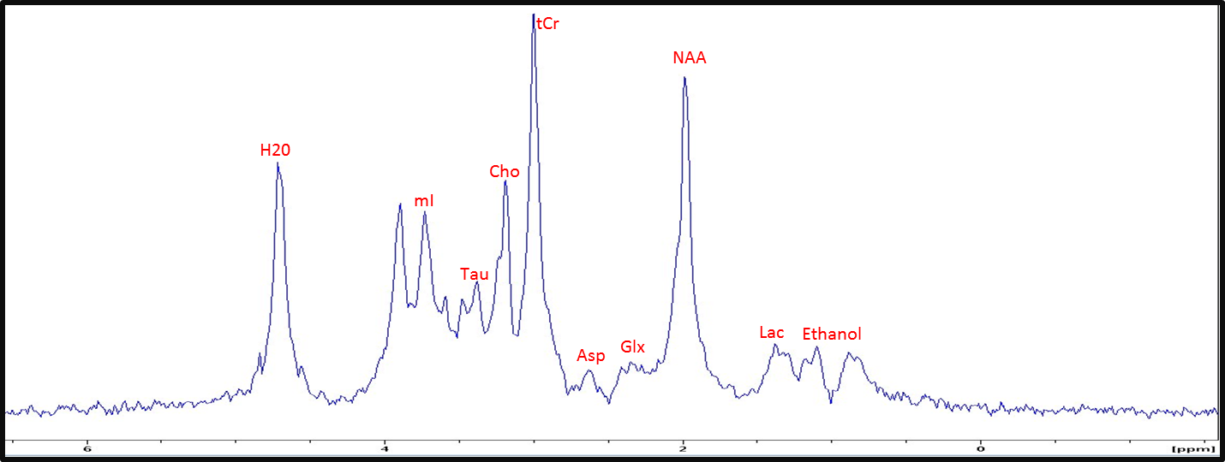
Metabolic Assessment of Migraines using Ultra-High Magnetic Fields
N. Abad^{1,2}, J.T. Rosenberg², T. Roussel³, D.C. Grice¹, M.G. Harrington⁴, S.C. Grant^{1,2}
Florida State University; 2. National High Magnetic Field Laboratory;
3. Weizmann Institute Science; 4. Huntington Medical Research Institute
Funding Grants: G.S. Boebinger (NSF DMR-1157490); S.C. Grant (NSF-NHMFL UCGP); M.G. Harrington (NIH R01-NS072497)
This study uses high-field NMR to evaluate biochemical imbalances in the brain that develop during the onset and progression of a migraine. Small molecules involved in energetic neuroprotective and neurotransmitter action in the rat brain were evaluated with a frequency-selective magnetic resonance technique called relaxation-enhanced (RE) ¹H spectroscopy in the MagLab’s unique 21.1T NMR/MRI magnet. Specific chemical signals were monitored in a (4mm)³ volume in the brain via repeated acquisitions every 10 minutes over 3 hours before, during, and after the injection of nitroglycerine (NTG) to induce a migraine analog in the rat. This approach enabled the most complete detection and monitoring of temporal biochemical changes related to migraine.
By following, for example, increasing lactate and elevated taurine levels in the brain, energetic and protective chemical actions were found to occur in the brain even before the rats’ behavior indicates migraine-associated pain. This finding suggests that the onset of the NTG-induced central sensitiztion involves either more extensive metabolism or -more likely- conversion from aerobic to anaerobic metabolism, which would be consistent with an osmoregulatory impact if ionic distributions in the brain are disturbed.
RE ¹H NMR spectrum during migraine
RE ¹H NMR spectrum without migraine
4 2 ppm
Using MagLab-developed NMR pulse sequences (4 mm)³ volumes in the rat cortex (pink boxes) are selected to acquire relaxation-enhanced (RE) ¹H NMR spectra over 3 hours. Spectra were acquired after either a nitroglycerine injection to induce migraine or a sham saline injection.
Lactate (Lac), N-acetyl Aspartate (NAA), Total Creatine (tCr), Choline (Cho), Aspartate (Asp), Taurine (Tau) were identified in the brain, along with Glutamine, Glutamate & GABA (together denoted Glx) and Glycine, Glutamine & Glutamate (together denoted Gly).
Facility Used: 900 MHz 105mm diameter Ultra-Wide-Bore NMR/MRI Magnet, NMR/MRI Facility at the MagLab/FSU
N. Abad, J.T. Rosenberg, T. Roussel, D.C. Grice, M.G. Harrington, S.C. and Grant, Metabolic assessment of a migraine model using relaxation-enhanced ¹H spectroscopy at ultrahigh field. Magnetic Resonance in Medicine 79(3):1266-1275, 2018.

Slide 2
Metabolic Assessment of Migraines using Ultra-High Magnetic Fields
N. Abad^{1,2}, J.T. Rosenberg², T. Roussel³, D.C. Grice¹, M.G. Harrington⁴, S.C. Grant^{1,2}
Florida State University; 2. National High Magnetic Field Laboratory;
3. Weizmann Institute Science; 4. Huntington Medical Research Institute
Funding Grants: G.S. Boebinger (NSF DMR-1157490); S.C. Grant (NSF-NHMFL UCGP); M.G. Harrington (NIH R01-NS072497)
What is this finding? In response to the injection of nitroglycerine to induce a migraine analog, lactate in the brain, the byproduct of cellular respiration as glucose consumed, increased over the course of three hours. In addition, taurine–a compound that regulates osmotic pressure by controlling water and salt concentrations–was found to be elevated in the migraine-suffering rat.
Why is this finding important? By following the progression of changes in energy utilization and osmotic pressure regulation during migraines, a better understanding of the root causes of migraine can be developed. The hope is to identify a potential “migraine generator” that is common across all types of an affliction that impacts approximately 38 million people in the USA. With this information, future treatments might address the cause of migraines, in contrast to current drugs that attempt to reduce the pain.
Why did this research need the MagLab? The high sensitivity and spectral separation available to relaxation-enhanced ¹H spectroscopy in the MagLab’s unique 21.1T magnet expands metabolic profiling to include lactate (Lac), taurine (Tau), aspartate (Asp) and Gly, a mixture of glycine, glutamine and glutamate.
RE ¹H NMR spectrum during migraine
RE ¹H NMR spectrum without migraine
4 2 ppm
Using MagLab-developed NMR pulse sequences (4 mm)³ volumes in the rat cortex (pink boxes) are selected to acquire relaxation-enhanced (RE) ¹H NMR spectra over 3 hours. Spectra were acquired after either a nitroglycerine injection to induce migraine or a sham saline injection.
Lactate (Lac), N-acetyl Aspartate (NAA), Total Creatine (tCr), Choline (Cho), Aspartate (Asp), Taurine (Tau) were identified in the brain, along with Glutamine, Glutamate & GABA (together denoted Glx) and Glycine, Glutamine & Glutamate (together denoted Gly).
Facility Used: 900 MHz 105mm diameter Ultra-Wide-Bore NMR/MRI Magnet, NMR/MRI Facility at the MagLab/FSU
N. Abad, J.T. Rosenberg, T. Roussel, D.C. Grice, M.G. Harrington, S.C. and Grant, Metabolic assessment of a migraine model using relaxation-enhanced ¹H spectroscopy at ultrahigh field. Magnetic Resonance in Medicine 79(3):1266-1275, 2018.
Notes:
1. What is the finding?
Here to be included a short description in layman language of the finding
2. Why this finding is important?
A short description of why the finding is important for scientific community, technology, society, etc…
3. Why NHMFL?
The answer to this question should provide information on why this finding could be achieved (only) at NHMFL (what unique capability of MagLab was essential for this finding).

