Slide 1
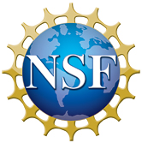
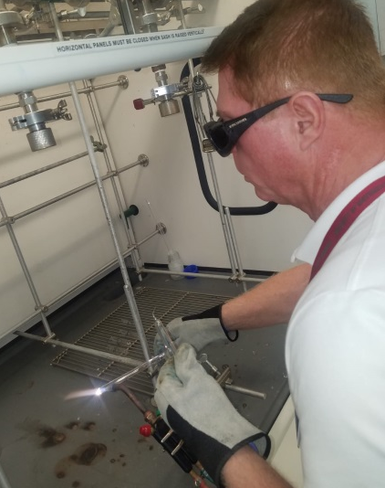
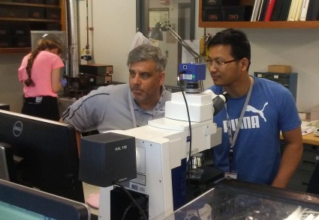
MagLab Education and Outreach:
the Research Experiences for Teachers (RET) Program
National High Magnetic Field Laboratory, Florida State University, Tallahassee FL
Funding Grants: G.S. Boebinger (NSF DMR-1644779)
The MabLab’s mission includes a commitment to STEM education. The MagLab’s Research Experience for Teachers (RET) program is an effective way to impact many students, since teachers participating in the program return to their schools with a better understanding of scientific research. The knowledge and confidence gained by RET participants will impact over 300 students in elementary, middle and high schools around Florida.
In 2018, the RET program, directed by Jose Sanchez, hosted ten Florida teachers from as far as Broward County near Miami. The teachers worked side-by-side with MagLab researchers on a wide variety of projects including Condensed Matter Physics, Materials Science and Technology, Applied Superconductivity, and Nuclear Magnetic Resonance.
For the first time, Prof. Michael Shatruk, FSU Chemistry, joined the MagLab’s RET program, working with two teachers, Larousse Charlot from Maynard Evans High School in Orlando, FL and Don Norton from Millennium Middle School in Sanford, FL. Larousse and Don prepared samples and worked on testing the conductive properties of AlFeB₂ and several variants of the compound. Dr. Shatruk had such a positive experience working with the teachers that he has agreed to work with them again next summer.
Dr. Wan Kyu Park, a recently-hired MagLab Research Faculty member, also mentored RETs for his first time. Dr. Park and his team worked with Melvin Figueroa, from New River Middle School in Ft Lauderdale, and Andy Bula, from Astronaut High School in Titusville, FL. Both Melvin and Andy experienced a very steep learning curve, but shortly after the start of the program, they both felt right at home in Dr. Park’s lab. Melvin and Andy worked on measuring superconducting properties of niobium using a technique developed by Dr. Park.
Facilities: The MagLab’s Center for Integrating Research and Learning (CIRL)
and Public Affairs Department

