Slide 1
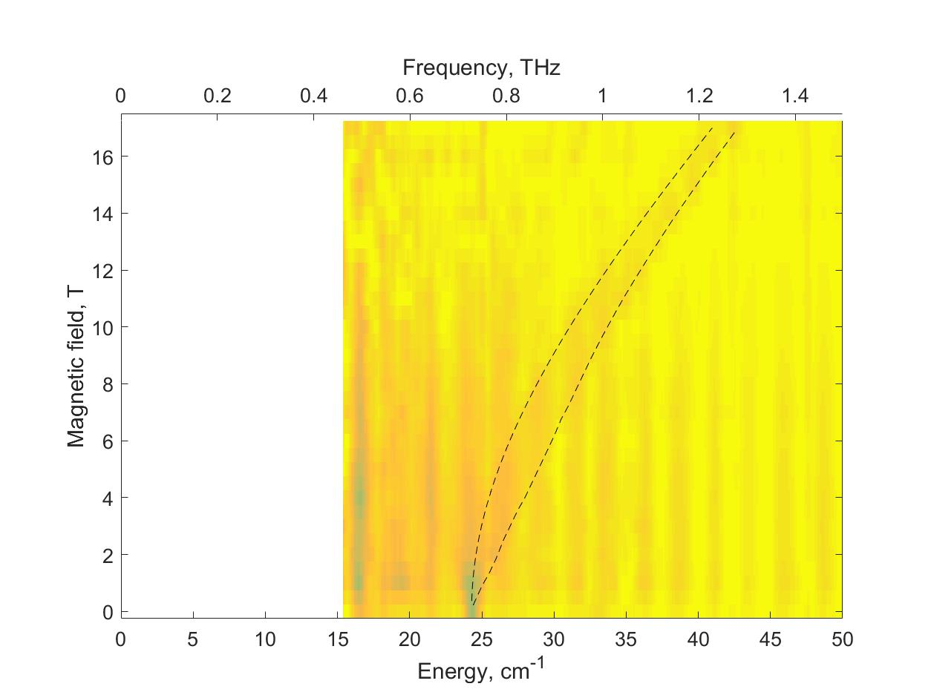
Manipulating the ferryl tilt in a non-heme oxoiron(IV) complex
that makes the complex a better oxidant
W. Rasheed¹, A. Draksharapu¹, S. Banerjee¹, V.G. Young, Jr. ¹, R. Fan², Y. Guo²,
M. Ozerov³, J. Nehrkorn³, J. Krzystek³, J. Telser⁴, L. Que, Jr.¹
1. University of Minnesota; 2. Carnegie Mellon University; 3. NHMFL; 4. Roosevelt University
Funding : G.S. Boebinger (NSF DMR-1157490, NSF DMR-1644779); L. Que, Jr. (NSF CHE-1665391); Y. Guo (NSF CHE-1654060)
Oxoiron(IV) complexes are often thought to be intermediates in mechanistic cycles of many enzymes, including the non-heme iron oxygenases. Their reactivity varies depending on the molecular geometry which can be altered by substituting ligands attached to the core of the complex. This user collaboration explored chemical properties of a series of oxoiron(IV) complexes differing by modifications at the sites shown in magenta in Fig. 1, some of which affected the angle of the ferryl unit [Fe=O]²⁺. This ferryl tilt changed the spectroscopic and magnetic properties of the complex, and most importantly, increased the chemical reactivity of the complex with oxygen.
Experiments at the MagLab involved High-Frequency and High-Field Electron Paramagnetic Resonance (HFEPR) as well as Far-InfraRed Magnetic Spectroscopy (FIRMS) (Fig. 2). These experiments measured parameters of the spin Hamiltonian describing the ground S = 1 spin state of the complexes.
Magnetic properties of the reported series of oxoiron(IV) complexes were linked to their geometric and electronic structure, as well as their catalytic activity towards C-H bond activation. Such studies will allow a better understanding of catalytic mechanisms of these complexes and potentially develop useful synthetic catalysts for many chemical reactions.
Figure 1. The structure of one of the oxoiron(IV) complexes investigated in this study. The tunable ligand substituents are shown in magenta.
Figure 2. A false-color (contour) map of the far-infrared magnetically-active transitions (FIRMS) in the same complex as in Fig. 1. The simulations (dashed lines) use spin Hamiltonian parameters: S = 1, D = 24.3 cm ^{–1}, E = 0, g⊥ = 2.08, g|| = 2.00.
Facilities/instrumentation: EMR Facility (15/17T SC magnet and spectrometer) and DC Facility (SCM3 and FTIR spectrometer) Citation: W. Rasheed; A. Draksharapu; S. Banerjee; V.G. Young; R. Fan; Y. Guo; M. Ozerov; J. Nehrkorn; J. Krzystek; J. Telser; L. Que Jr, Crystallographic evidence for a sterically induced ferryl tilt in a non-heme oxoiron(IV) complex that makes it a better oxidant,
Angew. Chem. Int. Ed., 57, 9387-9391 (2018) DOE: 10.1002/anie.201804836

Slide 2
Manipulating the ferryl tilt in a non-heme oxoiron(IV) complex
that makes the complex a better oxidant
W. Rasheed¹, A. Draksharapu¹, S. Banerjee¹, V.G. Young, Jr. ¹, R. Fan², Y. Guo²,
M. Ozerov³, J. Nehrkorn³, J. Krzystek³, J. Telser⁴, L. Que, Jr.¹
1. University of Minnesota; 2. Carnegie Mellon University; 3. NHMFL; 4. Roosevelt University
Funding : G.S. Boebinger (NSF DMR-1157490, NSF DMR-1644779); L. Que, Jr. (NSF CHE-1665391); Y. Guo (NSF CHE-1654060)
What is the finding? Chemists are actively working on synthesizing small molecules that replicate the reactions achieved in living systems by non-heme enzymes. An example of such a molecule is shown in Figure 1, for which the chemical reactivity was found to be tunable by modifying the ligands attached to the ferryl unit, the [Fe=O]²⁺ core of the complex.
Why is this important? Iron (Fe) is the most important metal in biology and takes many forms in living systems. Relatively well known are the heme proteins and enzymes, such as the oxygen transport protein hemoglobin and the liver enzyme cytochrome P540 that detoxifies chemicals that enter the bloodstream. Less well known are the non-heme enzymes that also perform important biological functions.
Improving our understanding of non-heme enzymes will enable two advances: (1) the synthesizing of chemicals using “greener” technology (low temperature and water-based, as in Nature); and (2) the developing of antibiotics that specifically target these enzymes in pathogenic organisms.
Why did this research need the MagLab? The ability to probe directly the [Fe=O]²⁺ active core of these complexes required the unique combination of photon energies and magnetic fields available at the MagLab. Data from these unique instruments enable comparisons among similar molecules to show subtle, but crucial, structural differences.
Figure 1. The structure of one of the oxoiron(IV) complexes investigated in this study. The tunable ligand substituents are shown in magenta.
Figure 2. A false-color (contour) map of the far-infrared magnetically-active transitions in the complex shown in Fig. 1. The data were obtained using facilities unique to the MagLab.
Facilities/instrumentation: EMR Facility (15/17T SC magnet and spectrometer) and DC Facility (SCM3 and FTIR spectrometer) Citation: W. Rasheed; A. Draksharapu; S. Banerjee; V.G. Young; R. Fan; Y. Guo; M. Ozerov; J. Nehrkorn; J. Krzystek; J. Telser; L. Que Jr, Crystallographic evidence for a sterically induced ferryl tilt in a non-heme oxoiron(IV) complex that makes it a better oxidant,
Angew. Chem. Int. Ed., 57, 9387-9391 (2018) DOE: 10.1002/anie.201804836
Notes:
1. What is the finding?
Here to be included a short description in layman language of the finding
2. Why this finding is important?
A short description of why the finding is important for scientific community, technology, society, etc…
3. Why NHMFL?
The answer to this question should provide information on why this finding could be achieved (only) at NHMFL (what unique capability of MagLab was essential for this finding).

