Slide 1
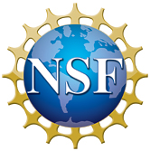
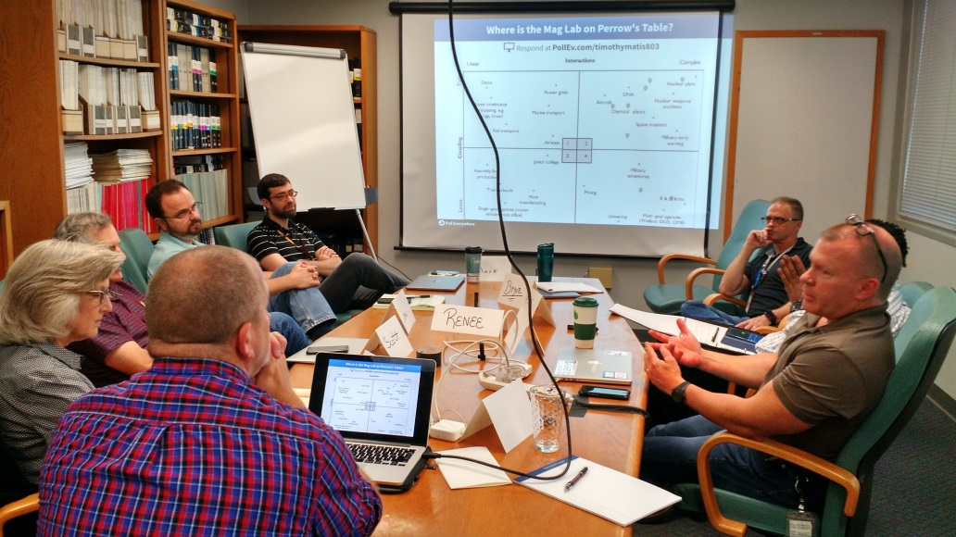
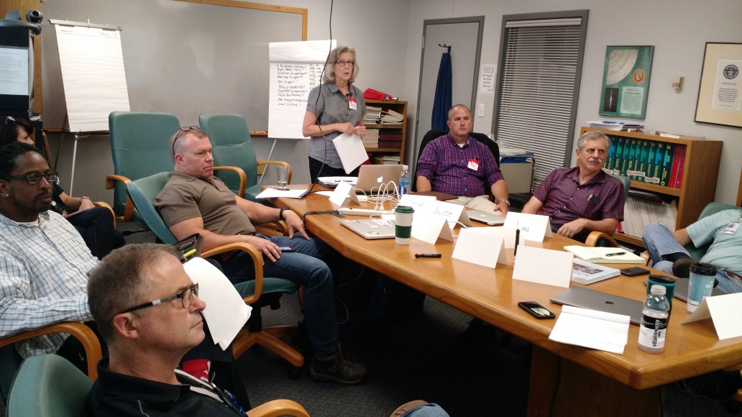
MagLab Workshop on Excellence in High Reliability Organizations
Julia H. Smith¹, Alfie Brown, Laymon Gray¹, Timothy P. Murphy¹
National High Magnetic Field Laboratory, Florida State University, Tallahassee FL
Funding Grants: G.S. Boebinger (NSF DMR-1157490, NSF DMR-1644779)
High Reliability Organizations (HROs) function in difficult and/or hazardous settings, yet are able to keep error rates low and operating time high due to internal operational practices. The MagLab’s DC Field Facility operates high-power and high-energy resistive and hybrid magnets that are supported by an industrial-scale chilled water plant, various high-power electrical systems, and a state-of-the-art cryogenics plant. As such, the MagLab decided that it would benefit from exploring how it might best implement HRO principles and practices.
The MagLab Workshop on Excellence in High Reliability Organizations hosted outside experts to instruct MagLab Safety and DC Field Facility personnel on the concepts and practices for operating a facility according to the principles of HRO theory. The workshop was facilitated by the Center of Excellence for High Reliability Organizations and Processes located at Texas Tech University. The instructors gave an overview of HROs, their characteristics, and the benefits to operations that result. Participants and instructors worked together to determine how DC Field Facility operations can fit within the landscape of HROs. Discussions centered around HRO practices and tools that can transform an organization into an HRO. Emphasis was put on identifying mechanisms to improve the organizational culture – with particular emphasis on the safety culture.
Workshop participants explored what HRO practices and principles could be implemented at the MagLab to reach a higher level of reliability as an organization.
Facilities: DC Magnet User Facility and Safety Department personnel.

