Slide 1
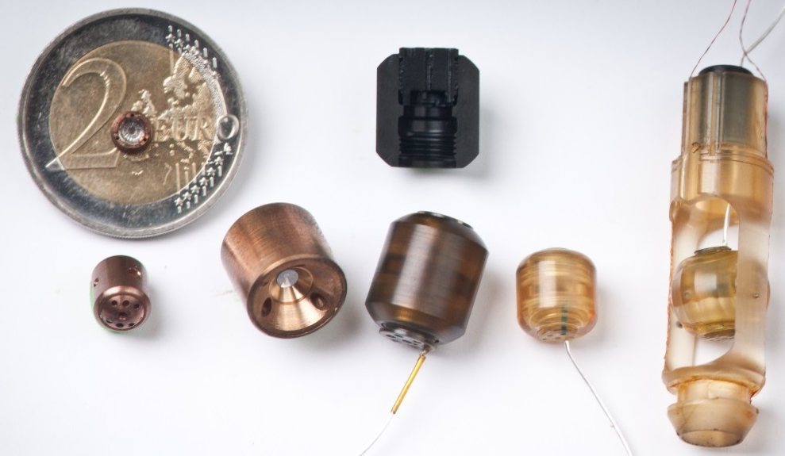
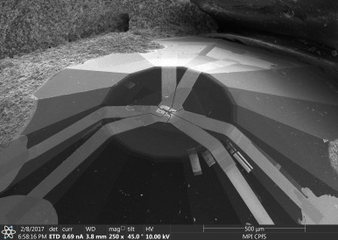
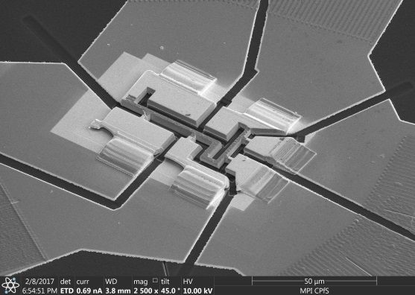
Tech Transfer: High Pressures for Materials Research
A.D. Grockowiak, W. A. Coniglio, V. Williams, and S. W. Tozer
National High Magnetic Field Laboratory, Florida State University, Tallahassee, FL
Funding Grants: G.S. Boebinger (NSF DMR-1157490, NSF DMR-1644779); S.W. Tozer NNSA SSAP
High pressures access “new” materials that are otherwise unattainable, including the recent discovery of superconductivity up to 203K in a sample of hydrogen sulfide pressurized to 150 GPa (or 1.5 million times atmospheric pressure)
Temperature, magnetic field, and pressure each represent a thermodynamic variable that can smoothly tune a material’s properties. When coupled in a single experiment under extreme conditions, they constitute a multidimensional probe to better test our theoretical understanding of new materials and their behavior under less extreme conditions.
An apparatus for generating high pressures typically has many parts in order to precisely align the anvils and apply the load, making them cumbersome to use in high magnetic fields. We have developed a simple five-piece apparatus, including the two anvils, that is based on the ubiquitous turnbuckle and features a detachable load mechanism. Made originally to fit into the 9 mm bore of Quantum Design’s Magnetic Properties Measurement System (MPMS), the design has morphed into more than 17 variations, both metal and plastic, that are used extensively in DC and pulsed magnetic fields and can be coupled with many standard high magnetic field techniques. The symmetric design has enabled magic angle spinning NMR, Electron Spin Resonance (ESR), Raman and Infrared spectroscopy, and, finally, X-ray scattering, which resulted in a commercial agreement with Almax easyLab.
1 cm
Various turnbuckle diamond anvil cells fabricated for high-pressure / high-magnetic-field experiments.
100 µm
An anvil with a sample
of CeRhIn₅ that has been
precisely shaped by Focused Ion Beam etching, created by MagLab user T. Helm from the Max Planck Institut in preparation for a collaborative experiment on pressure-induced effects on electron nematicity.
Facilities and instrumentation used: 35 T and 45 T hybrid were used as well as the 65 T short pulse and 60 T long pulse magnets
Citation: “Nonmetallic gasket and miniature plastic turnbuckle diamond anvil cell for pulsed magnetic field studies at cryogenic temperatures”, D.E. Graf, R.L. Stillwell, K.M. Purcell and S.W. Tozer, High Pressure Research 31 533-543 (2011).

