Slide 1


Pinning and melting of a quantum Wigner crystal
T. Knighton¹, Z. Wu¹, J. Huang¹, A. Serafin², J.-S. Xia^{2,} K.W. Baldwin³, K.W. West³
Wayne State University; 2. NHMFL and University of Florida; 3. Princeton University
Funding Grants: G.S. Boebinger (NSF DMR-1157490, NSF DMR-1644779); J. Huang (NSF DMR-1410302)
MagLab users sought an unambiguous demonstration of the transition within a two-dimensional electron system at ultra-low temperatures to an electronic solid state known as the Wigner crystal in which coulomb interactions cause the electrons to form a triangular lattice. Researchers measured the differential electrical resistivity, dV/dI, in low carrier density (n = 4 x 10⁻¹⁰ cm⁻²) and high mobility (3 x 10⁶ cm²/Vs) electronic systems in GaAs quantum wells. Electrons were were cooled to 9mK and a perpendicular magnetic field was applied to quench the kinetic energy, thus enabling coulomb interactions to dominate in this regime of high B/T.
The measurements revealed a striking threshold behavior for T ≲ 35 mK that evidences the formation of the Wigner crystal. The crystal is pinned (i.e. resistance > 1 GΩ) by disorder only at extremely low currents with magnitude < 5 pA. At currents just above the pinning threshold, the resistance plummets by more than an order of magnitude. The pinning is also destroyed by heating, consistent with the thermal melting of the Wigner crystal.
The temperature dependence was found to be non-activated and piecewise, implying the existence of a pinned Wigner crystal that appears to undergo a two-stage first-order transition upon heating.
Figure: Temperature dependence of the differential resisitivity, dV/dI, in the limit of V → 0, plotted on a semilogarithmic scale. Inset: comparison of the differential resistivity obtained with higher current drives.
Facility used: Nuclear demagnetization at the NHMFL High B/T Facility
Citation: T. Knighton, Z. Wu, J. Huang, A. Serafin, J.-S. Xia, L. N. Pfeiffer, K.W. West;
Evidence of two-stage melting of Wigner solids, Phys Rev B97, 085135 (2018). DOI: 10.1103/PhysRevB.97.085135

Slide 2
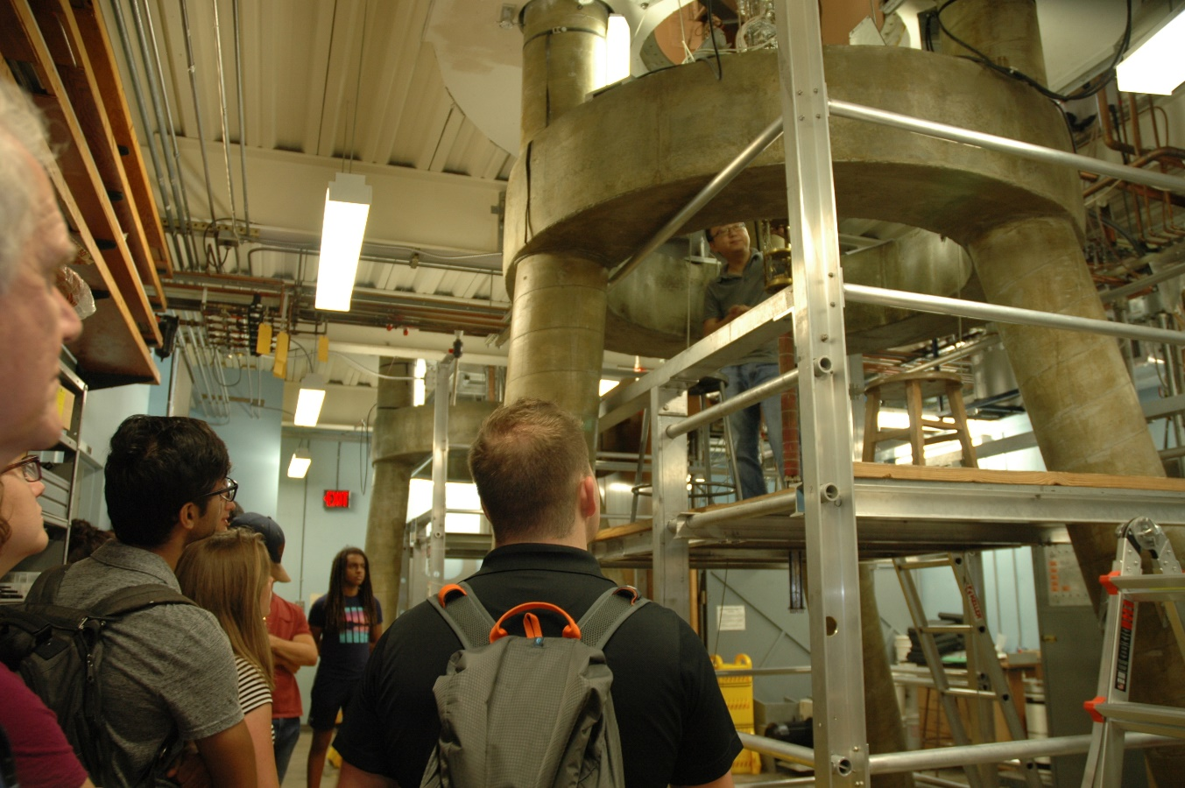
Pinning and melting of a quantum Wigner crystal
T. Knighton¹, Z. Wu¹, J. Huang¹, A. Serafin², J.-S. Xia^{2,} K.W. Baldwin³, K.W. West³
Wayne State University; 2. NHMFL and University of Florida; 3. Princeton University
Funding Grants: G.S. Boebinger (NSF DMR-1157490, NSF DMR-1644779); J. Huang (NSF DMR-1410302)
What is the finding? Users measuring the electrical resistivity of a two-dimensional electron system at ultra-high B/T, find the first evidence of a clear transition to a Wigner crystal state for the electrons in a high quality GaAs heterostructure.
Why is this important? These results reveal a long-predicted quantum ground state arising from strong electron-electron interactions in a nearly-ideal two-dimensional electron system
Why did this research need the MagLab? The external users needed two aspects of the High B/T Facility: (1) the access to very low temperatures and high magnetic fields simultaneously, and (2) an ultra-quiet environment for high sensitivity measurements of the electronic resisitivity.
Figure: Students from the University of Florida’s Student Science Training Program visit the MagLab’s High B/T Facility on July 13, 2018 with Kelley Deuerling.
Facility used: Nuclear demagnetization at the NHMFL High B/T Facility
Citation: T. Knighton, Z. Wu, J. Huang, A. Serafin, J.-S. Xia, L. N. Pfeiffer, K.W. West;
Evidence of two-stage melting of Wigner solids, Phys Rev B97, 085135 (2018). DOI: 10.1103/PhysRevB.97.085135
Notes:
1. What is the finding?
Here to be included a short description in layman language of the finding
2. Why this finding is important?
A short description of why the finding is important for scientific community, technology, society, etc…
3. Why NHMFL?
The answer to this question should provide information on why this finding could be achieved (only) at NHMFL (what unique capability of MagLab was essential for this finding).

