Slide 1
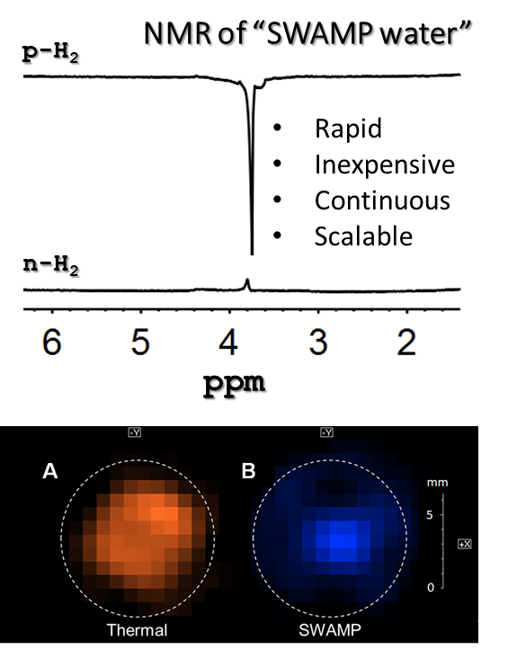
Surface Waters are Magnetized by Parahydrogen (SWAMP)
Evan W Zhao,¹ Raghu Maligal-Ganesh,³ Yong Du,¹ Tommy Y Zhao,¹ James Collins,² Tao Ma,⁴ Lin Zhou,⁴ Tian-Wei Goh,³ Wenyu Huang,^{3,4} Clifford R Bowers^{1,2}
University of Florida Chemistry; 2. NHMFL; 3. Iowa State University Chemistry; 4. Ames National Lab
Funding: G.S. Boebinger (NSF DMR-1157490, NSF DMR-1644779); Bowers (CHE-1507230); Huang(DE-AC02-07CH11358)
We discovered that the singlet proton order of parahydrogen (p-H₂), ordinarily invisible to nuclear magnetic resonance (NMR), can be converted into NMR-observable hyperpolarization of protons in liquid water, methanol, or ethanol on the surface of Pt₃Sn intermetallic nanoparticles. This hyperpolarization increases the sensitivity of NMR and MRI signals. In this SWAMP effect, singlet-triplet mixing is mediated by surface interactions and intermolecular couplings to co-adsorbed p-H₂. Pt and PtSn were ineffective, suggesting the importance of three-fold Pt(111) sites for dissociation of H₂, while Sn restricts H ad-atom diffusion.
p-H₂ is bubbled through a 2 mL suspension containing 50mg of Pt₃Sn intermetallic nanoparticles in an NMR tube in the Earth’s magnetic field, inducing hyperpolarization of the solvent. The tube is rapidly transferred to a high magnetic field where the NMR spectrum is acquired. Images of the now-hyperpolarized water were collected at 750MHz using the fast SPIRAL sequence. The NMR spectrum [top right] and preliminary image of SWAMP-hyperpolarized water [bottom right] are shown right.
SWAMP has promising applications to magnetic resonance angiography, protein NMR spectroscopy, and drug discovery. In addition, this technique could enable low-field medical MRI in remote or impoverished regions since it does not require any superconducting magnet.
Facilities and instrumentation used: High field SWAMP images were collected on the AMRIS 750 MHz imaging spectrometer.
Citation: E.W. Zhao, R. Maligal-Ganesh, Y. Du, T.Y. Zhao, J. Collins, T. Ma, L. Zhou, T.W. Goh, W.Y. Huang, C.R. Bowers,
Surface-Mediated Hyperpolarization of Liquid Water from Parahydrogen, Chem, 4 (6), 1387-1403 (2018)
DOI: 10.1016/j.chempr.2018.03.004

Slide 2
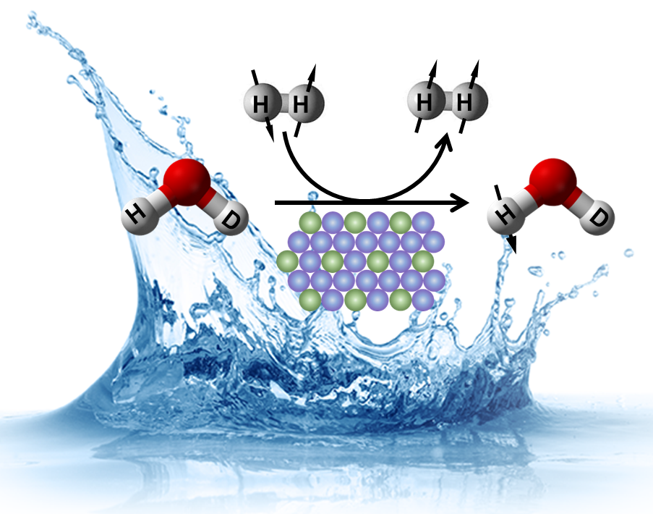
Surface Waters are Magnetized by Parahydrogen (SWAMP)
Evan W Zhao,¹ Raghu Maligal-Ganesh,³ Yong Du,¹ Tommy Y Zhao,¹ James Collins,² Tao Ma,⁴ Lin Zhou,⁴ Tian-Wei Goh,³ Wenyu Huang,^{3,4} Clifford R Bowers^{1,2}
University of Florida Chemistry; 2. NHMFL; 3. Iowa State University Chemistry; 4. Ames National Lab
Funding: G.S. Boebinger (NSF DMR-1157490, NSF DMR-1644779); Bowers (CHE-1507230); Huang(DE-AC02-07CH11358)
At room temperature, the magnetic moments of hydrogen nuclei (protons) in water point in random directions. We devised a simple method to align the proton magnetic moments in in the Earth’s magnetic field [right]. This is remarkable because such a process would seem to violate the postulates of thermodynamics and quantum mechanics.
What is the finding? Alignment of proton magnetic moments in liquid water was induced simply by bubbling parahydrogen gas through a suspension containing a special Pt₃Sn catalyst. This SWAMP effect (Surface Waters Are Magnetized by Parahydrogen) is mediated by symmetry-breaking interactions on the surface of the Pt₃Sn nanoparticles. The enhanced proton alignment was detected by nuclear magnetic resonance (NMR) and magnetic resonance imaging (MRI) at 750MHz in the MagLab’s AMRIS Facility.
Why is this important? NMR and MRI signals depend on the alignment of nuclear magnetic moments. The greater the alignment, the stronger the signal. Therefore, SWAMP has a myriad of promising applications, ranging from medical MRI to drug discovery and biomolecular NMR. SWAMP could one day enable low-field MRI in remote or impoverished areas.
Why did the research need the MagLab? The unique instrumentation in the MagLab’s AMRIS Facility allows for high-sensitivity NMR and MRI analysis which is ideal for imaging and spectroscopy applications with SWAMP water.
Facilities and instrumentation used: High field SWAMP images were collected on the AMRIS 750 MHz imaging spectrometer.
Citation: E.W. Zhao, R. Maligal-Ganesh, Y. Du, T.Y. Zhao, J. Collins, T. Ma, L. Zhou, T.W. Goh, W.Y. Huang, C.R. Bowers,
Surface-Mediated Hyperpolarization of Liquid Water from Parahydrogen, Chem, 4 (6), 1387-1403 (2018)
DOI: 10.1016/j.chempr.2018.03.004
Notes:
1. What is the finding?
Here to be included a short description in layman language of the finding
2. Why this finding is important?
A short description of why the finding is important for scientific community, technology, society, etc…
3. Why NHMFL?
The answer to this question should provide information on why this finding could be achieved (only) at NHMFL (what unique capability of MagLab was essential for this finding).

