Slide 1
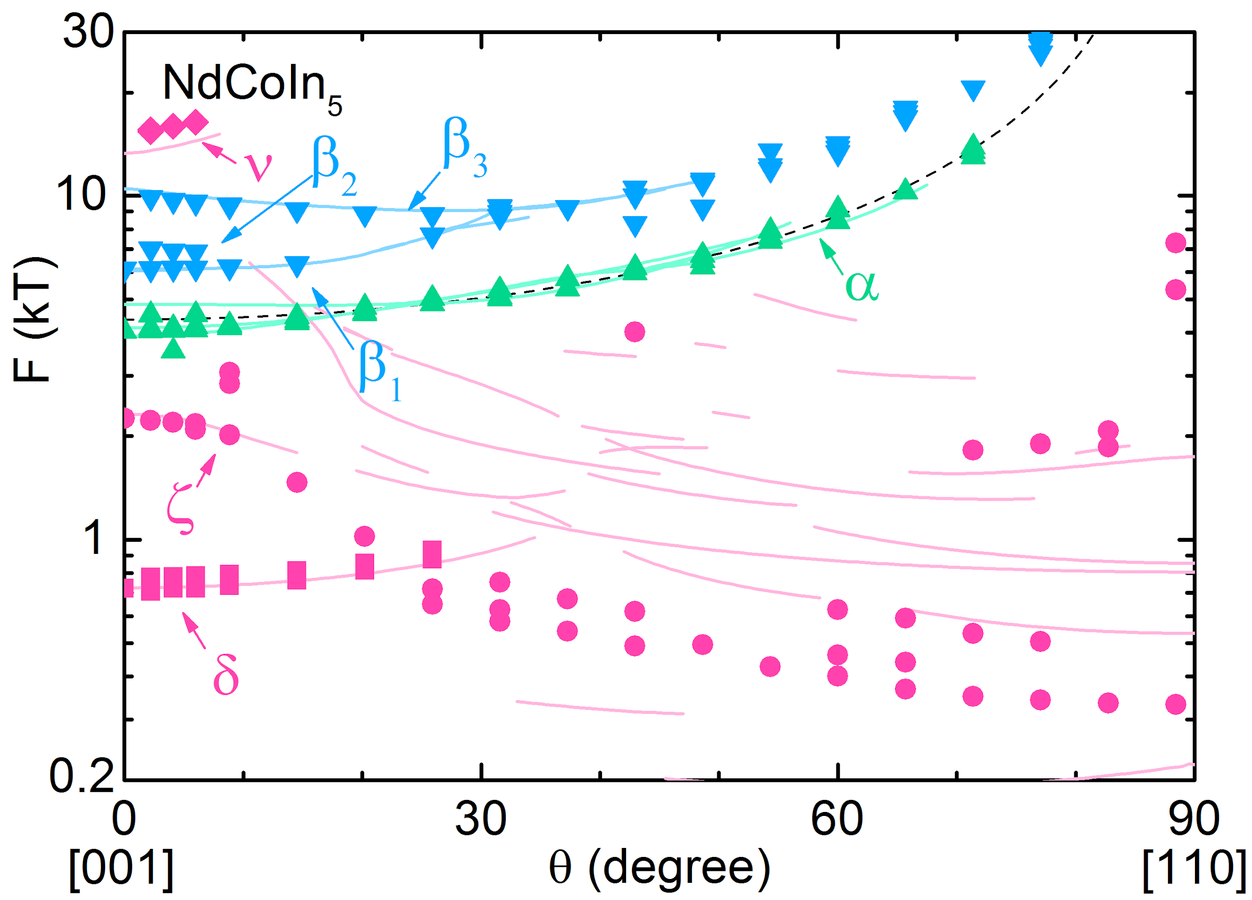
Quasi-2D to 3D Fermi Surface Topology Change in Ce_{1-x}Nd_{x}CoIn₅
J. Klotz,^{1,2} K. Götze,^{1,2} I. Sheikin,³ T. Förster,¹ D. Graf,⁴ J.-H. Park,⁴ E. S. Choi,⁴
R. Hu,⁵ C. Petrovic,⁵ J. Wosnitza,^{1,2} and E. L. Green¹
HZDR, Germany; 2. TU Dresden, Germany; 3. LNCMI, France ; 4. NHMFL, FSU ; 5. Brookhaven National Lab
Funding Grants: G.S. Boebinger (NSF DMR-1157490); BNL (U.S. DOE No. DE-SC0012704),
C. Petrovic (Humboldt Foundation); I. Sheikin, J. Wosnitza (ANR-DFG Grant Fermi-NESt); J. Wosnitza (GRK 1621)
Heavy fermion systems are well-known for exhibiting exotic quantum phenomena. One such system, CeCoIn₅, is perhaps most famous for the Q phase, an exotic high-field state with intertwined magnetic and superconducting orders. A scattering Q vector was observed in neutron scattering at zero applied magnetic field in Ce_{0.95}Nd_{0.05}CoIn₅ and it was theorized that Fermi surface nesting was responsible providing the motivation for our experiment.
Scientists from the European High Magnetic Field Laboratory (EMFL) and NHMFL collaborated to perform de Haas-van Alphen measurements on a doping series of high-quality crystals of Ce_{1-x}Nd_{x}CoIn₅ grown at Brookhaven National Lab. Due to the high level of electron-electron interaction (i.e. enhanced effective masses), magnetic fields up to 35 T and temperatures down to 40 mK were required to accurately measure the Fermi surface. Corresponding band structure calculations and an observed topology change between Nd doping x = 0.02 and 0.05 revealed the origin of the Q phase as arising from a spin density wave quantum critical point.
Figure: Example of one of the many datasets. (Top) Fourier transform of the torque magnetometry data shown in the inset, demonstrating the need for high magnetic fields and low temperatures to reveal the oscillations in their full detail. (Bottom) Angular dependence of the frequencies are in agreement with band structure calculations, where the colored lines correspond to the same-colored Fermi surfaces shown on the right.
Facilities used: DC Magnet User Facility: 35 Tesla, ³He cryogenic system and ³He / ⁴He portable dilution refrigerator.
Citation: J. Klotz, K. Goetze, I. Sheikin, T. Foerster, D. Graf, J.H. Park, E.S. Choi, R. Hu, C. Petrovic, J. Wosnitza, E.L. Green,
Fermi surface reconstruction and dimensional topology change in Nd-doped CeCoIn₅,
Phys. Rev. B Rapid Commun., 98, 081105 (2018) DOI: 10.1103/PhysRevB.98.081105

Slide 2
Quasi-2D to 3D Fermi Surface Topology Change in Ce_{1-x}Nd_{x}CoIn₅
J. Klotz,^{1,2} K. Götze,^{1,2} I. Sheikin,³ T. Förster,¹ D. Graf,⁴ J.-H. Park,⁴ E. S. Choi,⁴
R. Hu,⁵ C. Petrovic,⁵ J. Wosnitza,^{1,2} and E. L. Green¹
HZDR, Germany; 2. TU Dresden, Germany; 3. LNCMI, France ; 4. NHMFL, FSU ; 5. Brookhaven Nat’l Lab
Funding Grants: G.S. Boebinger (NSF DMR-1157490); BNL (U.S. DOE No. DE-SC0012704),
C. Petrovic (Humboldt Foundation); I. Sheikin, J. Wosnitza (ANR-DFG Grant Fermi-NESt); J. Wosnitza (GRK 1621)
What is the finding? Our experiment produced three key findings on the very unusual “Q-phase” in neodymium-doped CeCoIn₅, in which magnetism and superconductivity coexist: (1) The appearance of the Q vector previously observed in neutron scattering measurements on Ce_{0.95}Nd_{0.05}CoIn₅ is due to a transition from a two-dimensional to a three-dimensional metal. (2) This transition results from the formation of a spin density wave. (3) Neodymium likely alters the electronic pairing potential that leads to the superconductivity.
Why is this important? Physicists seeks to better understand exotic quantum mechanical states in unusual superconductors, such as the Q-phase. These results show an increase from two- to three-dimensionality, thus arguing against previously proposed Fermi surface nesting and pointing instead to spin density wave formation as the driving force for the transition.
Why did this research need the MagLab? The combination of high magnetic fields and low temperatures offered at the MagLab was crucial to resolving the many high frequency oscillations present in these heavy fermion compounds.
Figure: Example of one of the many datasets. (Top) Fourier transform of the torque magnetometry data shown in the inset, demonstrating the need for high magnetic fields and low temperatures to reveal the oscillations in their full detail. (Bottom) Angular dependence of the frequencies are in agreement with band structure calculations, where the colored lines correspond to the same-colored Fermi surfaces shown on the right.
Facilities used: DC Magnet User Facility: 35 Tesla, ³He cryogenic system and ³He / ⁴He portable dilution refrigerator.
Citation: J. Klotz, K. Goetze, I. Sheikin, T. Foerster, D. Graf, J.H. Park, E.S. Choi, R. Hu, C. Petrovic, J. Wosnitza, E.L. Green,
Fermi surface reconstruction and dimensional topology change in Nd-doped CeCoIn₅,
Phys. Rev. B Rapid Commun., 98, 081105 (2018) DOI: 10.1103/PhysRevB.98.081105
Notes:
1. What is the finding?
Here to be included a short description in layman language of the finding
2. Why this finding is important?
A short description of why the finding is important for scientific community, technology, society, etc…
3. Why NHMFL?
The answer to this question should provide information on why this finding could be achieved (only) at NHMFL (what unique capability of MagLab was essential for this finding).

