Slide 1
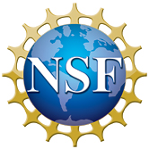
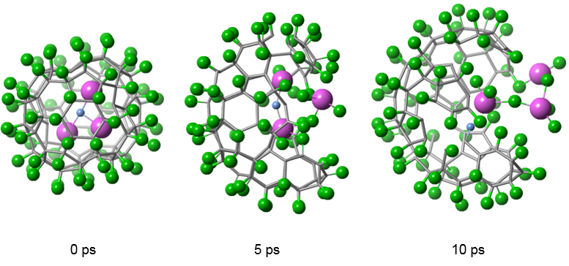
Functionalizing Molecular Nanocarbon with Fluorine Atoms
Antonio Moreno-Vicente¹, Marc Mulet-Gas², Paul W. Dunk², Josep M. Poblet¹, Antonio Rodríguez-Fortea¹
University of Rovira i Virgili, Spain; 2. National High Magnetic Field Laboratory, Florida State University
Funding Grants: G.S. Boebinger (NSF DMR-1157490, NSF DMR-1644779); A. Rodríguez-Fortea, J.M.Poblet (MCI CTQ2014-52774-P, GC 2014SGR, and XRQTC)
Endohedral metallofullerenes (EMFs) contain metal-based clusters (e.g., Sc₃N) within the nanoscale void of their C₈₀ cages. Their exceptional properties have gained intensive interest for potential applications in biomedicine and photovoltaics. For example, water-soluble EMFs are powerful MRI contrast agents. Also, the addition of a fluorine atom to the cage chemically tunes nanomaterials for use in plastic solar cell technology, technology that converts sunlight into clean energy.
MagLab users from Spain have used laser-based chemical sampling techniques in the MagLab’s Ion Cyclotron Resonance (ICR) facility to develop the synthesis of fluorinated molecular nanocarbon. The addition of fluorine (F) to the Sc₃N@C₈₀ compound has been an elusive goal, because all prior attempts have destroyed the fullerene cage. In this work, the researchers discovered a route that uses widely available and cheap polytetrafluoroethylene, more commonly known as Teflon, to selectively add one or two F atoms to the cage.
This research demonstrates that high field ICR mass spectrometry combined with theoretical calculations can unleash the discovery of new carbon compounds for sustainable energy, as well as shed light on fundamental behaviors of carbon nanoforms.
+ F
Sc₃N@C₈₀
Sc₃N@C₈₀F₂
(A)
+ F
Sc₃N@C₈₀F
Sc₃N@C₈₂
Sc₃N@C₈₂F
Sc₃N@C₈₁F
1110
1115
1120
1125
1130
1135
1140
1145
1150
1155
m/z
(B)
0 psec
5 psec
10 psec
(A) Up to two fluorine atoms are added to the Sc₃N@C₈₀ fullerene cage, as shown in the FT-ICR mass spectrum. (B) Calculations show that too many fluorine atoms (shown in green) destroy the cage (i.e., the cage opens after five picoseconds), whereas the controlled addition of only one or two fluorine atoms, as discovered in this work, keeps the nanocage intact.
Facilities and instrumentation used: Ion Cyclotron Resonance, 9.4 T actively shielded magnet, cluster instrument
Citation: A. Moreno-Vicente, M. Mulet-Gas, P.W. Dunk, J.M. Poblet, A. Rodríguez-Fortea, Probing the formation of halogenated endohedral metallofullerenes: Predictions confirmed by experiments, Carbon 129, 750-757 (2018)

Slide 2
Functionalizing Molecular Nanocarbon with Fluorine Atoms
Antonio Moreno-Vicente¹, Marc Mulet-Gas², Paul W. Dunk², Josep M. Poblet¹, Antonio Rodríguez-Fortea¹,
University of Rovira i Virgili, Spain; 2. National High Magnetic Field Laboratory, Florida State University
Funding Grants: G.S. Boebinger (NSF DMR-1157490, NSF DMR-1644779); A. Rodríguez-Fortea, J.M.Poblet (MCI CTQ2014-52774-P, GC 2014SGR, and XRQTC)
What is the finding?
Researchers found a way to add fluorine to high-impact carbon nanomaterials, which could chemically tune them for possible use in clean energy applications such as plastic solar cells.
Why is this important?
All prior attempts to add fluorine to the nanomaterial, Sc₃N@C₈₀, have led to destruction of the carbon cage. In this work, scientists have found a controlled way by means of laser vaporization to generate the first fluorinated and metal-encapsulated carbon nanocages, a long-standing challenge in the pursuit and design of new carbon nanomaterials.
Why did this research need the MagLab?
The discovery and formation of the these chemical compounds requires unique laser-based instrumentation coupled to analysis by high-magnetic-field FT-ICR mass spectrometry, an exclusive combination of state-of-the-art instrumentation found only in the MagLab’s Ion Cyclotron Resonance facility.
+ F
Sc₃N@C₈₀
Sc₃N@C₈₀F₂
+ F
Sc₃N@C₈₀F
Sc₃N@C₈₂
Sc₃N@C₈₂F
Sc₃N@C₈₁F
1110
1115
1120
1125
1130
1135
1140
1145
1150
1155
m/z
The Sc₃N@C₈₀ fullerene nanocage consists of a scandium nitride molecule (Sc₃N) contained in a cage of eighty carbon atoms (C₈₀). This mass spectrum from the MagLab’s Ion Cyclotron Resonance (ICR) user facility shows peaks that indicate the adding of up to two fluorine atoms to the exterior of the Sc₃N@C₈₀ nanocage for the first time. This is accomplished by means of laser plasma synthesis techniques in the MagLab’s ICR facility.
Facilities and instrumentation used: Ion Cyclotron Resonance, 9.4 T actively shielded magnet, cluster instrument
Citation: A. Moreno-Vicente, M. Mulet-Gas, P.W. Dunk, J.M. Poblet, A. Rodríguez-Fortea, Probing the formation of halogenated endohedral metallofullerenes: Predictions confirmed by experiments, Carbon 129, 750-757 (2018)
Notes:
1. What is the finding?
Here to be included a short description in layman language of the finding
2. Why this finding is important?
A short description of why the finding is important for scientific community, technology, society, etc…
3. Why NHMFL?
The answer to this question should provide information on why this finding could be achieved (only) at NHMFL (what unique capability of MagLab was essential for this finding).

