Slide 1
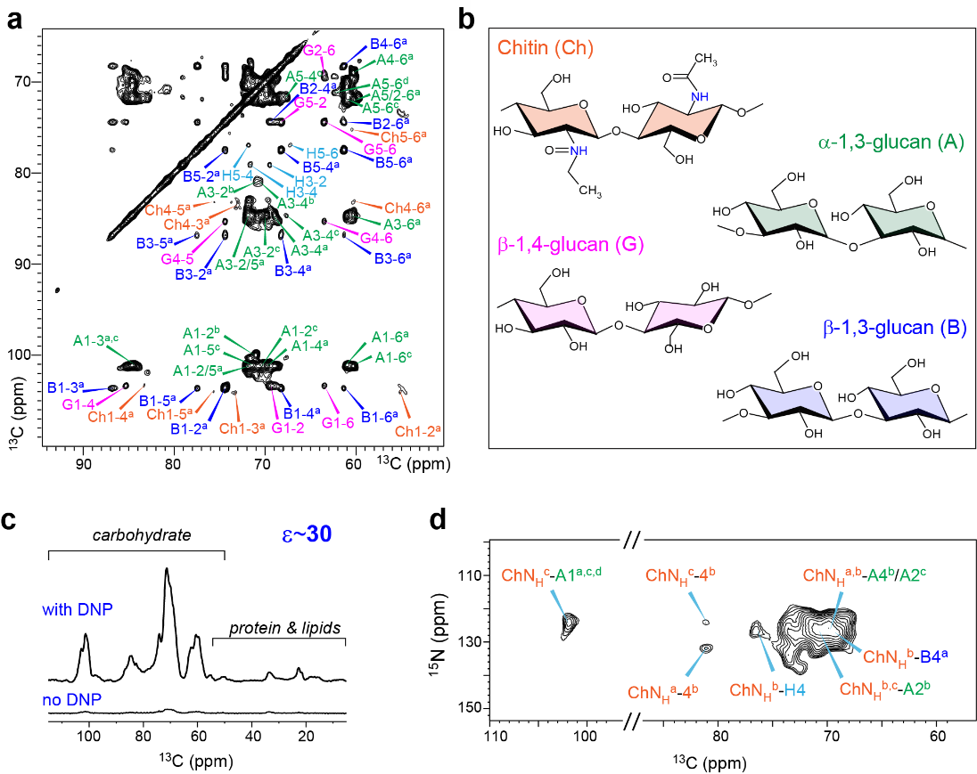
Uncovering the Secrets of Fungal Cell Wall Architecture
Xue Kang¹, Alex Kirui¹, Artur Muszyński², Malitha C Dickwella Widanage¹, Adrian Chen¹, Parastoo Azadi², Ping Wang³, Frederic Mentink-Vigier⁴, Tuo Wang¹
1. Louisiana State University; 2. University of Georgi; 3. LSU Health Sciences Center; 4. NHMFL.
Funding Grants: G.S. Boebinger (NSF DMR-1157490, NSF DMR-1644779); T. Wang (NSF OIA-1833040).
Life-threatening fungal infections affect more than two million people worldwide but effective antifungal medications are very limited, thus resulting in high mortality. The fungal cell wall is a promising target for future antifungal drugs as it contains polysaccharides that are absent in humans. However, our knowledge of the fungal cell wall architecture remains ambiguous due to technical constraints of traditional experimental techniques.
Experiments on the high-field magnets at the MagLab provide unprecedented NMR resolution from a variety of polysaccharides and proteins (Figs.1a,b). Magic Angle Spinning (MAS) Dynamic Nuclear Polarization (DNP) provides a 30-fold sensitivity enhancement (Fig. 1c), which enabled this collaboration to determine the spatial proximities between different biomacromolecules (Fig. 1d). This information on intermolecular packing, together with site-specific information on molecular hydration and dynamics, lead to a new structural model of the fungal cell wall that substantially differs from any preceding impressions of the structure of fungal cell walls.
The revised model will serve as the structural basis for designing better antifungal drugs that inhibit a broader spectrum of infectious fungi. The methods highlighted in this experiment can be widely applied to a variety of carbohydrate-rich biomaterials, such as the cell walls in plants, bacteria and algae.
Figure: The structural determination of intact fungal cell walls.
a, Two-dimensional ¹³C-¹³C spectra. b, Representative structure of glycans. c, Thirty-fold sensitivity enhancement by MAS-DNP. d, Intermolecular-only ¹⁵N-¹³C correlation spectrum reports many sub-nanometer contacts under the sensitivity enhancement provided by the MagLab’s MAS-DNP.
Facilities and instrumentation used: 800 MHz solid-state NMR and the 600 MHz/395 GHz DNP system at the MagLab’s NMR facility.
Citation: X.Kang, A.Jirui, A.Muszyński, M.C.D. Widanage, A.Chen, P.Azadi, P. Wang, F. Mentink-Vigier, T. Wang,
“Molecular architecture of fungal cell walls revealed by solid-state NMR”, Nature Comm 9 (1), 2747 (2018). DOI: 10.1038/s41467-018-05199-0

Slide 2
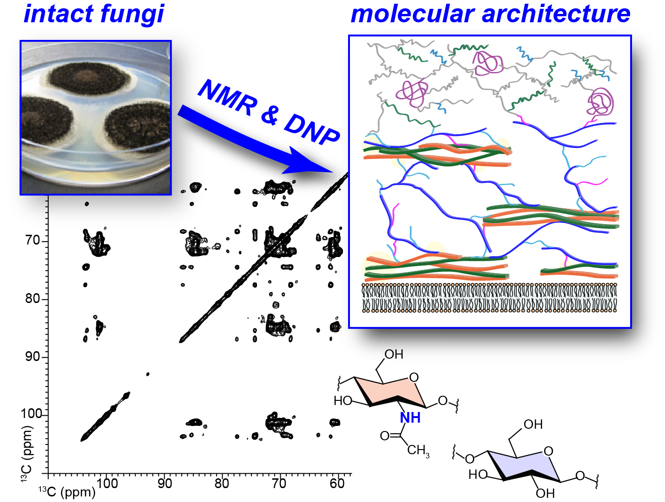
Uncovering the Secrets of Fungal Cell Wall Architecture
Xue Kang¹, Alex Kirui¹, Artur Muszyński², Malitha C Dickwella Widanage¹, Adrian Chen¹, Parastoo Azadi², Ping Wang³, Frederic Mentink-Vigier⁴, Tuo Wang¹
1. Louisiana State University; 2. University of Georgi; 3. LSU Health Sciences Center; 4. NHMFL.
Funding Grants: G.S. Boebinger (NSF DMR-1157490, NSF DMR-1644779); T. Wang (NSF OIA-1833040).
What is the finding? This collaboration determined the three-dimensional architecture of the carbohydrate-rich cell wall in native and intact fungi. By using Nuclear Magnetic Resonance (NMR) and Dynamic Nuclear Polarization (DNP), scientists can now elucidate how carbohydrates and proteins are packed to form the cell walls of the most prevalent and deadly fungi.
Why is this important? Fungal infections impact millions of humans every year. The knowledge from these experiments advances our understanding of the architecture of fungal cell walls. With this knowledge, it is likely that better antifungal drugs will be designed to help save lives.
Why did this research need the MagLab? The fungal cell wall is a highly complex composite of many different biomolecules. A successful determination of the structures in the fungal cell wall requires a combination of the increased resolution from high-field magnets and the NMR signal sensitivity boost resulting from DNP instruments in the MagLab’s unique DNP user program.
Figure: Solid-state NMR and Dynamic Nuclear Polarization (DNP) spectroscopy enable the determination of the location of many different biomolecules that exist in fungal cell walls.
Facilities and instrumentation used: 800 MHz solid-state NMR and the 600 MHz/395 GHz DNP system at the MagLab’s NMR facility.
Citation: X.Kang, A.Jirui, A.Muszyński, M.C.D. Widanage, A.Chen, P.Azadi, P. Wang, F. Mentink-Vigier, T. Wang,
“Molecular architecture of fungal cell walls revealed by solid-state NMR”, Nature Comm 9 (1), 2747 (2018). DOI: 10.1038/s41467-018-05199-0
Notes:
1. What is the finding?
Here to be included a short description in layman language of the finding
2. Why this finding is important?
A short description of why the finding is important for scientific community, technology, society, etc…
3. Why NHMFL?
The answer to this question should provide information on why this finding could be achieved (only) at NHMFL (what unique capability of MagLab was essential for this finding).

