Slide 1
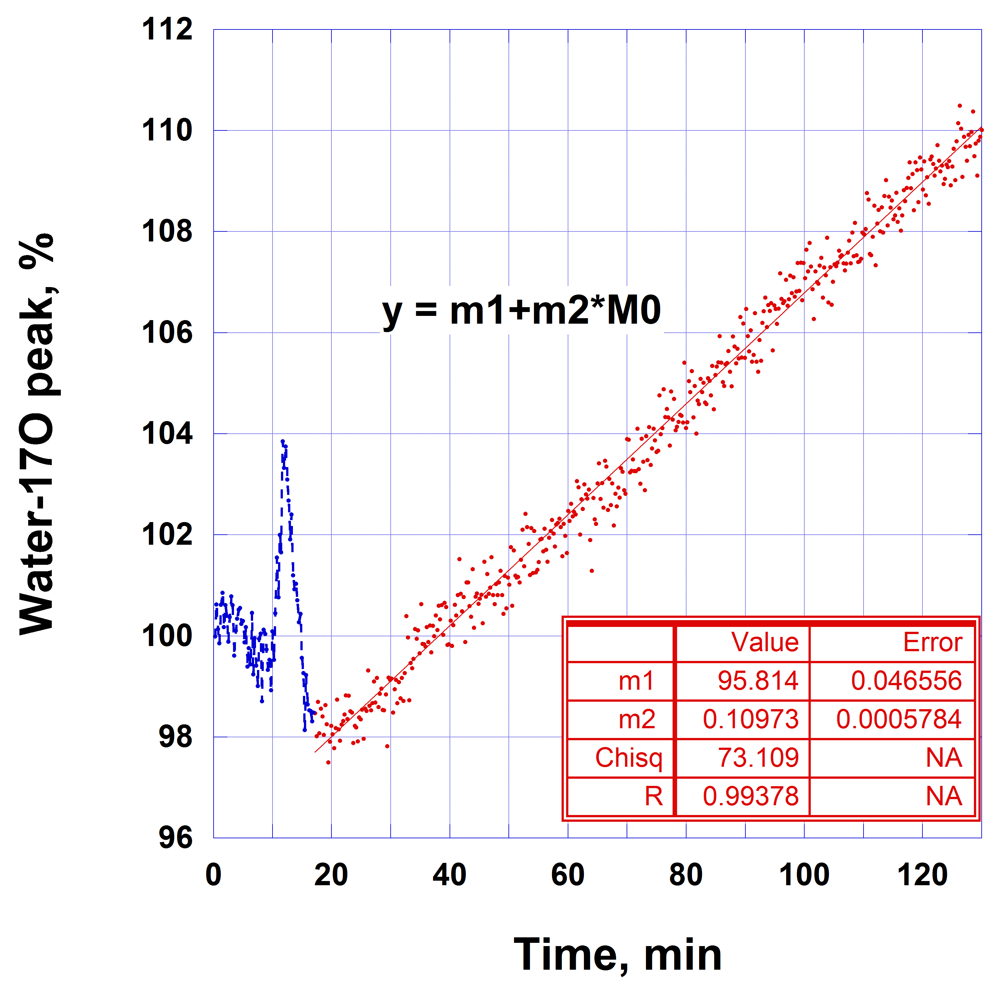
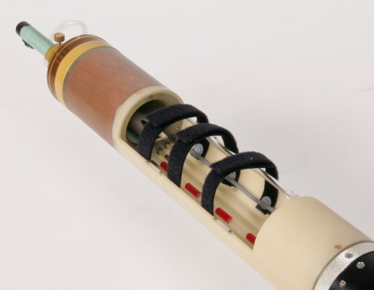
The world’s highest-magnetic-field animal MRI scanner
V.D. Schepkin¹, C. Levenson², P.L. Gor’kov¹, W.W. Brey¹, J.T. Rosenberg¹, S.C. Grant², L. Frydman¹, T.A. Cross¹
NHMFL, Tallahassee, FL; 2. Florida State University, Tallahassee, FL;
Funding Grants: G.S. Boebinger (NSF DMR-1157490, NSF DMR-1644779)
A recent article in Nature magazine [1] highlighted the world’s highest-field animal MRI magnet, designed and built by MagLab engineers and commissioned as a flagship magnet in the MagLab’s user program in 2004. This magnet allows acquisition of images at 21.1T and routinely demonstrates high sensitivity for low gamma nuclei. This dramatically advances the frontiers of MRI, especially for imaging quadrupolar nuclei. Currently, the maximum imaging volume is a cylinder of D x H = 33 mm x 40 mm, allowing in vivo MRI of rodents weighing up to 300 g.
Metabolism of compounds labeled with oxygen-17 can now be detected by MRI (Fig.1) Using this magnet and probe (Fig.2). Recently, sodium MRI of rodent brain tumors predicted tumor resistance to chemotherapy before initiation of therapy per-se (US Patent 8880146; Schepkin, Levenson). This represents a dramatic first step towards individualizing tumor therapy in humans.
The ultra-high magnetic field scanner has pioneered multiple scientific advances in MRI. One hundred scientific papers have been published crediting this unique magnet (https://nationalmaglab.org/images/users/nmr_mri/searchable_docs/900_pubs.pdf) by users from around the world.
Chemical exchange saturation transfer (CEST) MRI (Fig.3) at 21.1T is proving to be of great value in assessing natural tumor contrast in future human MRI at strong magnetic fields.
Fig. 1. (left) 3D oxygen-17 MRI of rat head (scan time 1.5 min).
(right) Time course of glucose-6-17O metabolism in rat head.
Metabolized
¹⁷O water
Glioma
Fig. 2. The MagLab’s in vivo rodent
Magnetic Resonance Imaging probe.
Fig. 3. CEST weighted MRI
of a tumor at 21.1 T.
Facilities and instrumentation used: NHMFL NMR, 900 UWB - 21.1 T magnet
Citation: [1] A. Nowogrodzki, “The Strongest Scanners”, Nature 563, 24 - 26 (2018).

Slide 2
The world’s highest-magnetic-field animal MRI scanner
V.D. Schepkin¹, C. Levenson², P.L. Gor’kov¹, W.W. Brey¹, J.T. Rosenberg¹, S.C. Grant², L. Frydman¹, T.A. Cross¹
NHMFL, Tallahassee, FL; 2. Florida State University, Tallahassee, FL;
Funding Grants: G.S. Boebinger (NSF DMR-1157490, NSF DMR-1644779)
What is the finding? Ultra-high-magnetic-field animal Magnetic Resonance Imaging (MRI) expands the frontiers of MRI. Using the MagLab’s unique 21.1T MRI magnet, oxygen-17 (Fig.1) and other nuclei intrinsic to our body have now become accessible to create images. Oxygen-17 MRI has been demonstrated to reveal the rate of glucose metabolism. Chemical exchange saturation transfer (CEST) MRI (Fig.3) demonstrates the natural contrast for tumor detection that is achievable at 21.1 T (Fig.2).
Why is this important? Different nuclei can image different chemical and metabolic processes to monitor functioning of living organs inside the body. Our first experiments with sodium MRI of tumors demonstrated that sodium in tumors can predict the tumor’s resistance to chemotherapy prior to administering chemotherapy. This non-invasive approach could permit an individualized strategy for cancer treatment.
Why did this research need the MagLab? The Maglab has unique magnets and probes (Fig.3), along with the scientific and technological expertise, to advance the frontiers of MRI using higher magnetic fields. The MagLab’s 21.1T MRI magnet is the highest-magnetic-field animal MRI scanner in the world.
Fig.1: (At left) 3D oxygen-17 MRI of rat head (scan time 1.5 min). (At right) Time course of glucose-6-17O metabolism in a rat brain.
Metabolized
¹⁷O water
Glioma
Fig.2: CEST weighted MRI
of a tumor at 21.1 T.
Fig.3: The MagLab’s in vivo rodent
Magnetic Resonance Imaging probe.
Facilities and instrumentation used: NHMFL NMR, 900 UWB - 21.1 T magnet
Citation: [1] A. Nowogrodzki, “The Strongest Scanners”, Nature 563, 24 - 26 (2018).
Notes:
1. What is the finding?
Here to be included a short description in layman language of the finding
2. Why this finding is important?
A short description of why the finding is important for scientific community, technology, society, etc…
3. Why NHMFL?
The answer to this question should provide information on why this finding could be achieved (only) at NHMFL (what unique capability of MagLab was essential for this finding).

