Slide 1
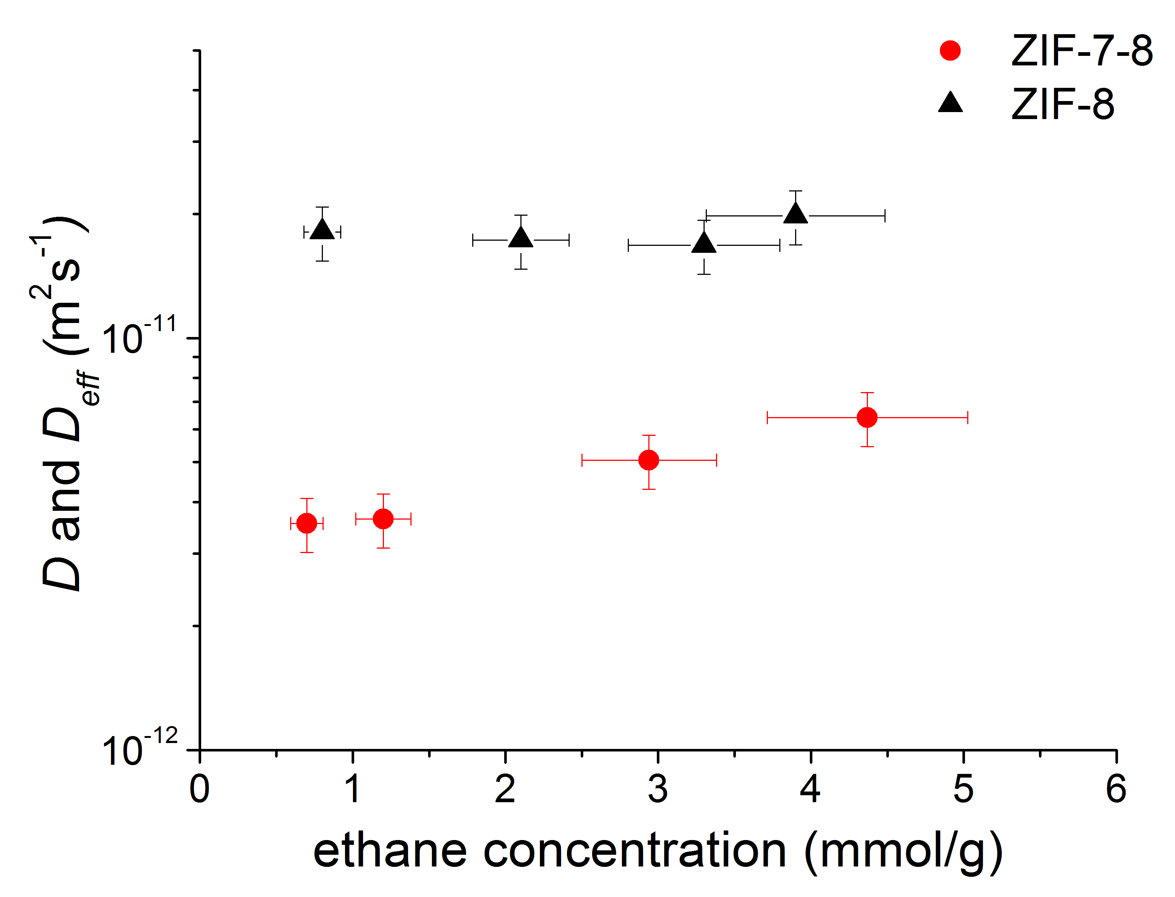
Microscale Diffusion in Mixed Linker Zeolitic Imidazolate Framework
Samuel Berens¹, Christian Chmelik², Febrian Hillman³, Jörg Kärger², Hae-Kwon Jeong³, Sergey Vasenkov¹
University of Florida; 2. Leipzig University; 3. Texas A&M University
Funding Grants: G.S. Boebinger (NSF DMR-1157490, NSF DMR-1644779);
H.-K. Jeong (NSF CMMI-1561897); S. Vasenkov (NSF CMMI-1561347)
Zeolitic imidazolate frameworks (ZIFs) are formed by organic linkers, which are bound to metal centers. ZIFs are porous materials that show promise for gas separation applications. Recently interest has been generated around mixed linker ZIFs owing to the potential of fine-tuning material properties by mixing different linkers in the same material.
Pulsed-field-gradient (PFG) NMR was used in combination with single crystal infrared microscopy (IRM) to study diffusion of ethane inside crystals of a mixed linker ZIF of the type ZIF-7-8. Multinuclear (¹³C and ¹H) PFG NMR diffusion studies of ethane reported here were performed at high magnetic fields (14T and 17.6T) and large magnetic field gradients up to 25 T/m.
PFG NMR in combination with IRM was successfully applied to quantify microscopic gas diffusion in a mixed linker ZIF for the first time. A distribution over ethane diffusivities in ZIF-7-8 was observed and attributed to a difference in the fraction of ZIF-8 and ZIF-7 linkers in different single crystals of ZIF-7-8. In agreement with the expectation of smaller aperture sizes in ZIF-7-8 than in a reference ZIF-8, the average ethane self-diffusivities in ZIF-7-8 were found to be significantly lower than those in ZIF-8. Fundamental understanding of transport properties of ZIFs will enable rational design of ZIF-based gas separations.
Effective self-diffusion coefficients (D_{eff}) in ZIF-7-8 (red circles) and self-diffusion coefficients (D) in the reference ZIF-8 (black triangles) for ethane measured by pulsed-field-gradient (PFG) NMR at 296 K, plotted as a function of the ethane concentration in the ZIF crystals.
Facilities used: AMRIS (Avance III HD 750 MHz and Avance III 600 MHz)
Citation: S. Berens, C. Chmelik, F. Hillman, J. Karger, H.K. Jeong, S. Vasenkov,
Ethane diffusion in mixed linker zeolitic imidazolate framework-7-8 by pulsed field gradient NMR in combination with single crystal IR microscopy, Phys. Chem. Chem. Phys., 20 (37), 23967-23975 (2018), DOI: 10.1039/c8cp04889d

Slide 2
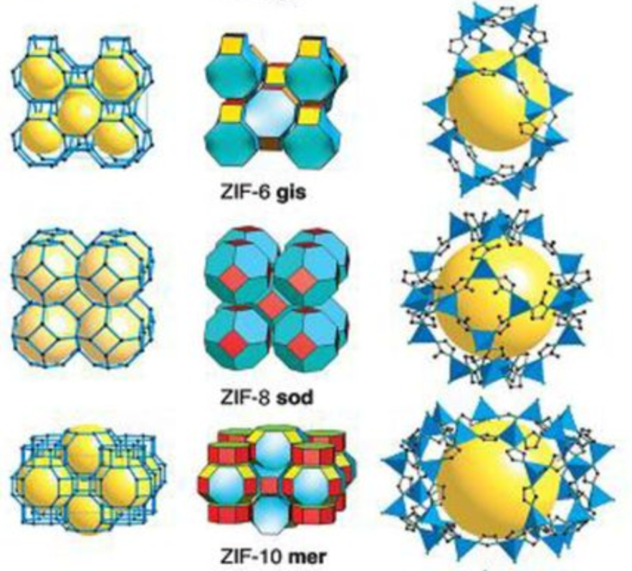
Microscale Diffusion in Mixed Linker Zeolitic Imidazolate Framework
Samuel Berens¹, Christian Chmelik², Febrian Hillman³, Jörg Kärger², Hae-Kwon Jeong³, Sergey Vasenkov¹
University of Florida; 2. Leipzig University; 3. Texas A&M University
Funding Grants: G.S. Boebinger (NSF DMR-1157490, NSF DMR-1644779);
H.-K. Jeong (NSF CMMI-1561897); S. Vasenkov (NSF CMMI-1561347)
What is the finding? It is demonstrated for the first time that high field NMR can be combined with infrared (IR) microscopy to quantify and understand microscopic gas transport in a novel class of porous molecular sieves. These materials are highly promising candidates for gas separation applications.
Why is this important? Porous membranes made with materials like Zeolitic Imidazolate Frameworks (ZIFs) hold the potential to reduce the energy costs for gas separations as much as tenfold in comparison with the currently used technologies. This represents a significant improvement because about half of the energy required for industrial-scale gas production is used for separations. However, in order to design molecular sieves to separate a specific gas from a mixture of gases, scientists must develop a fundamental understanding of molecular transport on microscopic length scales.
Why did this research need the MagLab? This research relied on MagLab instrumentation that combines high magnetic field and large magnetic field gradients in NMR diffusion studies.
(Above) Schematics of ethane diffusion in ZIF-7-8. (Below) Several of the dozens of ZIF structures.
Facilities used: AMRIS (Avance III HD 750 MHz and Avance III 600 MHz)
Citation: S. Berens, C. Chmelik, F. Hillman, J. Karger, H.K. Jeong, S. Vasenkov,
Ethane diffusion in mixed linker zeolitic imidazolate framework-7-8 by pulsed field gradient NMR in combination with single crystal IR microscopy, Phys. Chem. Chem. Phys., 20 (37), 23967-23975 (2018), DOI: 10.1039/c8cp04889d
Notes:
1. What is the finding?
Here to be included a short description in layman language of the finding
2. Why this finding is important?
A short description of why the finding is important for scientific community, technology, society, etc…
3. Why NHMFL?
The answer to this question should provide information on why this finding could be achieved (only) at NHMFL (what unique capability of MagLab was essential for this finding).

