Slide 1
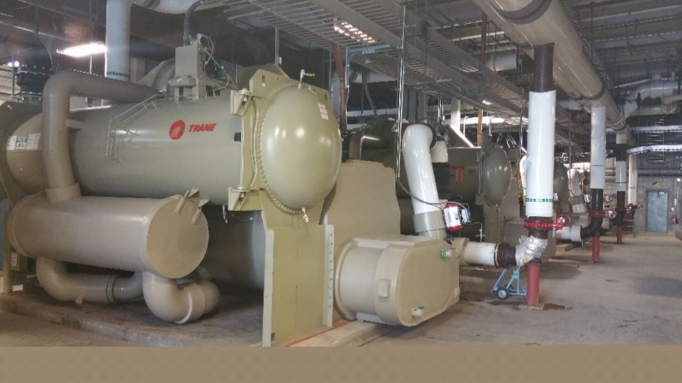
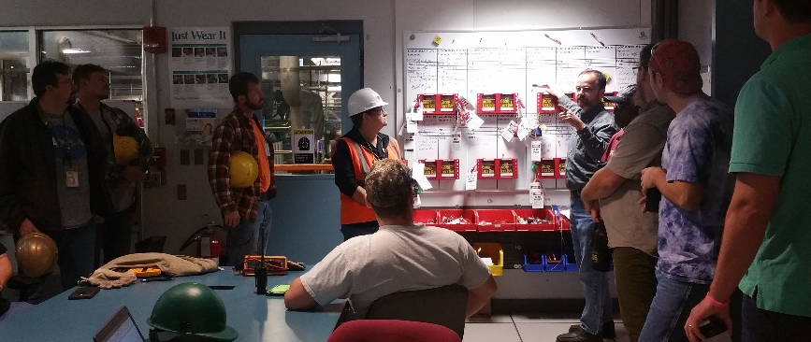
Facility Upgrades Enhance Safety & Reliability
National High Magnetic Field Laboratory
Funding Grants: G.S. Boebinger (NSF DMR-1644779)
During its annual maintenance shutdown in late 2018, the MagLab replaced four massive chillers that cool and circulate water to keep our resistive DC magnets from becoming molten metal when energized. The cooling tower basins were cleaned to reduce the potential for bacterial growth. During a week-long labwide power shutdown, the MagLab’s aging 4160V switchgear was replaced with more reliable new systems that will reduce arc flash hazards. Most importantly, however, new electrical disconnect switches were installed between the Power Supply Breakers and the DC Power Supply Transformers, a modification that simplifies the MagLab’s Lock/Tag/Verify process for electrical work, further reducing the likelihood of exposing workers to arc flash hazards.
For months prior to the shutdown, detailed work plans were developed for MagLab workers and visiting contractors in order to manage the many applications of Lock/Tag/Verify required to ensure that all hazardous energy sources were safely controlled during this complex and busy time.
To facilitate safe work, each morning, all workgroups including contractors met together to review and discuss each group’s planned work for the day. Also discussed were any difficulties or lessons learned from the previous workday. Despite numerous inter-dependent work processes and workgroups involved with the shutdown, using Integrated Safety Management, all employees and contractors safely completed all work assignments.
One Chiller, Unloaded on Site
(MagLab Director is 2 meters tall, including hard hat)
View of Four New Chillers, Installed
Acknowledgements: Directors Office, Health &Safety,
Facilities, Operations, Cryogenics, DC Magnets
Workers Conducting Daily Pre-Work Meeting

