Slide 1
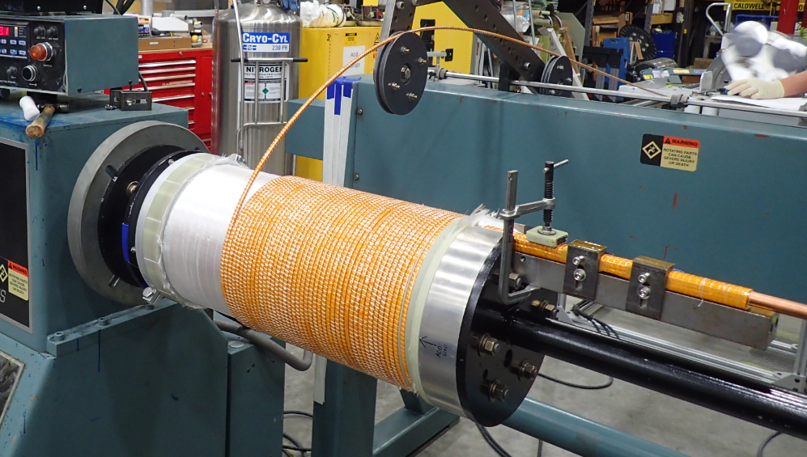
In-House Fabrication of Outsert Coil 1 for the 100T Pulsed Magnet
Iain Dixon¹, Todd Adkins¹, Ke Han¹, Doan Nguyen²
National High Magnetic Field Laboratory, Florida State University,Tallahassee FL
NHMFL Pulsed Field Facility, Los Alamos National Laboratory, Los Alamos NM
Funding Grants: G.S. Boebinger (NSF DMR-1157490, NSF DMR-1644779)
Pulsed magnets provide an excellent example of applied metal fatigue: magnets simply wear out after a certain design lifetime and must be replaced. MagLab engineers and technicians at our Tallahassee and Los Alamos campuses have recently collaborated to fabricate a large coil for the outer coil set of the 100T pulsed magnet, which is the flagship magnet of our Pulsed Field Facility. This is the first pulsed coil of such a large size to be fabricated in-house.
Previously, pulsed coils of this size were made commercially. However, a few years ago, the MagLab developed the capability to fabricate much larger superconducting coils using cable-in-conduit (CIC) superconductors for hybrid magnets now in Tallahassee, Berlin, and Nijmegen. The capabilities previously developed for CIC magnets are now enabling our own large pulsed coils to be fabricated in-house at the MagLab.
All conductor undergoes extensive nondestructive examination via eddy currents and the wound coil is inspected for quality through a number of electrical checks. Fabrication of the first coil in Tallahassee has been completed and the coil was delivered to the Los Alamos campus for final reinforcement.
In-house fabrication enables a much higher level of quality control of these exotic coils that must incorporate high-strength nano-composite conductors, highly-deformable Nitronic-40 shells, high modulus metal sheets, and a commercial fiber-epoxy overwrap in order to deliver world record pulses to the MagLab’s users.
Above: Winding of the 65cm long pulsed coil. The leads to and from the coil can be seen extending another 24cm to the right.
Right: View down the 22.5cm diameter bore of the near completed coil, into which the insert coil for the 100T pulsed magnet will fit.
Facilities used: Magnet Science & Technology Division, Large Coil Fabrication Facility; Pulsed Field Facility, Magnet Engineering Team.
Citation: D. N. Nguyen, J. Michel, C. H. Mielke, “Status and Development of Pulsed Magnets at the NHMFL Pulsed Field Facility”, IEEE Transactions on Applied Superconductivity, v 26, n 4, June 2016, DOI 10.1109/TASC.2016.2515982

Slide 2
In-House Fabrication of Outsert Coil 1 for the 100T Pulsed Magnet
Iain Dixon¹, Todd Adkins¹, Ke Han¹, Doan Nguyen²
National High Magnetic Field Laboratory, Florida State University,Tallahassee FL
NHMFL Pulsed Field Facility, Los Alamos National Laboratory, Los Alamos NM
Funding Grants: G.S. Boebinger (NSF DMR-1157490, NSF DMR-1644779)
Pulsed magnets are under such intense pressures when they are energized to high magnetic fields that they simply wear out after a certain number of pulses and must be replaced. The 100T Pulsed Magnet is the flagship magnet at the MagLab’s Pulsed Field Facility, holding the world record for non-destructive generation of a magnetic field by a pulsed magnet. The magnet has reached 100.75T, but is routinely operated at 92T to 95T to reduce the risk of the magnet wearing out.
What is the finding? Recent advances in big-coil fabrication at the MagLab and an increased understanding of high strength materials has enabled in-house fabrication of outsert coils for the MagLab’s largest pulsed magnets. We expect that this in-house fabrication will enable more rigorous quality control during fabrication to improve the reliability and lifetime of the 100T Pulsed Magnet, such that coils can be replaced less frequently.
Why is this important? The MagLab’s users benefit from higher magnetic fields because they yield scientific discoveries. More reliable and stronger coils result in improved and extended magnet performance and, thus, greater access to higher fields.
Why did this research need the MagLab? The MagLab leads the world in high-field magnet technology development and magnet engineering. Expertise developed from winding large superconducting coils has been coupled with pulsed magnet expertise to advance the state of the art for pulsed coil fabrication.
Above: Winding of the 65cm long pulsed coil. The leads to and from the coil can be seen extending another 24cm to the right.
Right: View down the 22.5cm diameter bore of the near completed coil, into which the insert coil for the 100T pulsed magnet will fit.
Facilities used: Magnet Science & Technology Division, Large Coil Fabrication Facility; Pulsed Field Facility, Magnet Engineering Team.
Citation: D. N. Nguyen, J. Michel, C. H. Mielke, “Status and Development of Pulsed Magnets at the NHMFL Pulsed Field Facility”, IEEE Transactions on Applied Superconductivity, v 26, n 4, June 2016, DOI 10.1109/TASC.2016.2515982

