Slide 1
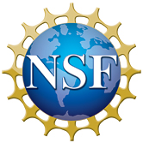
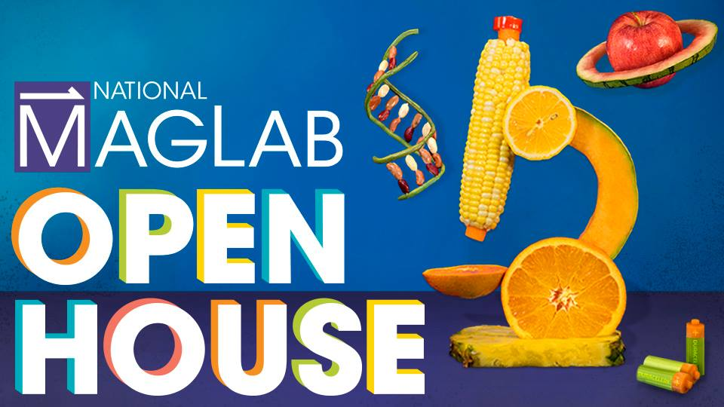
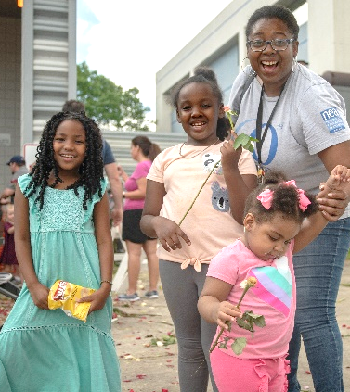
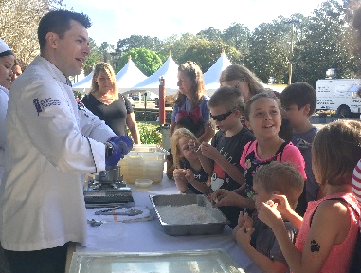
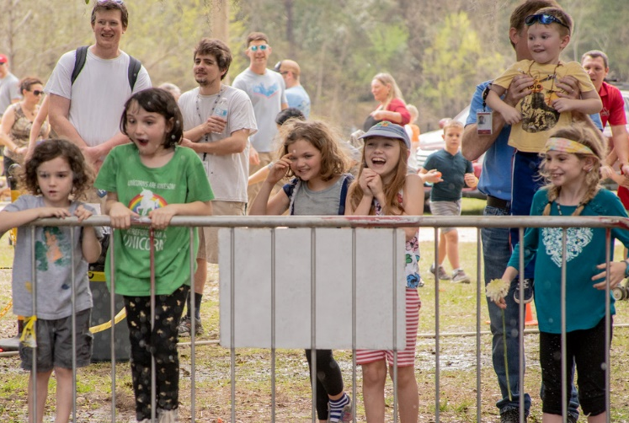
Largest Crowd Ever at the 2019 MagLab Open House
Funding Grants: G.S. Boebinger, National High Magnetic Field Laboratory, Florida State University
(NSF DMR-1644779)
More than 10,800 visitors came to the MagLab from across the southeast to sample the one hundred hands-on demonstrations to be found at “Science and Food”, the 2019 MagLab Open House science smorgasbord… shattering our previous record of 8400 visitors.
The MagLab wrote the recipe for science, featuring more than thirty community partners, including the Florida State University Nutrition Department, Florida A&M University’s Vitaculture, Keiser University’s Culinary Arts, and the Florida Department of Agriculture’s Food Safety Division…each of whom helped visitors learned about the science of food.
Visitors enjoyed a taste test of science: Molecular Cuisine, Glowing Pickles, Easy Bike Ovens, Einstein’s Ice Cream, Pitch-Perfect Marshmallows and special Moiré music at the world’s strongest DC magnet – the 45T Hybrid Magnet.

