Slide 1
NMR-based Metabolomics of Coral with Resistance to Bleaching
Kathryn E. Lohr^{1*}, Ram B. Khattri², Joy Guingab-Cagmat³, Emma F. Camp⁴, Matthew E. Merritt²,
Timothy J. Garrett³, Joshua T. Patterson^{1,5}
University of Florida (UF) Fisheries and Aquatic Sciences; 2. UF Biochemistry & Molecular Biology;
3. UF Pathology; 4. University of Technology Sydney; 5. The Florida Aquarium
Funding Grants: G.B. Boebinger (NSF DMR-1157490, NSF DMR-1644779); SECIM (NIH U24 DK097209);
NMR-based metabolite profiling of bio fluids is exquisitely sensitive to changes in metabolism, including coral samples used in this study [A]. High-resolution ¹H spectra can generate a significant amount of metabolic data and, in conjunction with multivariate analysis, can be effective for determining variability of metabolomic profiles among unique coral genotypes. ¹H NMR spectra revealed unique metabolomic profiles for multiple samples from three genetically distinct variants (U25, U41, and U44) of the coral Acropora cervicornis living in a common coral nursery.
¹H NMR spectra from methanol extracted A. cervicornis metabolite samples were collected at 14.1T. Fifty-nine chemical shifts that significantly differed between genotypes of A. cervicornis were identified with analysis of variance (ANOVA). Principal Component Analysis (PCA) [B] and Partial Least Squares Discriminant Analysis (PLS-DA) [C] found 72.8% and 70.8%, respectively, of total variance among genotypes in components 1 and 2. Clusters for genotypes U25 (red) and U44 (blue) are relatively separated while U41 (green) is not. Trimethyl-amine-N-oxide, a molecule that protects against nitrogen overload, is a primary driver of species differences.
These data provide insights into the previously unknown metabolism of corals that have a superior survivability in the face of increased coral bleaching.
A
Principal Component Analysis score plot
Partial Least Squares Discriminant Analysis score plot
[A] Three genotypes of Acropora cervicornis from an established coral
nursery near Tavernier, FL used in this study;
[B] PCA score plot with explained variances enclosed in brackets,
[C] PLS-DA score plot with explained variances enclosed in brackets.
Facilities and instrumentation used: Bruker 600 MHz NMR system with 5 mm cryoprobe at the MagLab’s AMRIS Facility.
Citation: Lohr, K.E.; Khattri, R.B.; Guingab-Cagmat, J.; Camp, E.F.; Merritt, M.E.; Garrett, T.J.; Patterson, J.T., Metabolomic profiles differ among unique genotypes of a threatened Caribbean coral, Nature Scientific Reports, 9, 6067 (2019). DOI: 10.1038/s41598-019-42434-0

Slide 2
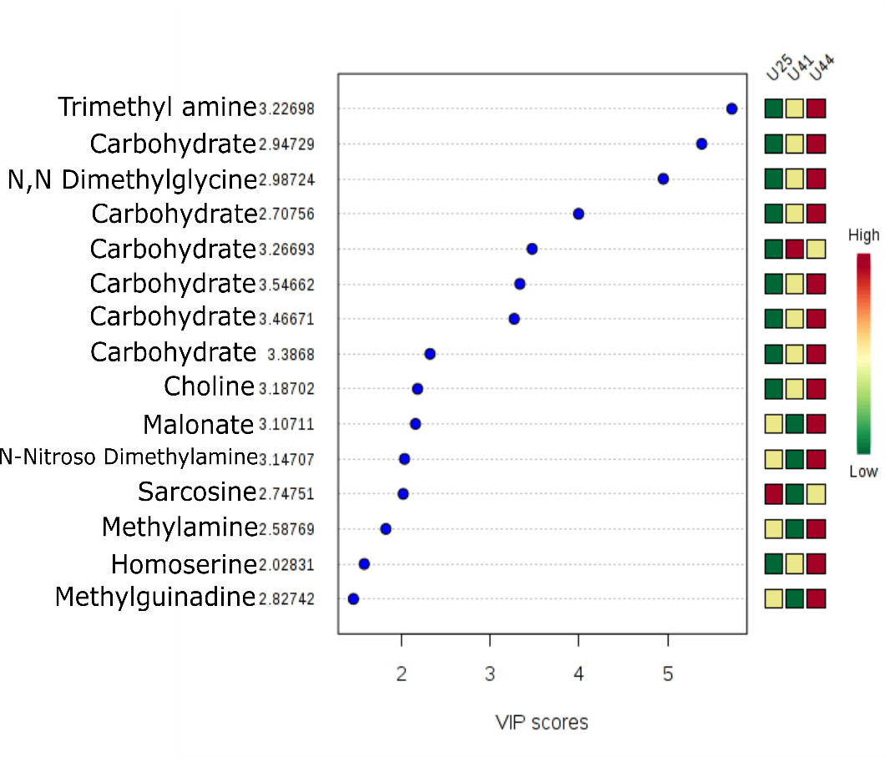
NMR-based Metabolomics of Coral with Resistance to Bleaching
Kathryn E. Lohr^{1*}, Ram B. Khattri², Joy Guingab-Cagmat³, Emma F. Camp⁴, Matthew E. Merritt²,
Timothy J. Garrett³, Joshua T. Patterson^{1,5}
University of Florida (UF) Fisheries and Aquatic Sciences; 2. UF Biochemistry & Molecular Biology;
3. UF Pathology; 4. University of Technology Sydney; 5. The Florida Aquarium
Funding Grants: G.B. Boebinger (NSF DMR-1157490, NSF DMR-1644779); SECIM (NIH U24 DK097209);
What is the finding? Different genotypes are found to have unique metabolic signatures for a particular coral species (A. cervicornis growing in a common garden, [A]) that exhibits a superior survivability in the face of increased coral bleaching. Levels of the metabolite Trimethyl-amine-N-oxide, a molecule that protects against nitrogen overload can distinguish the three genotypes studied. Some carbohydrates and fatty acids were also found to be significant in distinguishing between genotypes.
Why is this important? The global threat to coral reef growth is mounting. The loss of coral reefs has tremendous impacts on global ecology and fisheries. An understanding of the same-species variation in coral metabolite profiles could help understand mechanisms that promote coral survival and performance in stressed environments. Creating metabolomics profiles for different species could inform the coral selections most suitable for restoration of coral reefs.
Why did this research need the MagLab? Coral metabolism is largely unstudied. By accessing the instrumentation and expertise at the MagLab’s AMRIS facility, this collaboration demonstrated ¹H NMR-based metabolomics to be a powerful technique that can distinguish metabolism among different corals.
A
U25-a-2
U41-a-2
U44-a-3
U25
U41
U44
B
High
Low
[A] Three genotypes of Acropora cervicornis from this study.
[B] List of studied metabolites listed beginning with those most able to distinguish among the three genotypes studied. The relative concentrations of each metabolite are represented by color boxes at right.
Facilities and instrumentation used: Bruker 600 MHz NMR
system with 5 mm cryoprobe at the MagLab’s AMRIS Facility.
Citation: Lohr, K.E.; Khattri, R.B.; Guingab-Cagmat, J.; Camp, E.F.; Merritt, M.E.; Garrett, T.J.; Patterson, J.T., Metabolomic profiles differ among unique genotypes of a threatened Caribbean coral, Nature Scientific Reports, 9, 6067 (2019). DOI: 10.1038/s41598-019-42434-0

