Slide 1
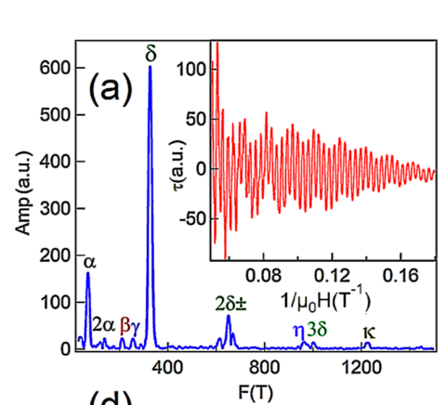
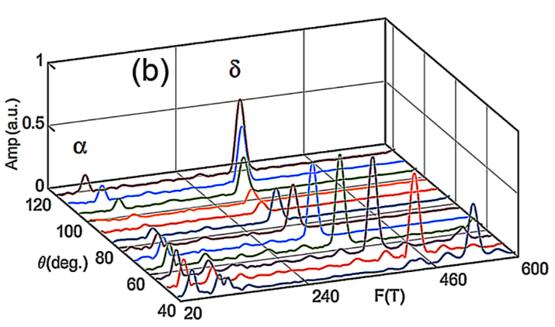
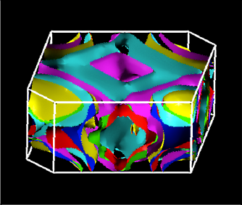
Evidence Supporting BiPd as a Topological Superconductor
Mojammel A. Khan¹, D. E. Graf², I. Vekhter¹, D. A. Browne¹, J. F. DiTusa¹, W. Adam Phelan^{1,†}, and D. P. Young¹ 1. Louisiana State University; 2. National High Magnetic Field Laboratory;
†. Current address: The Johns Hopkins University
Funding Grants: G.S. Boebinger (NSF DMR-1157490); D.P. Young (NSF DMR-1306392);
I. Vekhter (NSF DMR-1410741); J.F. DiTusa and D.P.Y.(DoE SC0012432)
Topological materials are scientifically fascinating and technologically appealing due to their unique electronic properties and behavior. The superconductor, BiPd, has the possibility of being a topological superconductor by virtue of its crystal structure being noncentrosymmetric, which means its crystal structure lacks a center of inversion symmetry. Its large spin-orbit coupling is therefore antisymmetric, making it a likely candidate material to host a topological superconducting state.
One method of determining if topological states are present is by measuring the Fermi surface of a material. This was accomplished via torque magnetometry, a technique that is highly sensitive to changes in the magnetization and allows a measurement of the angular dependence of the de Haas-van Alphen effect. The measurements were performed in a 35T resistive magnet coupled to a cryostat with a base temperature of 350 mK. Data from sweeping the magnetic field (a) are combined to produce (b) a map of the Fermi surface as a function of angle, which are compared to (c) calculations of the Fermi surface. Analysis of these data revealed that a nontrivial Berry phase is associated with the 𝛼 frequency, strongly suggesting the presence of topological states in bulk BiPd.
Facilities used: DC Field Facility, 35-Tesla resistive magnet (Cell 12).
Citation: Khan, M.A.; Graf, D.E.; Vekhter, I.; Browne, D.A.; DiTusa, J.F.; Phelan, W.A.; Young, D.P., Quantum oscillations and a nontrivial Berry phase in the noncentrosymmetric topological superconductor candidate BiPd, Phys. Rev. B Rapid Commun., 99, 020507 (2019) DOI: 10.1103/PhysRevB.99.020507.
(c)
(a) Inset: Quantum oscillations in the sample’s magnetization, measured by a torque cantilever magnetometer. Main panel: Fourier transform of these quantum oscillations between 5 and 20 T. The primary frequencies and their higher harmonics are labeled in the figure. These frequencies are inversely proportional to the extremal areas of the Fermi surface. (b) Frequency vs. angle map arising from shapes of the Fermi surface. (c) The calculated Fermi surface of BiPd projected into the first Brillouin zone. It is complex, 3-dimensional, and composed of multiple sheets.

Slide 2
Evidence Supporting BiPd as a Topological Superconductor
Mojammel A. Khan¹, D. E. Graf², I. Vekhter¹, D. A. Browne¹, J. F. DiTusa¹, W. Adam Phelan^{1,†}, and D. P. Young¹ 1. Louisiana State University; 2. National High Magnetic Field Laboratory;
†. Current address: The Johns Hopkins University
Funding Grants: G.S. Boebinger (NSF DMR-1157490); D.P. Young (NSF DMR-1306392);
I. Vekhter (NSF DMR-1410741); J.F. DiTusa and D.P.Y.(DoE SC0012432)
What is the finding? Measured magnetization oscillations in BiPd support the assertion that it is a topologically nontrivial superconductor. This finding adds to the growing list of the unique topological properties of BiPd.
Why is this important? The number of known topological superconductors is small. If further research confirms that BiPd is indeed a topological superconductor, this would provide a system perfect for exploring spin-orbit coupling experiments, which could provide an inroad to the manipulation of nontrivial superconducting phases.
Why did this research need the MagLab? Observing de Haas-van Alphen (dHvA) oscillations in this material required MagLab-size magnetic fields. The MagLab’s torque magnetometry probe is extremely sensitive to changes in the sample’s magnetization, and its rotation capabilities allow users to map the angular dependence of dHvA oscillations. Users then compare this experimental map to the calculated Fermi Surface, which further reinforced the case for topological superconductivity in BiPd.
Facilities used: DC Field Facility, 35-Tesla resistive magnet (Cell 12).
Citation: Khan, M.A.; Graf, D.E.; Vekhter, I.; Browne, D.A.; DiTusa, J.F.; Phelan, W.A.; Young, D.P., Quantum oscillations and a nontrivial Berry phase in the noncentrosymmetric topological superconductor candidate BiPd, Phys. Rev. B Rapid Commun., 99, 020507 (2019) DOI: 10.1103/PhysRevB.99.020507.
(c)
(a) Inset: Quantum oscillations in the sample’s magnetization, measured by a torque cantilever magnetometer. Main panel: Fourier transform of these quantum oscillations between 5 and 20 T. The primary frequencies and their higher harmonics are labeled in the figure. These frequencies are inversely proportional to the extremal areas of the Fermi surface. (b) Frequency vs. angle map arising from shapes of the Fermi surface. (c) The calculated Fermi surface of BiPd projected into the first Brillouin zone. It is complex, 3-dimensional, and composed of multiple sheets.

