Slide 1
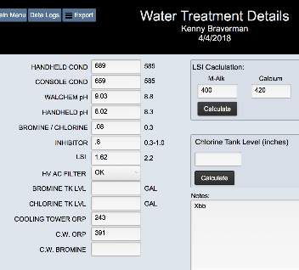
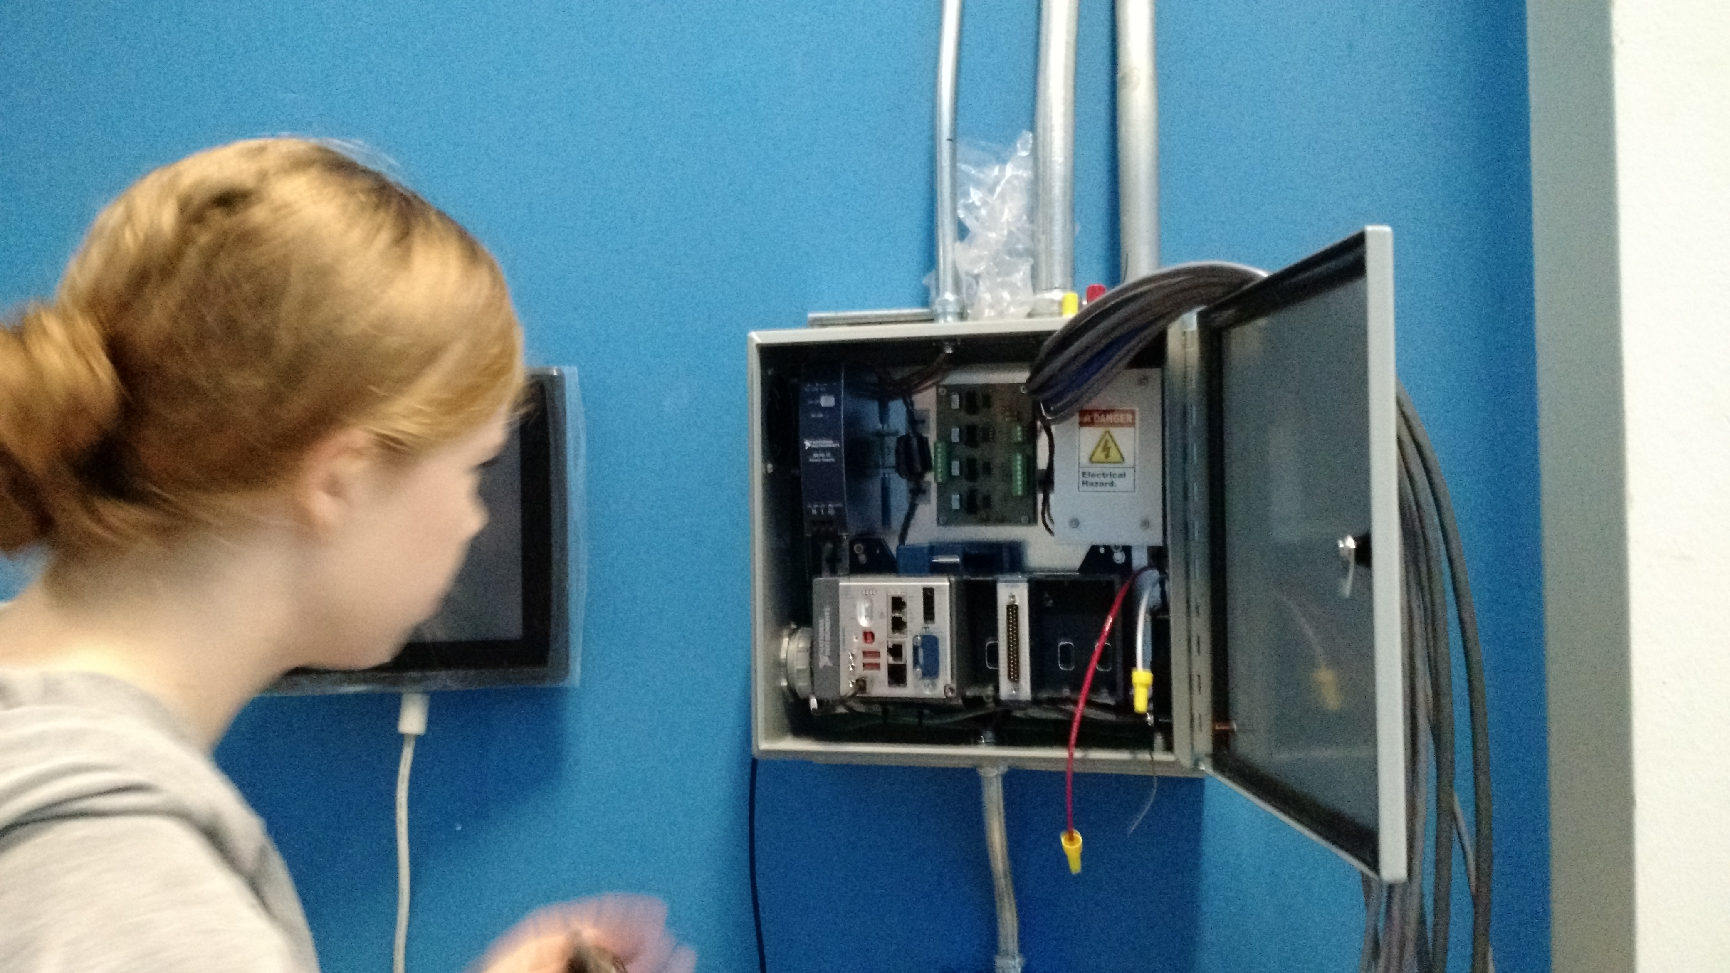
MagLab Undergraduate Researcher Wins
Regional Student Employee of the Year Award
A. L. Centers & J. H. Smith, National High Magnetic Field Laboratory, Florida State University
Funding Grants: G.S. Boebinger (NSF DMR-1157490, NSF DMR-1644779)
Abigail Centers, an undergraduate research assistant at the MagLab’s DC Field Facility, was honored on April 8, 2019 with the Florida State University (FSU) “Tony DiBenedetto” Student Employee of the Year (SEOTY) Award. The award honors the outstanding undergraduate employee who on “a daily basis demonstrates strength, skill, and character while delivering exceptional customer service and always going above and beyond the duties of their role”.
Abigail advanced to the regional competition, where the Southern Association of Student Employment Administrators (SASEA) selected Abigail Centers as the “2019 SASEA Student Employee of the Year” from a group of 800 students representing 22 institutions across the Southeastern US. This places Abigail among a group of the top four student employees nationally. Both awards emphasize the importance of the contributions that students make to research and educational institutions.
These awards recognized outstanding programming work for the MagLab’s DC Field Facility that started in 2017 when Abigail was an REU (Research Experiences for Undergraduates) student with a goal of getting acquainted with “real world” programming projects.
Photograph by V. Centers.
Examples of Abigail’s work include developing a database to store, display and distribute information from the MagLab’s cooling water quality control data. She also developed a power supply monitoring system for the MagLab’s resistive magnet power supplies, which monitor and record the performance of the four 14.5 MW power supplies in real-time and archive this data to one of the laboratory’s servers. The Power Supply Monitor program is written in LabView code based on an FPGA/cRIO system. The Power Supply Monitor program has become a critical part of the MagLab’s DC Magnet operations.
Centers and her mentor Smith at the SEOTY award ceremony at Florida State University
Facility: DC Field Facility.
Citation: NHMFL SEOTY website article, FSU SEOTY website article, NHMFL Database website article.
Photograph by J. H. Smith.
(Right) Water Treatment Database user graphical interface.
(Left) Centers during installation of the Power Supply monitoring hardware.

