Slide 1
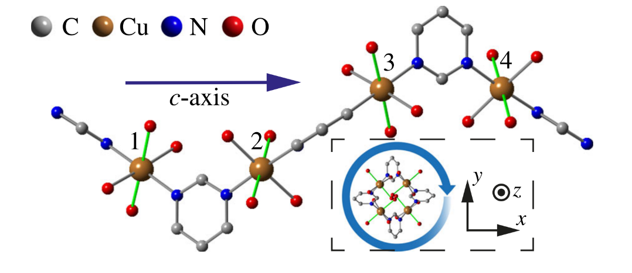
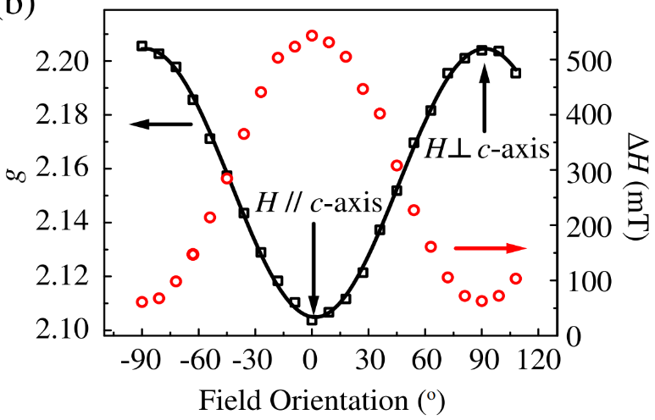
Anomalous Spin Excitations in a Chiral Staggered Chain
J. Liu¹, S. Kittaka², R. D. Johnson¹, T. Lancaster³, J. Singleton⁴, T. Sakakibara², Y. Kohama², J. van Tol⁵,
A. Ardavan¹, B. H. Williams¹, S. J. Blundell¹, Z. E. Manson⁶, J. L. Manson⁶, and P. A. Goddard⁷.
Univ. of Oxford, UK; 2. Univ. of Tokyo, Japan; 3. Durham Univ. UK; 4. NHMFL, Los Alamos; 5. NHMFL, Tallahassee; 6. Eastern Washington Univ.; 7. Univ. of Warwick, UK.
Funding Grants: G.S. Boebinger (NSF DMR-1157490, NSF-DMR1644779); P.A. Goddard (EPSRC, ERC-681260); J.L.Manson (DMR-1703003); R.D.Johnson (Royal Society)
For anti-ferromagnets (AFMs), there can be an energy difference between the ground state and first excited state (a gapped AFM) or this energy difference can be zero (a gapless AFM), in which the AFM is driven purely by quantum mechanics rather than anisotropy. An applied magnetic field can drive quantum phase transitions between gapped and gapless phases. S=1/2 anti-ferromagnetic Heisenberg chains typically remain gapless, but alternating local spin environments can lead to a field-induced spin gap. This study looked at a system with a chiral staggered spin environment and finds a behavior different than for non-chiral staggered systems, due to additional terms involving a uniform Dzyaloshinskii-Moriya coupling and a fourfold periodic staggered field.
The experiments of magnetometry, heat capacity, electron spin resonance and the theoretical analysis involved a diverse group of scientist from the UK, Japan, and the US. The high magnetic field Electron Magnetic Resonance available at the MagLab was a crucial component to the success of this study of this chiral staggered spin chain.
The results demonstrate that spin chains with a screw symmetry can present a remarkable suppression of the magnetic-field-induced spin gap. This opens the quest for finding other materials where anisotropic interactions and particular crystal symmetries conspire to enable entirely novel magnetic states.
Fig. 1. Chain Structure of Cu(pym)(H₂O)₄SiF₆·H₂O. Staggered elongated Cu-O bonds(green) correspond to local g_{ǁ} axes
Fig. 2. Orientation dependence of Cu(II) g-factor and linewidth at 300K.
Facilities: EMR facility, 12.5T magnet, Tallahassee, and NHMFL Los Alamos National Lab.
Citation: Liu, J.; Kittaka, S.; Johnson, R.D.; Lancaster, T.; Singleton, J.; Sakakibara, T.; Kohama, Y.; van Tol, J.; Ardavan, A.; Wiliams, B.H.; Blundell, S.J.; Manson, Z.E.; Manson, J.L.; Goddard, P.A., Unconventional Field-Induced Spin Gap in an S = 1=2 Chiral Staggered Chain,Phys. Rev. Lett., 122, 057207 (2019) DOI: 10.1103/PhysRevLett.122.057207

Slide 2
Anomalous Spin Excitations in a Chiral Staggered Chain
J. Liu¹, S. Kittaka², R. D. Johnson¹, T. Lancaster³, J. Singleton⁴, T. Sakakibara², Y. Kohama², J. van Tol⁵,
A. Ardavan¹, B. H. Williams¹, S. J. Blundell¹, Z. E. Manson⁶, J. L. Manson⁶, and P. A. Goddard⁷.
Univ. of Oxford, UK; 2. Univ. of Tokyo, Japan; 3. Durham Univ. UK; 4. NHMFL, Los Alamos; 5. NHMFL, Tallahassee; 6. Eastern Washington Univ.; 7. Univ. of Warwick, UK.
Funding Grants: G.S. Boebinger (NSF DMR-1157490, NSF-DMR1644779); P.A. Goddard (EPSRC, ERC-681260); J.L.Manson (DMR-1703003); R.D.Johnson (Royal Society)
Figure: Chain Structure of Cu(pym)(H₂O)₄SiF₆·H₂O, showing staggered elongated Cu-O bonds (green) along the chain.
What is the finding? We find a material that forms chains of atoms (see figure) in which the magnetic fields of the copper ions are lined up in a screw-like manner (along the green lines in the figure), orienting in different directions as one moves down the chain. We find that key magnetic properties are quite different than for systems that do not have this screw symmetry.
Why is this important? Understanding the magnetism of materials is not only of importance to the scientific theory of matter, but also for the development of new materials for technological applications, like information storage and information processing.
Why did this research need the MagLab? This study looked at the magnetic and thermodynamic properties of this material as a function of the magnetic field. The high electrical frequencies and magnetic fields, as well as the sensitivity of the unique magnetic resonance spectrometers at the MagLab, were all crucial for the successful investigation of this material.
Facilities: EMR facility, 12.5T magnet, Tallahassee, and NHMFL Los Alamos National Lab.
Citation: Liu, J.; Kittaka, S.; Johnson, R.D.; Lancaster, T.; Singleton, J.; Sakakibara, T.; Kohama, Y.; van Tol, J.; Ardavan, A.; Wiliams, B.H.; Blundell, S.J.; Manson, Z.E.; Manson, J.L.; Goddard, P.A., Unconventional Field-Induced Spin Gap in an S = 1=2 Chiral Staggered Chain,Phys. Rev. Lett., 122, 057207 (2019) DOI: 10.1103/PhysRevLett.122.057207

