Slide 1


Luttinger Liquid Behavior of Helium-Three in Nanotubes
J. Adams¹, D. Candela², C. Huan¹, M. Lewkowitz¹, N. Sullivan¹,
University of Florida; 2. University of Massachusetts
Funding Grants: G.S. Boebinger (NSF DMR-1157490, NSF DMR-1644779); C. Huan(NHMFL-UCGP)
Considerable experimental effort has been devoted to exploring the fundamental properties of one-dimensional (1D) systems in which strong correlations render all excitations to be collective. These systems are theoretically described in terms of a Tomonaga-Luttinger liquid (TTL) state, one of the few exact quantum mechanical solutions of a strongly-correlated system.
Helium-3 (³He) adsorbed in mesoporous materials that contain nanoscale 1D channels can serve as a model system for studying TTL physics of uncharged systems. The line density can be varied in a controlled manner and NMR methods can measure particle dynamics over a wide temperature range.
NMR techniques ‒ developed at the MagLab’s High B/T Facility to enable high sensitivity measurements of the dynamics of atoms at very low temperatures ‒ have been used to measure the thermal relaxation of ³He atoms confined to the interior of “MCM-41” nanotubes at temperatures near the fermi degeneracy temperature, T_{F} ~ 0.075K.
The observed spin-lattice relaxation time (see Figure) shows the expected peak in the relaxation rate at the temperature T=2T_{F}, as well as behavior consistent with the expected linear decrease at lower temperatures, measured by NMR down to ~50mK, indeed, an extremely low temperature for successful NMR measurements! These results verify predictions of the landmark TTL theory for uncharged Fermi atoms confined to one dimension, i.e. within nanochannels featuring a diameter comparable to the atoms’ deBroglie wavelength.
Figure: Temperature dependence of the nuclear spin-lattice relaxation time of ³He atoms confined to the interior of ⁴He-plated nanotubes of diameter comparable to the atoms’ deBroglie wavelength. The solid red line is scaled from the calculations of Polini et al. [Phys. Rev. Lett. 98, 26403 (2007)]. The deviation at 0.4K (red arrow) is associated with the first excitation level for transverse motion in the tubes.
Facilities and instrumentation used: Bay2 of the High B/T Facilities were used for the measurements.
Citation: Huan, C.; Adam, J.; Lewkowitz, M.; Masuhara, N.; Candela, D.; Sullivan, N.S., Nuclear Spin Relaxometry of 3He Atoms Confined in Mesoporous MCM-41, J. Low Temp. Phys., 196 (1-2), 308-313 (2019) doi.org/10.1007/s10909-018-02123-0

Slide 2
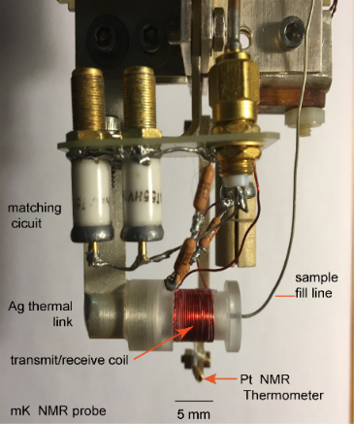
Luttinger Liquid Behavior of Helium-Three in Nanotubes
J. Adams¹, D. Candela², C. Huan¹, M. Lewkowitz¹, N. Sullivan¹,
University of Florida; 2. University of Massachusetts
Funding Grants: G.S. Boebinger (NSF DMR-1157490, NSF DMR-1644779); C. Huan(NHMFL-UCGP)
What is the finding? The motions of atoms in a liquid comprised of the rare version of helium, known as “helium-three” (or ³He), is determined from nuclear magnetic resonance (NMR) measurements of the alignment of the magnetic fields of the helium atoms. We find that the temperature dependence of this magnetic field alignment, when the liquid is confined to long nanotubes, follows the prediction expected for an exotic quantum mechanical fluid called a Luttinger liquid.
Why is this important? The Luttinger liquid theory is a triumph of theoretical physics, as it is one of the few exactly solved problems in quantum mechanics for systems of strongly interacting particles. Acquiring experimental results that can confirm (or refute) these theoretical predictions is very challenging and very important to verify (or undermine) this prominent, cutting-edge theory.
Why did this research need the MagLab? The unique high-sensitivity low-temperature NMR spectrometer of the high B/T Facility was needed for this experiment, because the NMR signal is greatly reduced by a fundamental property of helium-three at these low temperatures (known technically as “the onset of Fermi degeneracy”).
Figure: The photo shows the NMR probe used for the ultra-low temperature NMR measurements. The NMR coil is the red wire labeled “transmit/receive coil”. The helium-three atoms are introduced to the nanotubes located in the interior of the NMR coil through the “sample fill line”. The entire system is in contact with the low temperatures generated by the refrigerator through the silver piece labelled “Ag thermal link.”
Facility used: Bay 2 of the High B/T Facility
Citation: Huan, C.; Adam, J.; Lewkowitz, M.; Masuhara, N.; Candela, D.; Sullivan, N.S., Nuclear Spin Relaxometry of 3He Atoms Confined in Mesoporous MCM-41, J. Low Temp. Phys., 196 (1-2), 308-313 (2019)
doi.org/10.1007/s10909-018-02123-0

