Slide 1
Ultra-high Magnetic Fields Provide New Insights into Bone-like Materials
Bonhomme¹, Gervais¹, Gras,² Combes², Wang,³ Hung³, Gan³, Laurencin⁴
1 Sorbonne Univ (Paris, FR); 2 CIRIMAT (Toulouse, FR); 3 NHMFL (Tallahassee, USA); 4 ICGM (Montpellier, FR)
Funding Grants: G.S. Boebinger (NSF DMR-1157490, NSF DMR-1644779); C. Combes (ANR-16-CE19-0013)
Calcium is abundantly present in living organisms, most notably in mineralized tissues like bone and teeth. However, determining the local vicinity of calcium within such complex materials is far from trivial. In particular, techniques like Nuclear Magnetic Resonance (NMR) spectroscopy are highly challenging, because the NMR-active isotope, ⁴³Ca, is a spin 7/2 nucleus of poor natural abundance (0.14%) and low Larmor frequency.
Ultra-high and homogeneous magnetic fields are particularly suited to tackle the poor receptivity of calcium-43. This user collaboration utilized the MagLab’s 35.2T Series Connected Hybrid (SCH) magnet to study a series of synthetic biomaterials, both crystalline and amorphous, using ⁴³Ca solid state NMR. They find that the SCH’s unprecedented levels of sensitivity and resolution can, for example, resolve calcium environments in CaHPO₄ for the first time using a one-dimensional ⁴³Ca NMR experiment at 35.2T, a resolution that was not previously possible at 20.0T (see Figure).
Such analyses open the frontier for future, more detailed investigations of calcium environments in a variety of calcium-containing materials of great interest, including biomaterials, mineralized tissues, cement, and concrete. These in-depth structural analyses will allow a much more complete understanding of these materials, including the atomic-scale origin of their properties.
CaHPO₄ (monetite):
Four different local environments of calcium
⁴³Ca solid-state NMR of monetite
20.0 T
Increase in
sensitivity
and resolution
35.2 T
20
10
0
-10
-20
-30
-40
δ(⁴³Ca) /ppm
Facilities and instrumentation used: Series Connected Hybrid Magnet of the DC Magnet Facility.
Citation: C. Bonhomme, X.L. Wang, I. Hung, Z. Gan, C. Gervais, C. Sassoye, J. Rimsza, J.C. Du, M.E. Smith, J.V. Hanna, S. Sarda, P. Gras, C. Combes, D. Laurencin, Pushing the limits of sensitivity and resolution for natural abundance Ca-43 NMR using ultra-high magnetic field (35.2 T), Chemical Communications, 54 (69), 9591-9594 (2018) doi.org/10.1039/c8cc05193c

Slide 2
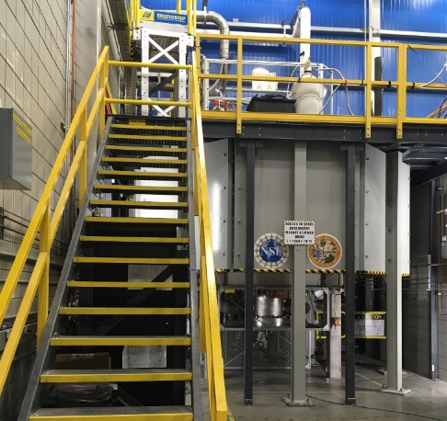
Ultra-high Magnetic Fields Provide New Insights into Bone-like Materials
Bonhomme¹, Gervais¹, Gras,² Combes², Wang,³ Hung³, Gan³, Laurencin⁴
1 Sorbonne Univ (Paris, FR); 2 CIRIMAT (Toulouse, FR); 3 NHMFL (Tallahassee, USA); 4 ICGM (Montpellier, FR)
Funding Grants: G.S. Boebinger (NSF DMR-1157490, NSF DMR-1644779); C. Combes (ANR-16-CE19-0013)
What is the finding? Researchers recently achieved unprecedented insight into the local atomic structure in the vicinity of calcium atoms within materials related to bones. This is leading to a more profound understanding of complex materials constructed from multiple components.
Why is this finding important? Bone and teeth are intrinsically complex mineralized tissues. They are known to be composed of calcium phosphate minerals, proteins (mainly collagen), and water. However, details on the structural relationship of these components at the atomic scale has been lacking, and precise information on the local structure around elements like calcium has been missing. This work shows that the MagLab’s new Series Connected Hybrid magnet enables researchers to access such information. This will not only deepen our knowledge of bone structure, but assist in developing novel materials for bone substitution and, potentially, regeneration. More generally, given the prevalence of calcium in many other materials, including cement and concrete, extending these techniques further will find a wide range of important materials to study.
Why the MagLab? The 36T Series Connected Hybrid offers uniquely high and uniform magnetic fields, suitable for the “magnetic resonance” techniques necessary to elucidate the local structure around calcium, providing information not accessible prior to the commissioning of this magnet.
Synthetic
calcium-containing biomaterials
Ultra-high and ultra-uniform magnetic fields
at the MagLab
Calcium-phosphates
related to bone
and dental tissues
35.2T
Magnetic Resonance
studies of calcium
to measure
the local environments
around the calcium atoms
20
0
-20
-40
δ(⁴³Ca) /ppm
Facilities and instrumentation used: Series Connected Hybrid Magnet of the DC Magnet Facility.
Citation: C. Bonhomme, X.L. Wang, I. Hung, Z. Gan, C. Gervais, C. Sassoye, J. Rimsza, J.C. Du, M.E. Smith, J.V. Hanna, S. Sarda, P. Gras, C. Combes, D. Laurencin, Pushing the limits of sensitivity and resolution for natural abundance Ca-43 NMR using ultra-high magnetic field (35.2 T), Chemical Communications, 54 (69), 9591-9594 (2018) doi.org/10.1039/c8cc05193c

