Slide 1
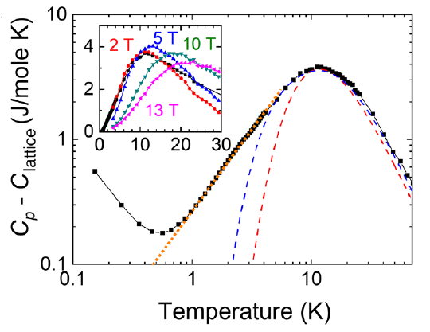
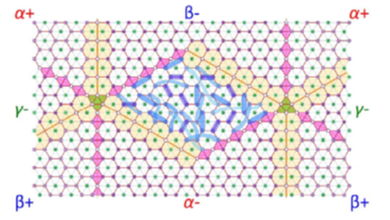
Spin Liquid “Lakes” with Topologically-Interesting Edge States in TbInO3
Jaewook Kim¹, Xueyun Wang¹, Fei-Ting Huang¹, Yazhong Wang¹, Xiaochen Fang¹, Xuan Luo², Y.Li^{1,3}, Meixia Wu^{1,4,} S.Mori⁵, D.Kwok¹, Eun Deok Mun^{6,7}, V.S. Zapf⁶, and Sang-Wook Cheong^{1,2} ¹Rutgers Univ; ²Max Plank POSTECH, Pohang Univ of Science and Technology; ³Shandong Univ; ⁴South China Univ of Technology, ⁵Osaka Prefecture Univ; ⁶NHMFL-Pulsed Field Facility, LANL; ⁷Simon Fraser Univ, Canada
Funding Grants: G.S. Boebinger (NSF DMR-1157490,1644779)
Recent pulsed magnet experiments support TbInO₃ as a spin liquid candidate in which structural and ferroelectric boundaries create topological edge states around the spin liquid regions.
TbInO₃ has a strongly frustrated 2D triangular structure of magnetic Tb ions. It is also a ferroelectric in which the In atoms can trimerize and the Tb atoms can be displaced above or below the 2D plane, creating six different kinds of ferroelectric domains (α±, β±, γ±). The atomically-sharp domain walls have different magnetic exchange interactions than the interior of the domains, which results in magnetic edge states.
MagLab users have explored this material down with specific heat down to 0.15 K and with magnetization in magnetic fields up to 65 teslas to rule out magnetic ordering in this material, while magnetic exchange interactions may be as much as 20 K, which suggests a spin liquid state in TbInO₃. In addition, both measurements imply an emergent honeycomb magnetic lattice, as only one of two Tb sites has a magnetic ground state. Thus, TbInO₃ is a honeycomb magnetic lattice with a spin liquid state. Theory indicates that the clean and atomically thin edges between spin liquid regions can host Majorana fermions.
Piezo-force microscopy and scanning tunneling electron microscopy on these single crystals finds the structural and ferroelectric domains that are shown in the figure.
Top: Magnetization to 60T (left). Heat capacity to < 1K (right). Bottom: Schematic of TbInO₃ describing three different structural/ferroelectric domains (α+,β−,γ−) as well as atomically-sharp domain walls. The innermost region (γ+) shows a snapshot of entangled spins (blue loops) in the spin liquid state
Reference: J.W. Kim, Y. Wang, F.T. Huang, Y. Wang, X. Fang, X. Luo, Y. Li, M. Wu, S. Mori, D. Kwok, E.D. Mun, V.S. Zapf, S.W. Cheong, Spin liquid state and topological structural defects in hexagonal TbInO3, Phys. Rev. X, 9, 031005 (2019) doi.org/10.1103/PhysRevX.9.031005
Facilities: 65 T magnets and PPMS (with dilution refrigerator) at the NHMFL-Pulsed Field Facility.

Slide 2
Spin Liquid “Lakes” with Topologically-Interesting Edge States in TbInO3
Jaewook Kim¹, Xueyun Wang¹, Fei-Ting Huang¹, Yazhong Wang¹, Xiaochen Fang¹, Xuan Luo², Y.Li^{1,3}, Meixia Wu^{1,4,} S.Mori⁵, D.Kwok¹, Eun Deok Mun^{6,7}, V.S. Zapf⁶, and Sang-Wook Cheong^{1,2} ¹Rutgers Univ; ²Max Plank POSTECH, Pohang Univ of Science and Technology; ³Shandong Univ; ⁴South China Univ of Technology, ⁵Osaka Prefecture Univ; ⁶NHMFL-Pulsed Field Facility, LANL; ⁷Simon Fraser Univ, Canada
Funding Grants: G.S. Boebinger (NSF DMR-1157490,1644779)
What is the finding? Using intense pulsed magnetic fields and measurements at low temperatures, MagLab users have found evidence of a long-sought “spin liquid” in terbium indium oxide: TbInO₃. In this material, the magnetic fields of the electrons (the “spins”) have a strong tendency to want to align in opposite directions with their neighbors (called “antiferromagnetism”) but they are “frustrated”. That is because three spins on a triangle cannot anti-align with each of their two neighbors. In TbInO₃, the frustrated spins instead form an unusual dynamic quantum state called a “spin liquid”. This material is unique in that it also has clean and atomically-thin grain boundaries between the spin liquid regions that can create a special state of spins coming from the edges rather than the center of the spin liquid regions.
Why is this important? Physicists have long been seeking a material in which an elusive spin liquid state can be observed. In a spin liquid, the electrons do not move, so spin liquids are electrical insulators. However, the magnetic field orientations of the electrons, their so-called “spins”, do move, behaving like a liquid of spins. As such, a spin liquid is a new form of quantum state that goes beyond ordinary static ordering of spins.
In this material, clean and atomically thin edges between spin liquid regions can host so-called “Majorana fermions”, which are elusive particles that could be used for quantum computing.
Why did this research need the MagLab? The magnetic properties needed to be measured up to 60T to rule out magnetic ordering, to identify the crystal electric field levels to determine the magnetic state of the Tb atoms, and to fit the data to relevant theoretical models.
Schematic of TbInO₃ in which one electron sits at each site on a triangular lattice. The atomic locations describe three different structural/ferroelectric domains (α+,β−,γ−) as well as atomically-sharp domain walls (yellow and purple) between the domains. The innermost region (γ+) shows a snapshot of entangled spins (blue loops) in the spin liquid state.
Facilities: 65 T magnets and PPMS (with dilution refrigerator) at the NHMFL-Pulsed Field Facility.
Reference: J.W. Kim, Y. Wang, F.T. Huang, Y. Wang, X. Fang, X. Luo, Y. Li, M. Wu, S. Mori, D. Kwok, E.D. Mun, V.S. Zapf, S.W. Cheong, Spin liquid state and topological structural defects in hexagonal TbInO3, Phys. Rev. X, 9, 031005 (2019) doi.org/10.1103/PhysRevX.9.031005

