Slide 1
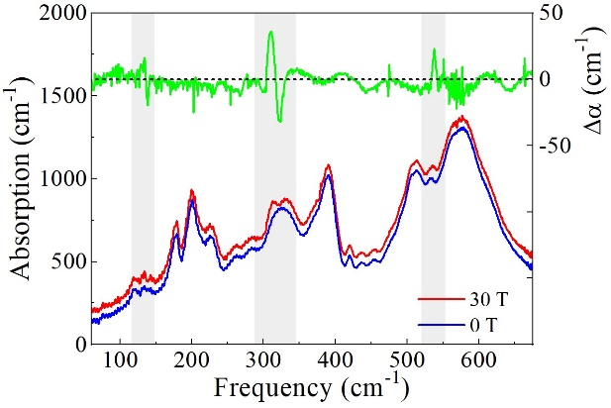
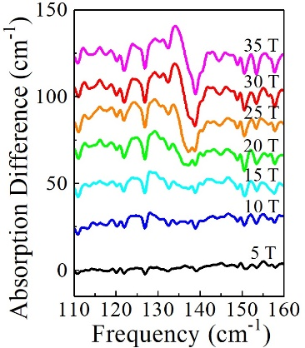
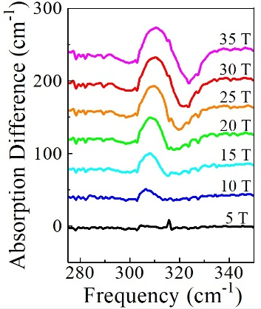
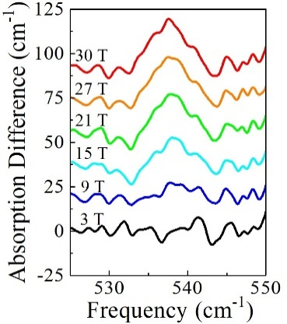
Why does magnetic switching occur at such high magnetic fields in Sr₃NiIrO₆?
K.R. O'Neal,¹ A. Paul,² A. al-Wahish,¹ K.D. Hughey,¹ A.L. Blockmon,¹ X. Luo,^{3, 4, 5} S.-W. Cheong,^{3, 4, 6} V.S. Zapf,⁷
C.V. Topping,⁸ J. Singleton,⁷ M. Ozerov,⁹ T. Birol,² and J. L. Musfeldt¹
1. University of Tennessee; 2. University of Minnesota; 3. Pohang University of Science and Technology; 4. Pohang Accelerator Laboratory; 5. Institute of Solid State Physics; 6. Rutgers University; 7. NHMFL at Los Alamos National Laboratory; 8. University of St Andrews; 9. NHMFL at Florida State University
Funding Grants: J.L. Musfeldt (NSF DMR-1629079, DOE DE-FG02-01ER45885), S.-W. Cheong (NSF DMR-1629059, ICT 2016K1A4A01922028), T. Birol (NSF DMR-1629260), G.S. Boebinger, J Singleton, V.S. Zapf, M. Ozerov (NSF DMR-1157490, NSF DMR-1644779), J. Singleton, V.S. Zapf DOE BES “Science at 100 Tesla”
Sr₃NiIrO₆ displays one of the highest known coercive magnetic fields: up to 55 Tesla is needed to switch the magnetization of this material between different branches of the hysteresis loop in a plot of magnetization versus applied magnetic field.
This material contains magnetic Ni²⁺ and Ir⁴+ in oxygen cages, that alternate along chains. While materials with 3d transition metal ions like Ni²⁺ display strong electron correlations, narrow band widths, and robust magnetism, materials with 5d magnetic ions like Ir⁴⁺ are recognized for strong spin-orbit coupling, increased hybridization, and more diffuse orbitals. Combining these properties leads to novel behavior such as the ultra-high coercive fields. Little is known about the physics behind this incredible coercivity, such as the importance of the lattice, domains, or interchain interactions. We explore these here with magneto-optical measurements.
Fig.1 (a) displays the infrared spectrum of Sr₃NiIrO₆ at 0 and 35T, with the difference displayed at the top. Three phonons [Fig. 1 (b-d)] show sensitivity to magnetic field and grow as the magnetization squared. Together, these data reveal which lattice distortions facilitate microscopic spin rearrangements., resulting in the creation of magnetic order, which pushes the magnetic switching to very high magnetic fields as high as 55T.
(a)
(b)
(c)
(d)
Facilities and instrumentation used: FT-IR spectrometer with 35T resistive magnet in the NHMFL DC Field Facility, and 65T pulsed magnets in the NHMFL Pulsed Field Facility.
Citations: [1] J. Singleton, J. Kim, C. Topping, A. Hansen, E. Mun, S. Chikara, I. Lakis, S. Ghannadzadeh, P. Goddard, Y. Oh, S-W. Cheong, and V. Zapf, Phys. Rev. B, 94, 224408 (2016)
Figure (a) Infrared spectrum at 0 and 35 T, with the difference highlighted above. (b) Integrated absorption differences track magnetization squared. (c-e) Zoomed view of absorption differences
[2] K.R. O'Neal, A. Paul, A. al-Wahish, K.D. Hughey, A. Blockmon, X. Luo, S-W. Cheong, V. Zapf, C.V. Topping, J. Singleton, M. Ozerov, T. Birol, J.L. Musfeldt, Spin-lattice and electron-phonon coupling in 3d/5dhybrid Sr₃NiIrO₆, njp Quantum Materials, 4, 48 (2019) doi.org/10.1038/s41535-019-0184-x

Slide 2
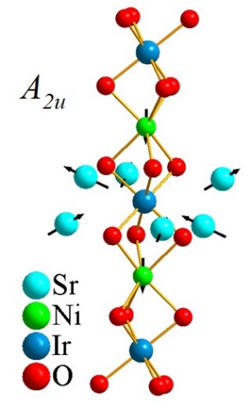
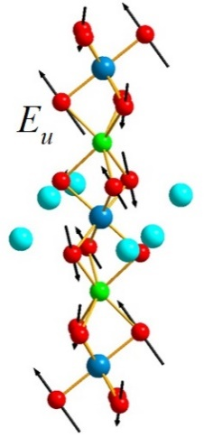
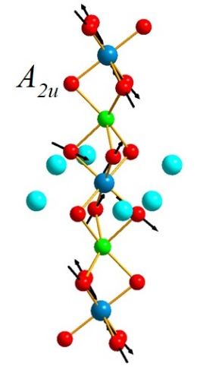
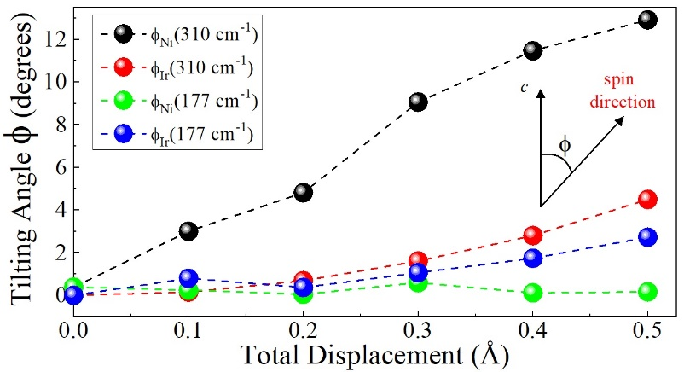
Why does magnetic switching occur at such high magnetic fields in Sr₃NiIrO₆?
K.R. O'Neal,¹ A. Paul,² A. al-Wahish,¹ K.D. Hughey,¹ A.L. Blockmon,¹ X. Luo,^{3, 4, 5} S.-W. Cheong,^{3, 4, 6} V.S. Zapf,⁷
C.V. Topping,⁸ J. Singleton,⁷ M. Ozerov,⁹ T. Birol,² and J. L. Musfeldt¹
1. University of Tennessee; 2. University of Minnesota; 3. Pohang University of Science and Technology; 4. Pohang Accelerator Laboratory; 5. Institute of Solid State Physics; 6. Rutgers University; 7. NHMFL at Los Alamos National Laboratory; 8. University of St Andrews; 9. NHMFL at Florida State University
Funding Grants: J.L. Musfeldt (NSF DMR-1629079, DOE DE-FG02-01ER45885), S.-W. Cheong (NSF DMR-1629059, ICT 2016K1A4A01922028), T. Birol (NSF DMR-1629260), G.S. Boebinger, J Singleton, V.S. Zapf, M. Ozerov (NSF DMR-1157490, NSF DMR-1644779), J. Singleton, V.S. Zapf DOE BES “Science at 100 Tesla”
What is the finding? Deformations of the crystalline lattice in the material Sr₃NiIrO₆ in response to a magnetic field result from the creation of magnetic order, which plays a role in pushing the magnetic switching to very high magnetic fields, as high as 55T.
Why is this important? Materials whose magnetism can be switched by magnetic fields are critical to many applications of magnetism. When a large magnetic moment is switched at high magnetic fields, it is called ‘hard magnetism’, which is a much sought after technology. Here we explore why the magnetic moment of Sr₃NiIrO₆ can only be switched at magnetic fields up to 55 T. This is a record high “coercive field” for magnetic switching.
Why did this research need the MagLab? The coercive field of Sr₃NiIrO₆ reaches a maximum of 55T, requiring pulsed magnets to fully access. Measuring infrared spectra takes much longer times to collect, so a 35T resistive magnet was used rather than a pulsed magnet for the infrared spectroscopy. 35 T was required to achieve significant changes due to the high energy scales in this material.
(a)
(b)
(c)
(d)
Facilities and instrumentation used: FT-IR spectrometer combined with 35T resistive magnet in the NHMFL DC Field Facility, and 65T pulsed magnets in the NHMFL Pulsed Field Facility.
Citations: [1] J. Singleton, J. Kim, C. Topping, A. Hansen, E. Mun, S. Chikara, I. Lakis, S. Ghannadzadeh, P. Goddard, Y. Oh, S-W. Cheong, and V. Zapf, Phys. Rev. B, 94, 224408 (2016)
[2] K.R. O'Neal, A. Paul, A. al-Wahish, K.D. Hughey, A. Blockmon, X. Luo, S-W. Cheong, V. Zapf, C.V. Topping, J. Singleton, M. Ozerov, T. Birol, J.L. Musfeldt, Spin-lattice and electron-phonon coupling in 3d/5dhybrid Sr₃NiIrO₆, njp Quantum Materials, 4, 48 (2019) doi.org/10.1038/s41535-019-0184-x
Figure (a-c) Motion pattern of atoms for the phonon modes that change in magnetic field. (d) Spin tilting angle versus phonon displacement magnitude, showing that the phonons are coupled to the magnetism [2]
Notes:
1. What is the finding?
Here to be included a short description in layman language of the finding
2. Why this finding is important?
A short description of why the finding is important for scientific community, technology, society, etc…
3. Why NHMFL?
The answer to this question should provide information on why this finding could be achieved (only) at NHMFL (what unique capability of MagLab was essential for this finding).

