Slide 1
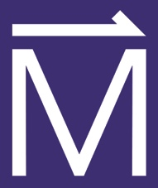
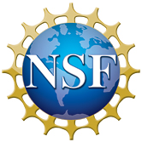
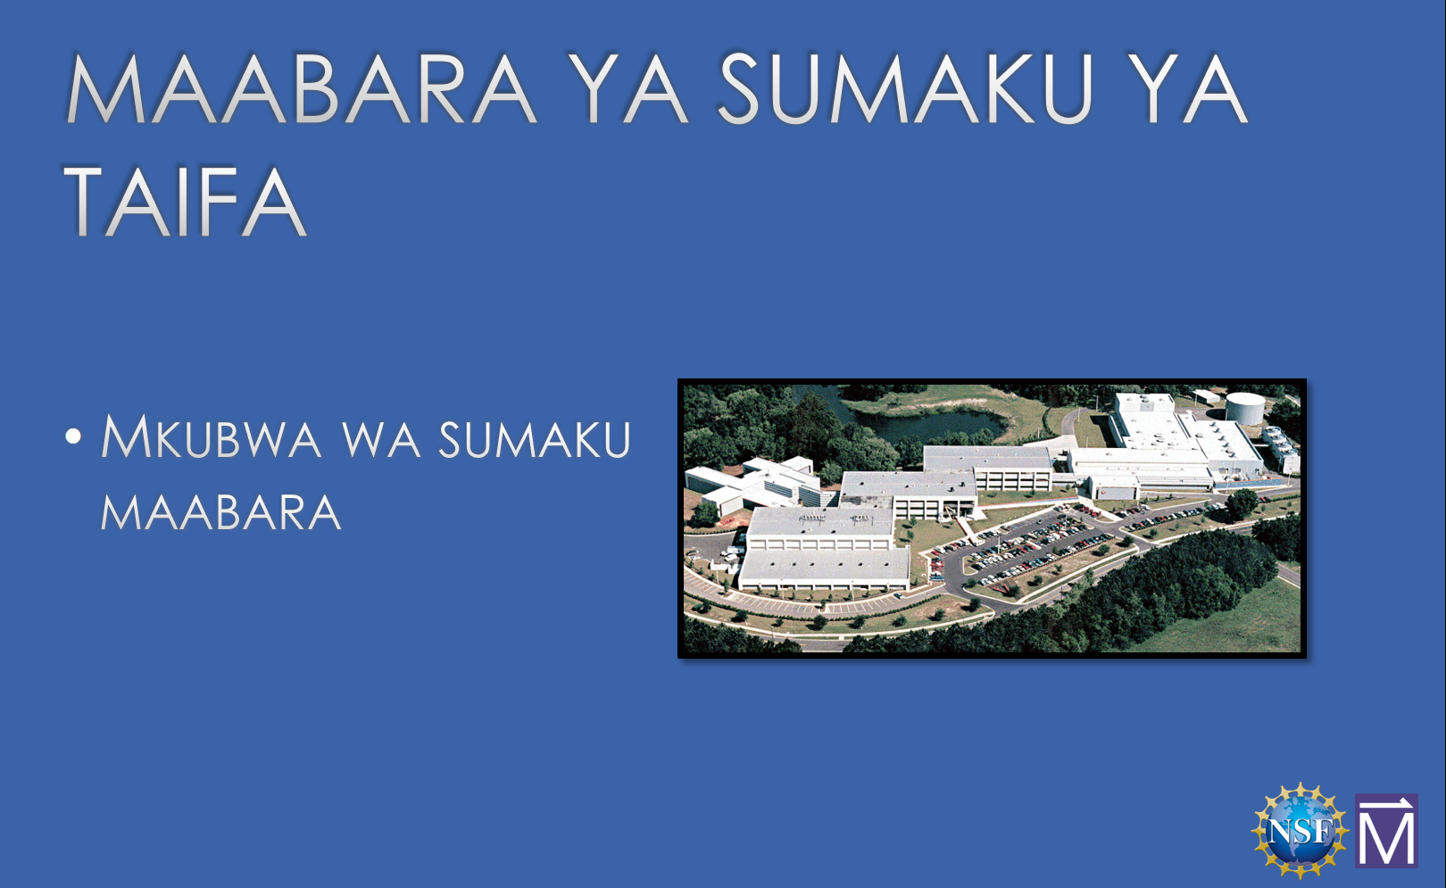
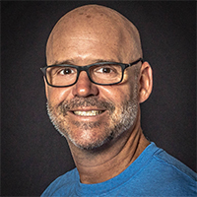
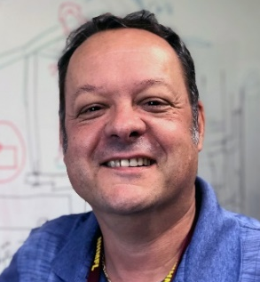
MagLab Educational Outreach to English Language Learners
, C.R. Villa¹, J. Chapman², L. Urban²
National High Magnetic Field Laboratory, Florida State University, Tallahassee, FL;
2. Leon County Schools, Tallahassee, FL
Funding Grants: G.S. Boebinger (NSF DMR-1157490, NSF DMR-1644779)
The MagLab’s Center for Integrating Research and Learning (CIRL) develops and facilitates educational outreach for K-12 teachers and students. In May 2019, K-12 Education Programs Director Carlos Villa created a special version of CIRL’s electricity and magnetism outreach activity for a Leon County English Language Learners (ELL) field trip that presented in both Spanish and Swahili to immigrant students who had recently moved to Tallahassee. These outreach classes have been previously offered by the MagLab in Spanish, German, and French. This was the first offering in Swahili and a presentation in Korean is planned.
During the visit to the MagLab, the students are able to build electromagnets and test what factors make them stronger. Then the students tour the MagLab and speak to MagLab staff to learn about science careers in their native language.
The population of ELL students in US schools has grown to about 4.6 million (9.4% of the school age population). ELL students are often interested in STEM topics and can comprehend the concepts, but their access to rigorous instruction is often limited by the assumption that they must achieve a certain proficiency in English before they can participate, even though hands-on learning opportunities often require fewer English skills and may even enhance English learning. CIRL continues to address the challenges faced by ELL students with initiatives like this.
In Swahili, the slide reads: National Magnet Laboratory. Largest Magnet Laboratory in the world.
MagLab employees Jose Sanchez (left) and Steve Ranner (right) facilitated the bilingual tours in Spanish and Swahili, respectively.
The MagLab leads the world in magnet research and is also a leader in informal science education. Field trips to the MagLab help local students understand the science performed at the Magnet Lab. They learn that the MagLab is a global laboratory working with scientists and engineers from around the world, and they learn that the MagLab the home of a diverse workplace that includes people from cultures and countries from all over the world.

