Slide 1


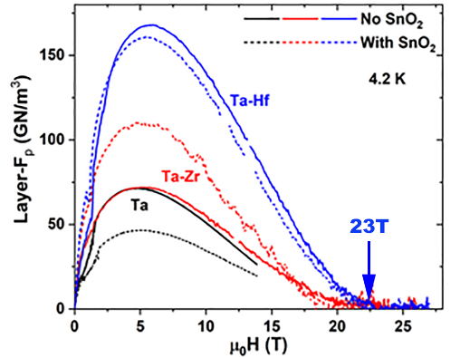
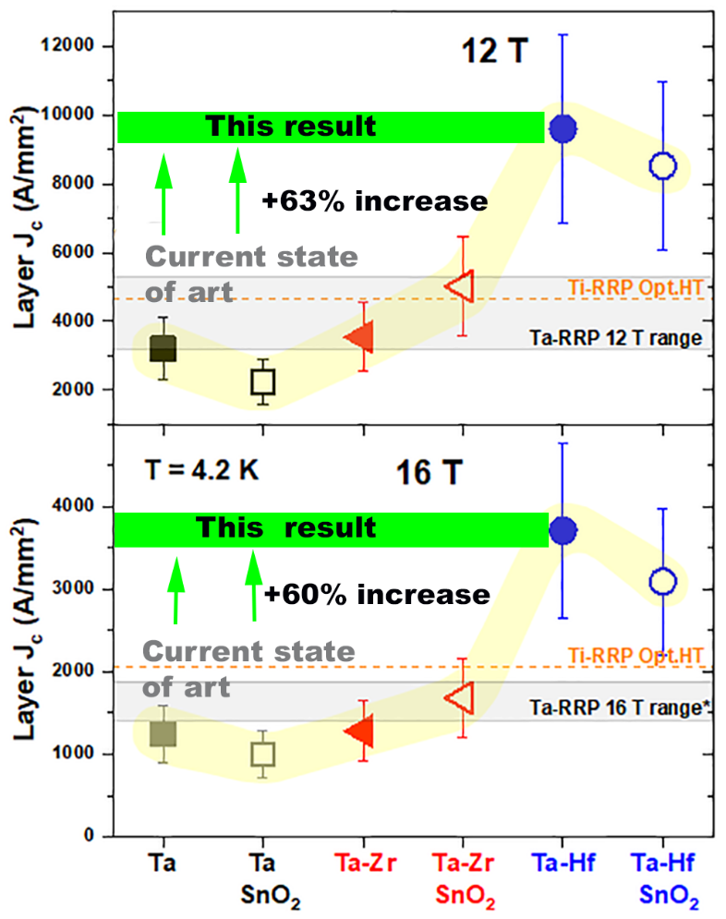
Hafnium greatly improves Nb₃Sn superconductor for high field magnets
Shreyas Balachandran¹, Chiara Tarantini¹, Peter J. Lee¹, Fumitake Kametani^{1,2}, Yi-Feng Su¹,
Benjamin Walker¹, William L. Starch¹, and David C. Larbalestier^{1,2}
NHMFL, Florida State University; 2. Dept of Mechanical Engineering, Florida State University
Funding Grants: G.S. Boebinger (NSF DMR-1157490, NSF DMR-1644779); DOE (DE-SC0012083 )
Niobium-Tin, Nb₃Sn, conductors are the conductor of choice in high-field magnet applications for nuclear magnetic resonance, accelerators, and fusion. Nb₃Sn magnets will be needed for a next-generation (100TeV) proton collider; however, the desired non-Copper current density (J_{c}) of 1500A/mm² (at 16T and 4.2K) is substantially above the best presently available Nb₃Sn conductor designs.
A variety of variants of Nb₃Sn monofilament wires were fabricated in-house at the MagLab to include Nb₄Ta rods with Zirconium (Zr) and Hafnium (Hf) additions, both with and without SnO₂ suitable for internal oxidation of the Zr and Hf. The properties of the various wires were measured over the entire superconducting range at fields up to 31T at MagLab.
Researchers found that group IV alloying (by Zr and Hf) in the presence of Tantalum (Ta) increases the global vortex pinning force (Layer F_{P}) at 4.2K, more than doubling any previous Nb₃Sn production wire (Figure 1). This, in turn, raises the irreversibility field (H_{irr}) of the wire, thus expanding the magnetic field range over which the superconductor has a zero resistance.
The layer critical current density (Layer J_{c}) at 16T and 4.2K, exceeds 3500 A/mm² (Figure 2.), which at the typical 60% fill factor of present high-J_{c} wires, suggests a non-Copper J_{c} of 2000 A/mm², exceeding the goal for the next-generation Future Circular Collider (FCC) planned for CERN.
Figure 1. Pinning force curves over the full superconducting range indicates a doubling in force magnitude in Hf-based Nb₃Sn (blue) over conventional present-day Ta (black) based conductors
Figure 2. Layer critical current density in Hf-based conductors indicate a performance boost of 60% at 16T above the present state-of-the-art Restack Rod Process (RRP) commercial wire.
Facility used: DC Field Facility’s 31T, 50mm Bore Magnet - Cell 7
Citation: S. Balachandran, C. Tarantini, P.J.. Lee, F. Kametani, Y. Su, B. Walker, W.L. Starch, D.C. Larbalestier,
Beneficial influence of Hf and Zr additions to Nb4at%Ta on the vortex pinning of Nb₃Sn with and without an O source,
Superconductor Science and Technology, 32, 044006 (2019) doi.org/10.1088/1361-6668/aaff02

Slide 2
Hafnium greatly improves Nb₃Sn superconductor for high field magnets
Shreyas Balachandran¹, Chiara Tarantini¹, Peter J. Lee¹, Fumitake Kametani^{1,2}, Yi-Feng Su¹,
Benjamin Walker¹, William L. Starch¹, and David C. Larbalestier^{1,2}
NHMFL, Florida State University; 2. Dept of Mechanical Engineering, Florida State University
Funding Grants: G.S. Boebinger (NSF DMR-1157490, NSF DMR-1644779); DOE (DE-SC0012083 )
What is the finding? MagLab researchers have found that adding the element Hafnium (Hf) to a Niobium (Nb)-Tantalum (Ta) base alloy and forming a superconductor Nb₃Sn after reaction with Tin (Sn) at high temperatures of 670°C leads to tremendous improvements in the electrical current carrying ability (Layer J_{c}) of this conductor wire by 60% at operating magnetic fields of 16T at temperatures of 4.2K (see Figure).
Why is this important? The high increase in the current carrying capacity of superconducting Nb₃Sn wire is of particular interest to NMR researchers, MRI clinicians, and scientists pursuing next-generation accelerators and nuclear fusion. In particular, this research result specifically indicates that future 16T dipole magnets for the next-generation Future Circular Collider (FCC) planned to be constructed in CERN can be fabricated using this new Nb₃Sn conductor, rather than the riskier high-temperature superconductors.
Why did this research need the MagLab?
The conductor was developed in-house by researchers at the MagLab. In addition, characterization of the conductors at high fields up to the full superconducting range of Nb₃Sn (26T) would not have been possible elsewhere.
Facility used: DC Field Facility’s 31T, 50mm Bore Magnet - Cell 7
Citation: S. Balachandran, C. Tarantini, P.J.. Lee, F. Kametani, Y. Su, B. Walker, W.L. Starch, D.C. Larbalestier,
Beneficial influence of Hf and Zr additions to Nb4at%Ta on the vortex pinning of Nb₃Sn with and without an O source,
Superconductor Science and Technology, 32, 044006 (2019) doi.org/10.1088/1361-6668/aaff02
Figure: Layer critical current density, J_{c}, in a variety of variants of Nb₃Sn monofilament wires fabricated to include Tantalum (Ta), Zirconium (Zr) and Hafnium (Hf) additions, both with and without SnO₂ suitable for internal oxidation of the Zr and Hf. Hf based conductors indicate a performance boost above the present state of the art Restack Rod Process (RRP) commercial conductors.
This improvement is nearly 65% at 12T and 60% at 16T.
Notes:
1. What is the finding?
Here to be included a short description in layman language of the finding
2. Why this finding is important?
A short description of why the finding is important for scientific community, technology, society, etc…
3. Why NHMFL?
The answer to this question should provide information on why this finding could be achieved (only) at NHMFL (what unique capability of MagLab was essential for this finding).

