Slide 1
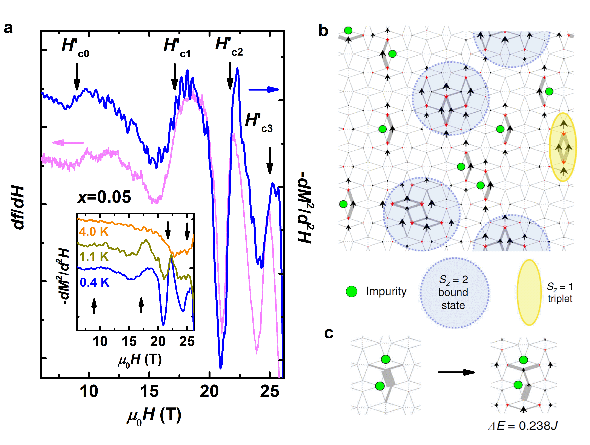
Emergent states of matter in chemically doped quantum magnets
Zhenzhong Shi¹, William Steinhardt¹, David Graf², Philippe Corboz³, Franziska Weickert², Neil Harrison⁴, Marcelo Jaime⁴, Casey Marjerrison¹, Hanna A. Dabkowska⁵, Frédéric Mila⁶, Sara Haravifard¹
1. Duke University; 2. NHMFL/FSU; 3. University of Amsterdam; 4. NHMFL/LANL; 5. McMaster University; 6. Institute of Physics, École Polytechnique Fédérale de Lausanne (EPFL)
Funding Grants: G.S. Boebinger (NSF DMR-1157490, NSF DMR-1644779); Z. Shi, W. Steinhardt, C. Marjerrison, S. Haravifard (Duke Fairbank Chair in Physics, Powe Junior Faculty Award & NSF ECCS-1542015); P. Corboz, F. Mila (EU Horizon 2020 No. 677061); N. Harrison & M. Jaime (DOE-BES “Science at 100 T program”)
Impurities in materials are not always unwanted. In fact, they can play a central role in scientific and technological breakthroughs. This study provides crucial insights into impurity effects in the two-dimensional Shastry-Sutherland quantum magnet, SrCu₂(BO₃)₂
Substituting small amounts of Mg for Cu (called “chemical doping”) in SrCu₂(BO₃)₂ crystals creates emergent magnetic states where the Mg impurities couple with spin triplet bound states. This results in localized bound states at two threshold magnetic fields (H_{c3} & H_{c2} in the Fig.a) and paired impurity states at H_{c1} and H_{c0}. The experimental and numerical results are in remarkable agreement, confirming our discovery of a rare example where even a small doping concentration significantly alters the ground state of a frustrated quantum magnet, leading to stable impurity pairs and inducing new spin states at high magnetic fields.
Understanding the impurity effects in the doped SrCu₂(BO₃)₂ system opens the door to realizing long-sought-after quantum materials such as resonating valence bond (RVB) superconductors. This work may also shed light on quantum phase transition paradigms that go beyond the conventional Landau-Ginzburg-Wilson theory.
Shastry-Sutherland quantum magnet:
SrCu_{2-x}Mg_{x}(BO₃)₂
Figure (a) Emergence of magnetization anomalies, indicated by the black arrows, are shown in Tunnel Diode Oscillator data, df/dH (magenta, left axis) and magnetization, −dM²/d²H (blue, right axis) versus magnetic field. (b) Spin configuration above H’_{c3}, obtained in the total S_{z} = 11 sector. The size of the spins scale with the magnitude of the local magnetic moment, where black (red) arrows point along (opposite to) the external magnetic field. The thickness of the gray bonds scales with the local bond energy (the thicker the lower the energy). (c) Special 2-impurity configuration in the S_{z} = 0 (left) and S_{z} = 1 (right) sectors, respectively, with an excitation energy ΔE = 0.238J.
Facilities: DC Facility 35T magnet, Pulsed Facility 65T magnet
Citation: Z.Shi, W.Steinhardt, D.Graf, P.Corboz, D.Weickert, N.Harrison, M. Jaime, C. Marjerrison, H.A. Dabkowska, F. Mila, S. Haravifard,
Emergent bound states and impurity pairs in chemically doped Shastry-Sutherland system, Nature Communications 9, 2349 (2019) doi.org/10.1038/s41467-019-10410-x

Slide 2
Emergent states of matter in chemically doped quantum magnets
Zhenzhong Shi¹, William Steinhardt¹, David Graf², Philippe Corboz³, Franziska Weickert², Neil Harrison⁴, Marcelo Jaime⁴, Casey Marjerrison¹, Hanna A. Dabkowska⁵, Frédéric Mila⁶, Sara Haravifard¹
1. Duke University; 2. NHMFL/FSU; 3. University of Amsterdam; 4. NHMFL/LANL; 5. McMaster University; 6. Institute of Physics, École Polytechnique Fédérale de Lausanne (EPFL)
Funding Grants: G.S. Boebinger (NSF DMR-1157490, NSF DMR-1644779); Z. Shi, W. Steinhardt, C. Marjerrison, S. Haravifard (Duke Fairbank Chair in Physics, Powe Junior Faculty Award & NSF ECCS-1542015); P. Corboz, F. Mila (EU Horizon 2020 No. 677061); N. Harrison & M. Jaime (DOE-BES “Science at 100 T program”)
What is the finding? Scientists discovered rich impurity-induced changes of localized magnetism by substituting very small amounts of magnesium (Mg) for copper (Cu) – called “chemical doping” – in the quantum magnet SrCu₂(BO₃)₂. Measurements done at the MagLab showed that the Mg impurities formed stable pairs and induced new spin states at high magnetic fields.
Why is this important? SrCu₂(BO₃)₂ is the physical realization of an exactly solvable quantum mechanical problem in magnetism, known as the Shastry-Sutherland model. This model touches upon several important frontiers in condensed matter physics. Understanding the impurity effects in these chemically doped materials opens the prospects of realizing some of the long-sought-after quantum states of matter such as resonating valence bond (RVB) superconductors and perhaps also quantum phase transitions, which are not well-described by our present standard theory (Landau-Ginzburg-Wilson theory) for phase transitions.
Why did this research need the MagLab? The MagLab provides access to low temperatures and high magnetic fields coupled with state-of-the-art experimental techniques that enable the comprehensive study presented in our work.
Shastry-Sutherland quantum magnet: SrCu_{2-x}Mg_{x}(BO₃)₂
Figure: Spin configurations at magnetic fields above 25T. The size of the spins scale with the magnitude of the local magnetic moment, where black arrows point along the external magnetic field and the red arrows point opposite to the external magnetic field. The thickness of the gray bonds scales with the local bond energy (the thicker the bond, the lower the energy).
Facilities: DC Facility 35T magnet, Pulsed Facility 65T magnet
Citation: Z. Shi, W. Steinhardt, D. Graf, P. Corboz, D. Weickert, N. Harrison, M. Jaime, C. Marjerrison, H.A. Dabkowska, F. Mila, S. Haravifard,
Emergent bound states and impurity pairs in chemically doped Shastry-Sutherland system, Nature Communications 9, 2349 (2019) doi.org/10.1038/s41467-019-10410-x

