Slide 1
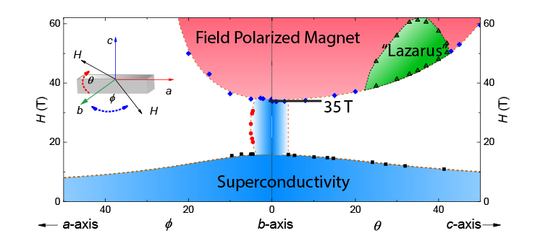
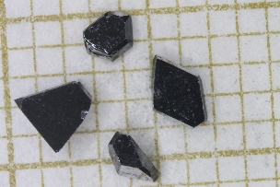
“Lazarus” Superconductivity: Extreme Re-Entrant Superconductivity
S. Ran^{1,2,3}, I-L. Liu^{1,2,3}, Y.S. Eo¹, D.J. Campbell¹, P. Neves¹, W.T. Fuhrman¹, S.R. Saha^{1,2}, C. Eckberg¹, H. Kim¹, D. Graf⁴, F. Balakirev⁵, J. Singleton^{5,6}, J. Paglione^{1,2}, and N.P. Butch^{1,2}
1 CNAM, Department of Physics, University of Maryland 2 NIST Center for Neutron Research 3 Department of Materials Science and Engineering, University of Maryland 4 NHMFL Florida State University 5 NHFML Los Alamos National Laboratory 6 Department of Physics, The Clarendon Laboratory, University of Oxford
Funding: Boebinger (NSF DMR-1157490, NSF DMR-1644779), Paglione (NSF DMR-1610349, DOE DE-SC0019154, Moore GBMF4419), Butch (NIST)
MagLab users recently discovered that UTe₂ is an exotic superconductor below 1.6K, with outstanding properties: 1) strong spin fluctuations that suggest proximity to magnetic order, 2) a large residual specific heat that suggests that half of the electrons are not gapped in the superconducting state, and 3) an anisotropic and very large upper critical field that exceeds available laboratory magnetic fields.
Higher field xperiments required the MagLab’s magnets to determine the largest value of the upper critical magnetic field: an amazing 35T (blue region in the figure), which is an incredibly upper critical field for a superconductor with a 1.6K critical temperature. Indeed, 35T is an order of magnitude greater than the paramagnetic limit of conventional superconductors above which all electron spins would be expected to be aligned. This find strongly indicates that spins of the paired electrons in UTe₂ are parallel in a spin triplet configuration, not antiparallel as in most superconductors.
Unexpectedly, a new superconducting phase was found to be stabilized at even higher fields, but only over a limited range of field direction. This reentrant “Lazarus” superconductivity between 40T and 65T challenges our understanding of how magnetic fields typically destabilize superconductivity. In addition, these spin-triplet superconducting states are strong candidates for unusual nodal p-wave pairing and may harbor sought-after topological Majorana zero-energy modes.
Magnetic field versus angle dependence of the superconducting phases in UTe₂. The “low-field” phase (blue) extends to 35T, but only over a narrow angular window with the magnetic field very nearly aligned along the b-axis. At even higher fields, reentrant “Lazarus” superconductivity was discovered (green), which is stable at such high magnetic fields that it challenges our theoretical understanding of superconductivity.
Single crystals of UTe₂ from the Butch group at University of Maryland. Credit: Sheng Ran
Facilities and instrumentation used: 35 T resistive magnet, 45 T hybrid magnet (DC) and 65 T pulsed magnets
Citation: S. Ran, I-L. Liu, Y.S. Eo, D.J. Campbell, P. Neves, W.T. Fuhrman, S.R. Saha, C. Eckberg, H. Kim, D. Graf, F. Balakirev, J. Singleton, J. Paglione, and N.P. Butch, “Extreme magnetic field-boosted superconductivity,” Nature Physics (2019). DOI: 10.1038/s41567-019-0670-x

Slide 2
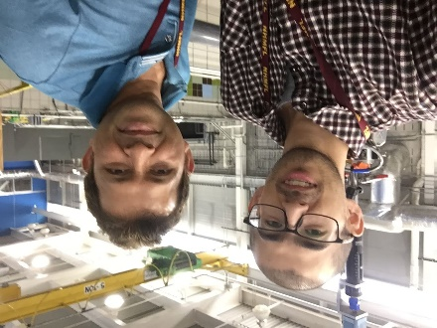
“Lazarus” Superconductivity: Extreme Re-Entrant Superconductivity
S. Ran^{1,2,3}, I-L. Liu^{1,2,3}, Y.S. Eo¹, D.J. Campbell¹, P. Neves¹, W.T. Fuhrman¹, S.R. Saha^{1,2}, C. Eckberg¹, H. Kim¹, D. Graf⁴, F. Balakirev⁵, J. Singleton^{5,6}, J. Paglione^{1,2}, and N.P. Butch^{1,2}
1 CNAM, Department of Physics, University of Maryland 2 NIST Center for Neutron Research 3 Department of Materials Science and Engineering, University of Maryland 4 NHMFL Florida State University 5 NHFML Los Alamos National Laboratory 6 Department of Physics, The Clarendon Laboratory, University of Oxford
Funding: Boebinger (NSF DMR-1157490, NSF DMR-1644779), Paglione (NSF DMR-1610349, DOE DE-SC0019154, Moore GBMF4419), Butch (NIST)
What is the finding? An unusually high magnetic field of 35T is required to destroy the exotic superconductivity in uranium ditelluride, which underscores its uniqueness. In addition, MagLab users have discovered a second, “Lazarus”, superconductivity that only exists for magnetic fields above 40T, which defies our basic understanding of superconductor physics.
Why is this important? These results confirm the mounting evidence that uranium ditelluride is an unusual “p-wave spin-triplet” superconductor. Physicists are searching for such materials in order to exploit their topological properties in future fault-tolerant quantum computing.
More fundamentally, the “Lazarus” phase violates our textbook understanding of superconductivity and will thus teach us something new about how superconductivity works.
Why did this research need the MagLab? The large magnetic fields (35T) required to destabilize the low-field superconductivity are not achievable with even the largest conventional magnets available in universities. The “Lazarus” superconductivity exists at even higher fields (40T to 65T) and would not have been otherwise discovered.
Credit: Emily Edwards (UMD)
Magnetic field versus angle dependence of the superconducting phases in UTe₂. The “low-field” phase (blue) extends to 35T, but only over a narrow angular window with the magnetic field very nearly aligned along the b-axis. At even higher fields, reentrant “Lazarus” superconductivity was discovered (green), which is stable at such high magnetic fields that it challenges our theoretical understanding of superconductivity.
Facilities and instrumentation used: 35 T resistive magnet,
45 T hybrid magnet (DC) and 65 T pulsed magnets
Citation: S. Ran, I-L. Liu, Y.S. Eo, D.J. Campbell, P. Neves, W.T. Fuhrman, S.R. Saha, C. Eckberg, H. Kim, D. Graf, F. Balakirev, J. Singleton, J. Paglione, and N.P. Butch,
“Extreme magnetic field-boosted superconductivity,”
Nature Physics (2019). DOI: 10.1038/s41567-019-0670-x
Left: Postdoctoral researcher Sheng Ran and research scientist Shanta Saha at the MagLab for DC magnet experiments.

