Slide 1
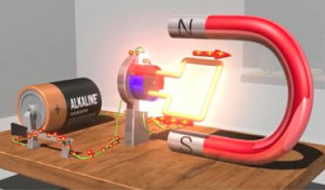
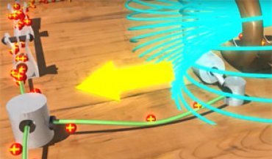
Seeing is Believing with See-Thru Science Video Series
Public Affairs Department
National High Magnetic Field Laboratory
Funding Grants: G.S. Boebinger (NSF DMR-1157490, NSF DMR-1644779)
Concepts of electricity and magnetism can be complicated for audiences to understand because they can’t see what’s happening. In the See-Thru Science video series, we have crafted animations to show viewers what electricity and magnetism might look like if they weren't invisible.
The series includes videos on:
How Capacitors Work
How Electromotive Forces Work
How Ignition Coils Work
How Microwaves Work
What Oersted Discovered with his Compass
The Lorenz Force
How Van de Graaff Generators Work
How DC Motors Work
How MRI Machines Work
Right & Left Hand Rules
The 10 See-Thru Science videos
have nearly 5 million views on YouTube!
The “How Capacitors Work” video
has more than 2.3 million views alone!
In addition, two separate companies have expressed interest in using the videos for their internal training purposes.
The videos are available online at https://nationalmaglab.org/education/magnet-academy/watch-play/see-thru-science
or on YouTube at https://www.youtube.com/playlist?list=PLWTjLY9zQ5n7mGnsWi7pGHB44SyeZMwgM

