Slide 1


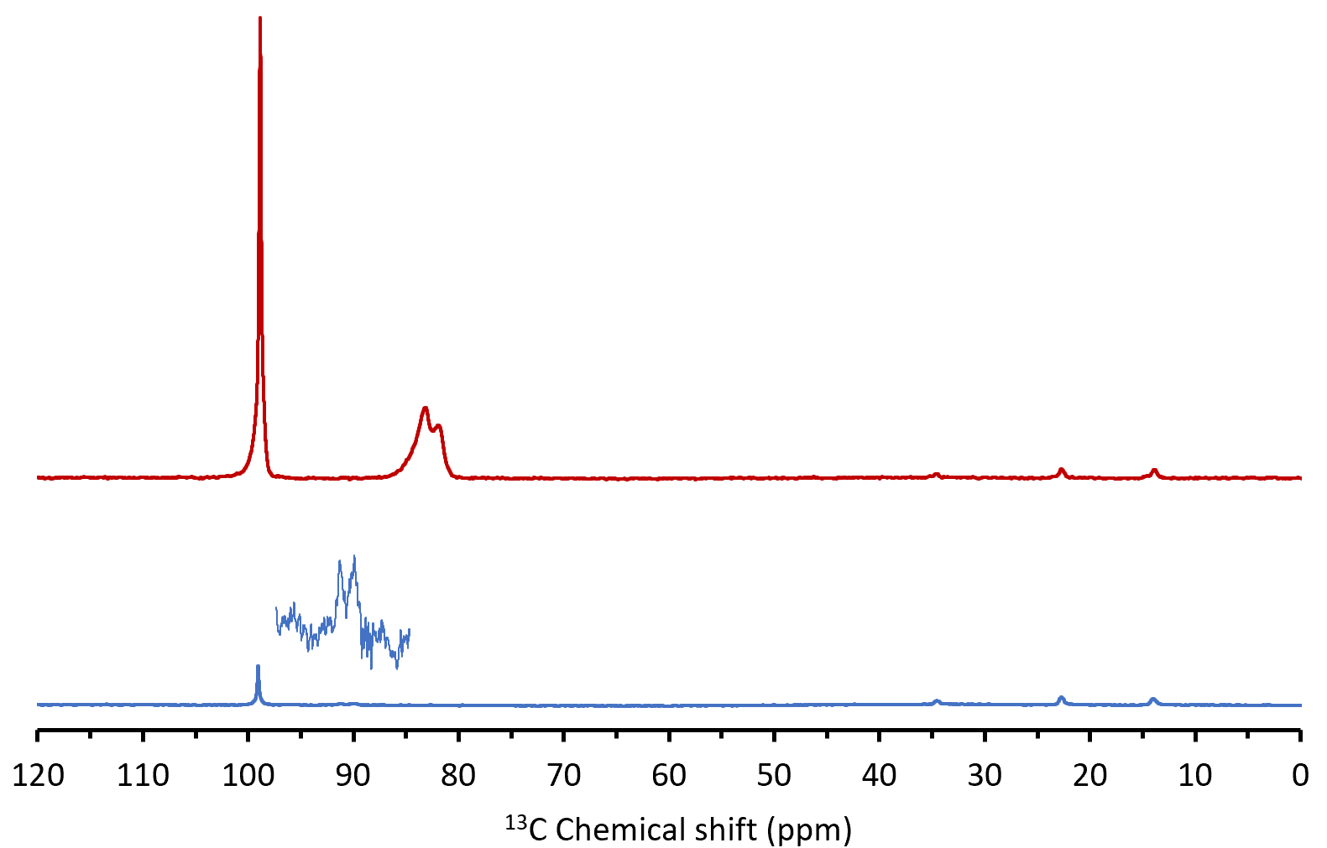
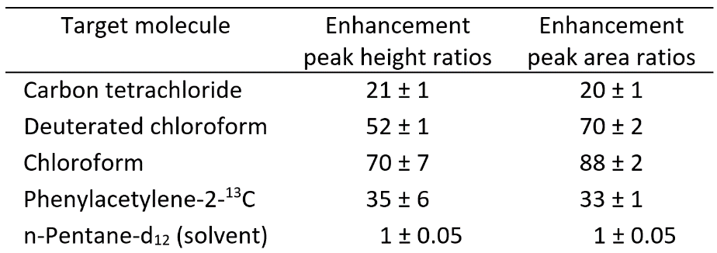
Liquid State Dynamic Nuclear Polarization
at High Magnetic Field
Thierry Dubroca¹, Sungsool Wi¹, Johan van Tol¹, Lucio Frydman^{1,2}, Stephen Hill^{1,3},
1. NHMFL, 2. Weizmann Institute, 3. Florida State University;
Funding Grants: G.S. Boebinger (NSF DMR-1157490, NSF DMR-1644779); S. Hill (CHE-1229170); S. Wi (CHE-1808660)
Liquid-state Nuclear Magnetic Resonance is a commonly used tool in chemistry, biology and medicine to identify and characterize molecules, but it suffers from low sensitivity. Dynamic Nuclear Polarization (DNP) can increase the sensitivity, but it is challenging in the liquid state and particularly at high magnetic fields, where the the challenge is worth addressing because NMR resolution increases with increasing magnetic field.
In this study we demonstrate a significant gain in sensitivity (as high as seventy-fold) in the liquid state using the scalar Overhauser effect (a form of DNP) at 14.1T in a large sample volume, while also demonstrating the higher resolution from high magnetic fields.
We used the newly-commissioned 14.1T liquid DNP magnet system, developed in-house at the MagLab, to demonstrate large enhancements in ¹³C magnetic resonance signals for ¹³C located in several molecules (see Table 1).
The strong scalar liquid DNP effect observed is limited to specific molecules, but it demonstrates the dipolar Overhauser effect, which can be universally applied to many molecules. The dipolar effect is particularly strong for small molecules used in studies of metabolomics (medical), natural products (biology), and molecular dynamics (chemistry), thus advancing a wide variety of applications.
Figure 1: Nuclear Magnetic Resonance spectra without scalar Overhauser effect (blue) and with it (red).
Carbon tetrachloride
Enhancement = 21x
Chloroform
Enhancement = 70x
ZOOM
Facilities and instrumentation used: 14.1 T liquid DNP magnet system in the EMR and NMR facilities
Citation: T. Dubroca, S. Wi, J. van Tol, L. Frydman and S. Hill,
Large volume liquid state scalar Overhauser dynamic nuclear polarization at high magnetic field,
Phys. Chem. Chem. Phys. 21 21200-21204 (2019); 10.1039/C9CP02997D
Table 1: Sensitivity enhancements for various molecules.

Slide 2
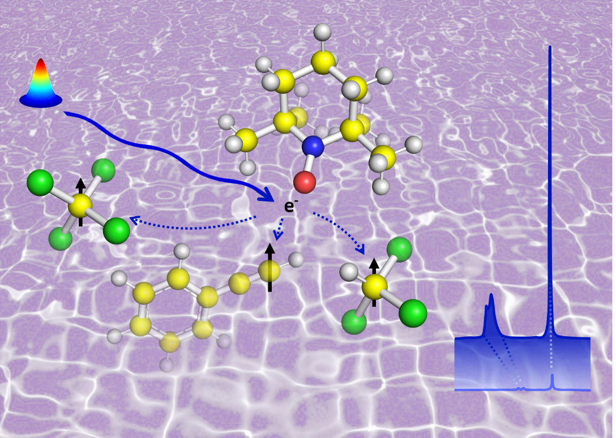
Overhauser Effect in Liquids toward Identification and Concentration measurement of Small Molecules
Thierry Dubroca¹, Sungsool Wi¹, Johan van Tol¹, Lucio Frydman^{1,2}, Stephen Hill^{1,3},
1. NHMFL, 2. Weizmann Institute, 3. Florida State University;
Funding Grants: G.S. Boebinger (NSF DMR-1157490, NSF DMR-1644779); S. Hill (CHE-1229170); S. Wi (CHE-1808660)
What is the finding?
Exquisite sensitivity gains have been achieved permitting the observation at very low concentrations of molecules through a newly-developed technology, called “Dynamic Nuclear Polarization using the scalar Overhauser effect”. See Figure.
Why is this important?
This finding demonstrates a path forward in using the Overhauser effect to dramatically enhance sensitivity of molecules in low concentrations. This effect is particularly strong for small molecules that are important to detect in experiments on metabolomics (medicine). natural products (biology), and molecular dynamics (chemistry), thus opening a path toward a large variety of research applications.
Why did this research need the Maglab?
At present, this research can only be performed at the MagLab because it requires the use of a unique in-house developed high magnetic field (14T) liquid dynamic nuclear polarization spectrometer. The spectrometer was specifically designed for high resolution (high magnetic field and high field homogeneity) and high sensitivity (strong Overhauser effect in liquids and large sample volumes).
Figure. A microwave beam (rainbow and solid blue arrow) is used to excite a free electron (purple), which in turn enhances (dashed blue arrows) magnetic resonance signals (black arrows) on near-by carbon atoms (yellow), thus allowing high sensitivity in combination with high-resolution.
Facilities and instrumentation used: EMR and NMR & 14.1 T liquid DNP magnet system
Citation: T. Dubroca, S. Wi, J. van Tol, L. Frydman and S. Hill,
Large volume liquid state scalar Overhauser dynamic nuclear polarization at high magnetic field
Phys. Chem. Chem. Phys. 21 21200-21204 (2019); 10.1039/C9CP02997D

