Slide 1


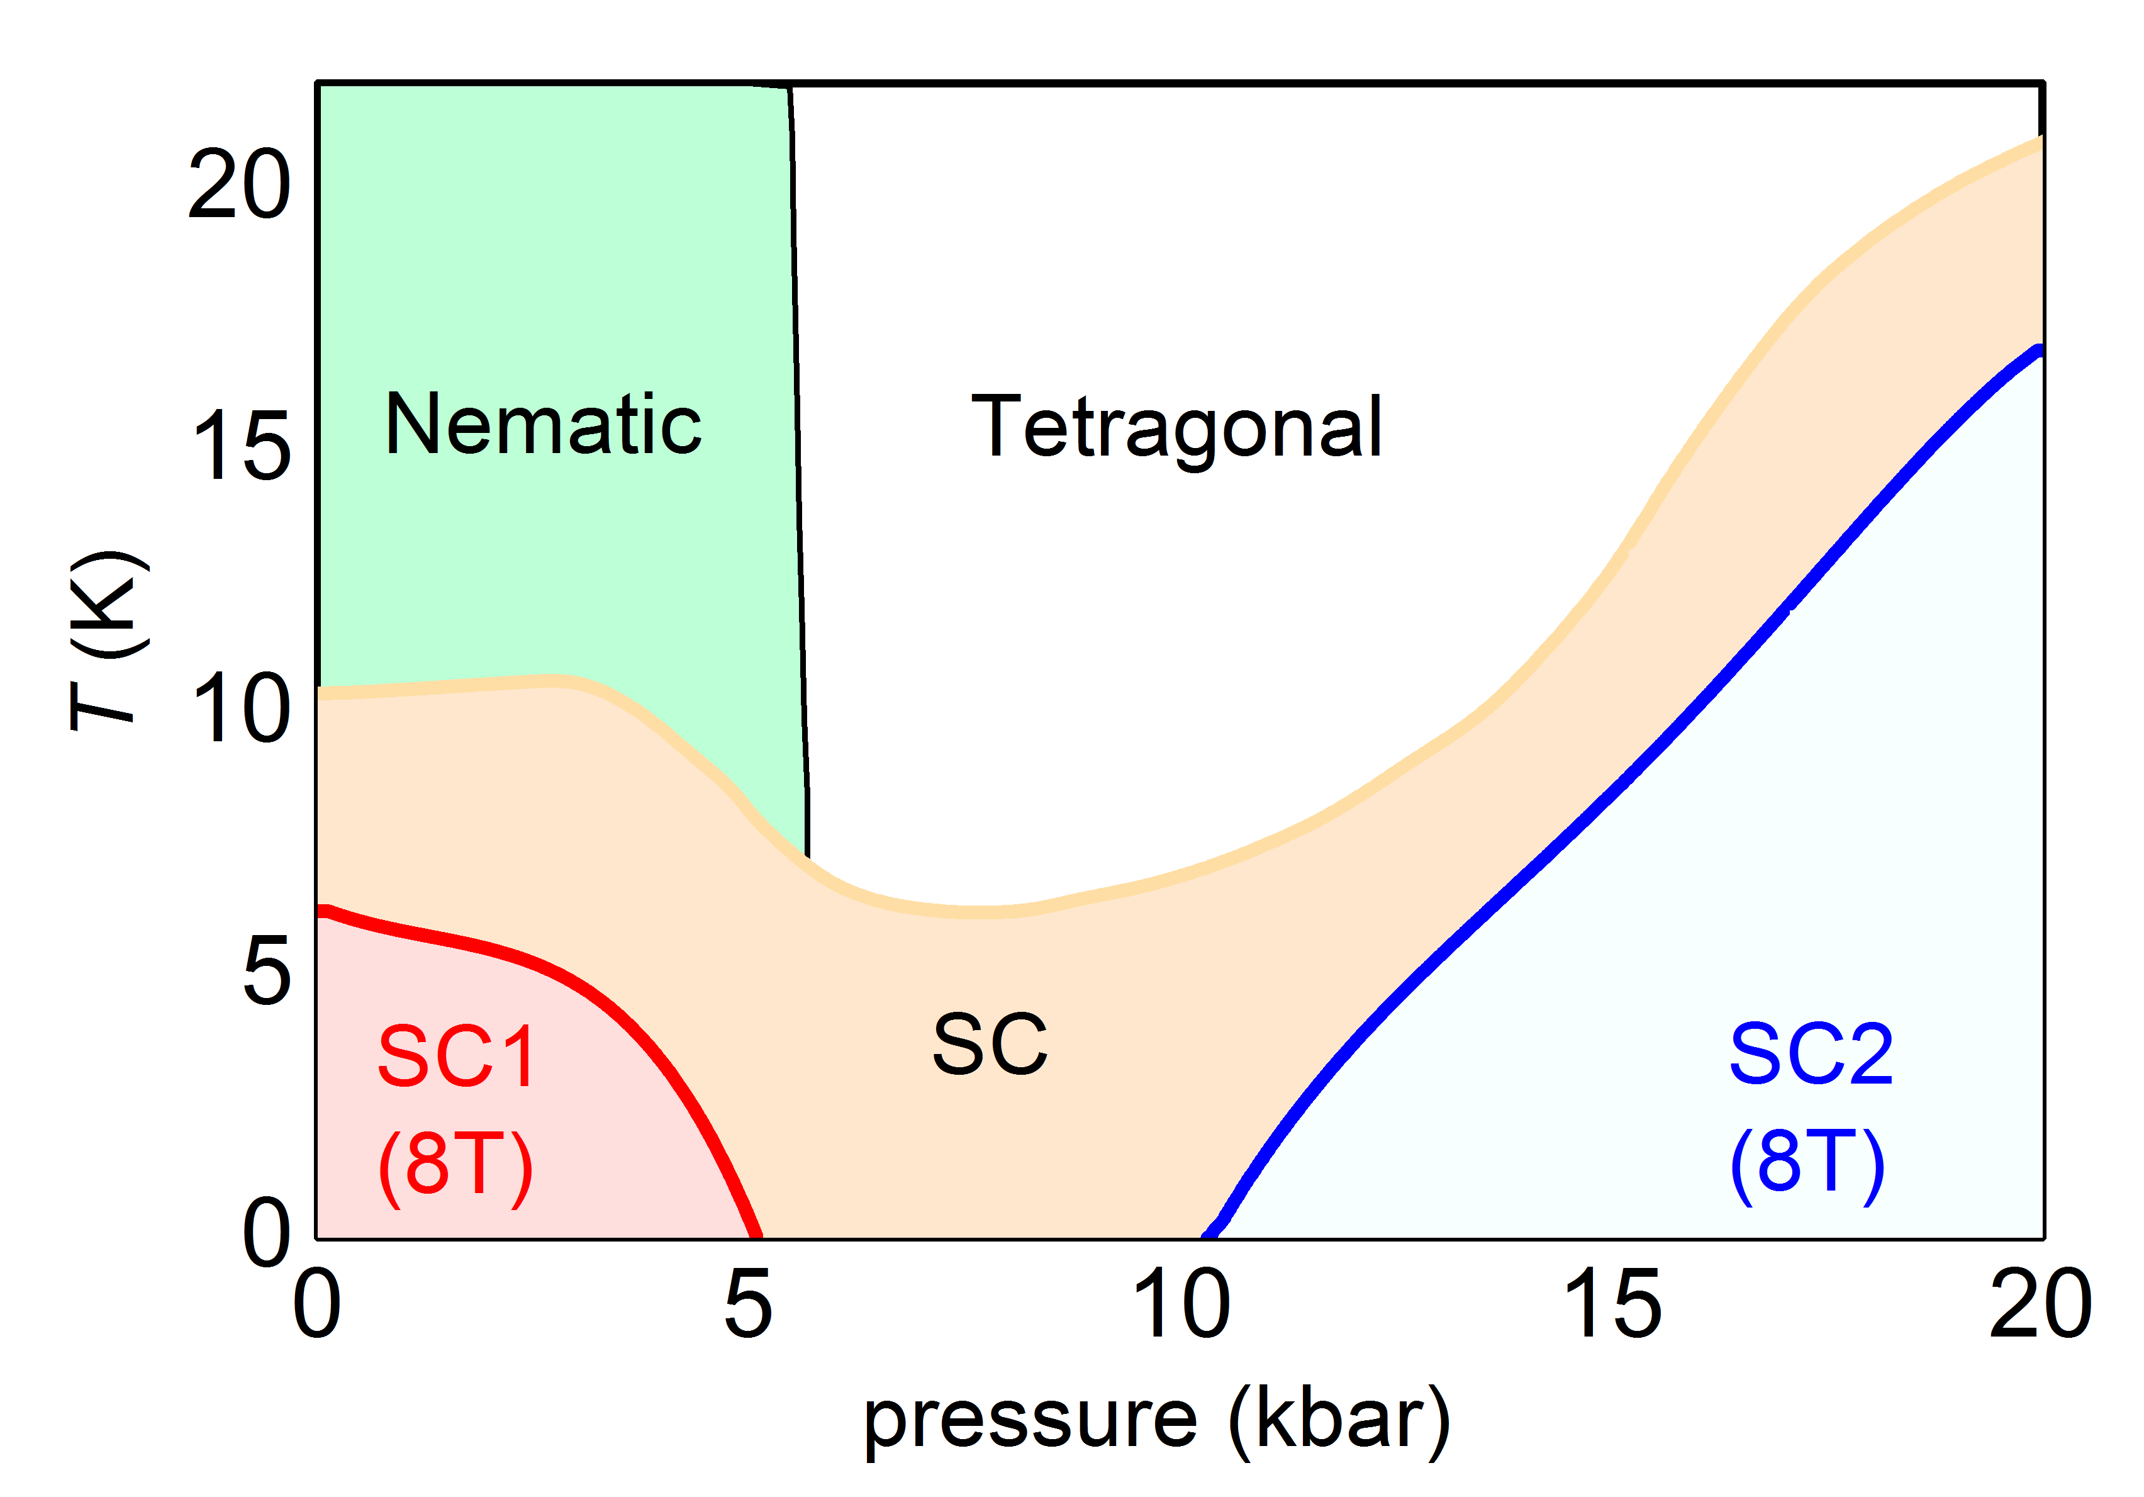
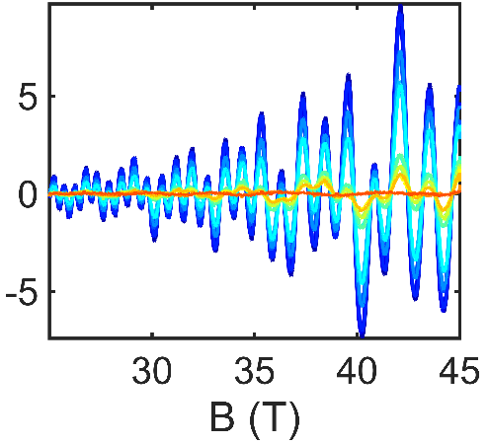
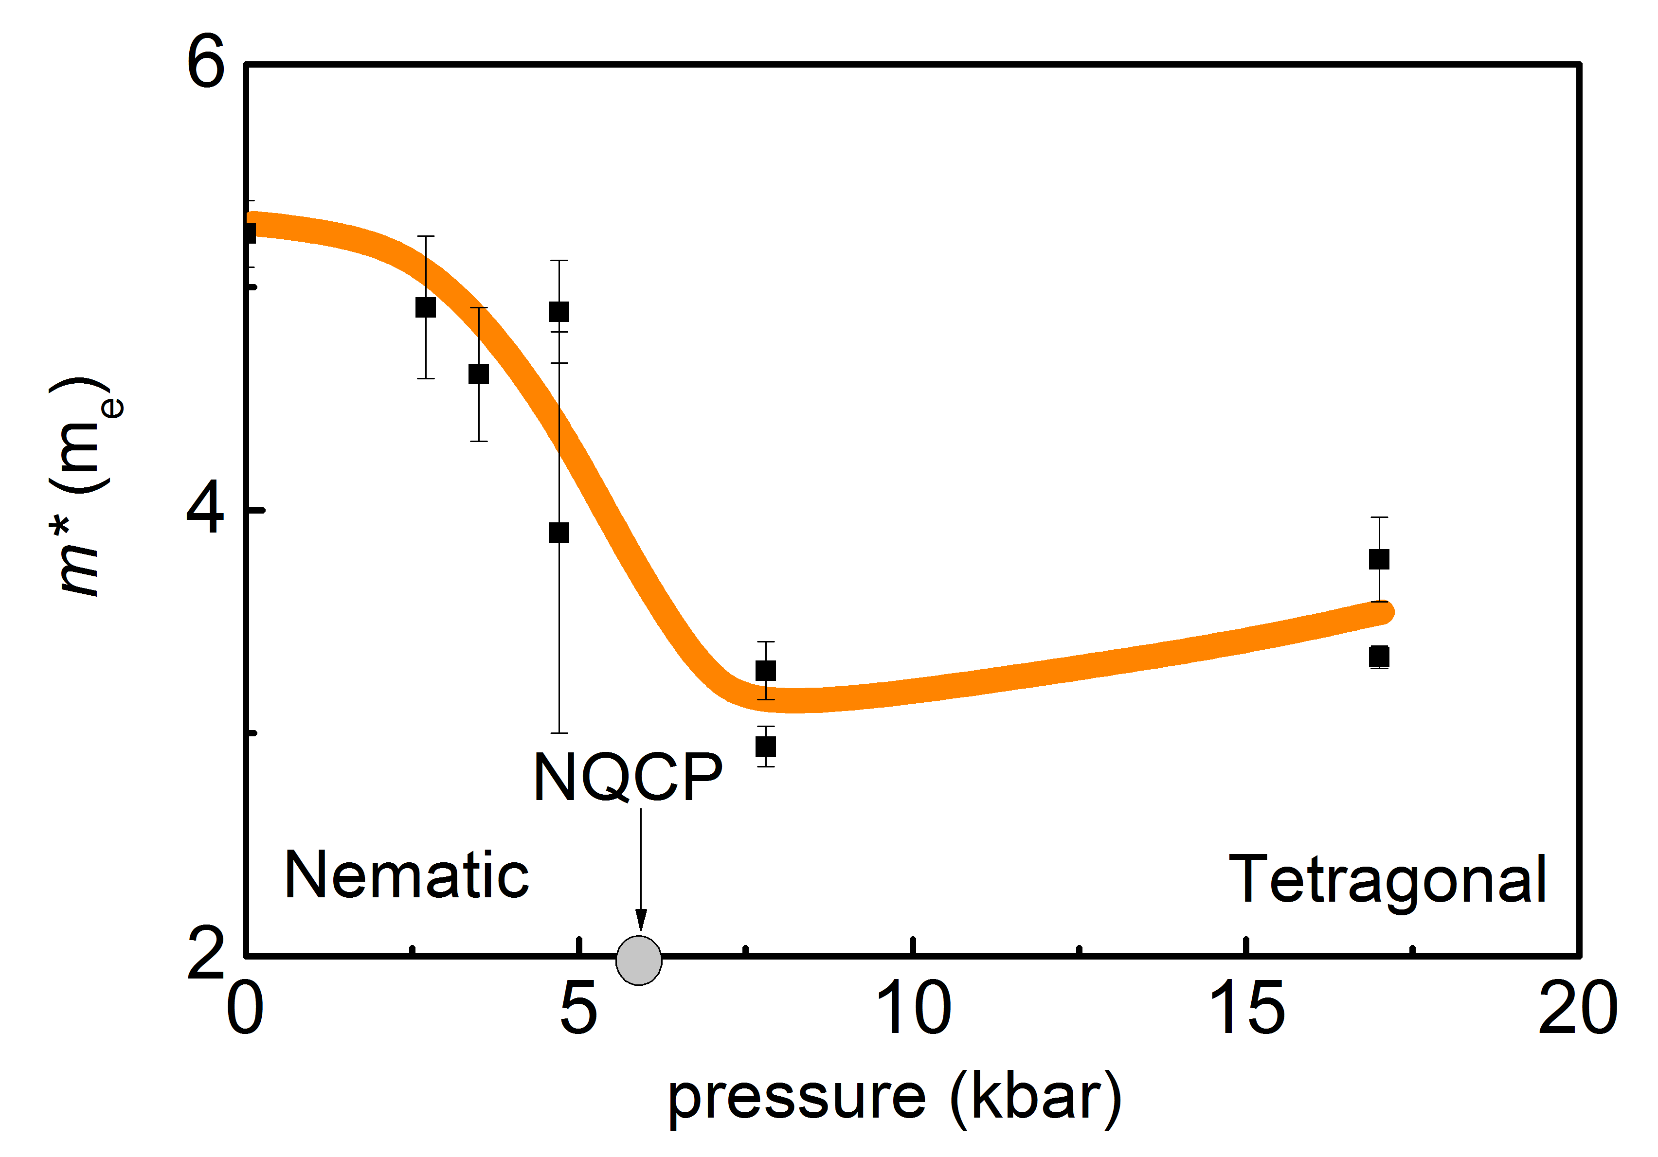
Influence of a nematic phase on high-temperature superconductivity
Pascal Reiss¹, David Graf², Amir A. Haghighirad^{1,3} and Amalia I. Coldea¹
1. University of Oxford; 2. NHMFL at Florida State University; 3. Karlsruhe Institute of Technology;
Funding Grants: G.S. Boebinger (NSF DMR-1157490, NSF DMR-1644779);
A.I. Coldea (EPSRC-UK: EP/I004475/1, EP/I017836/1; EP/M020517/1);
The term “nematic state” might sound exotic, but you may well carry examples in your digital watch or calculator display. In a nematic phase, the molecules display elements of both liquids and solids, hence the term “liquid crystal display”. By coupling high magnetic fields and high pressures, MagLab users have found that electrons in FeSe_{0.89}S_{0.11} change from a nematic phase at low pressures to a standard metallic tetragonal phase at higher pressures, crossing a nematic quantum critical point (NQCP) above 5 kbar.
Differences between the electron phases greatly affect the quantum mechanical states that emerge. In FeSe_{0.89}S_{0.11}, this results in two distinct superconducting phases, as seen in Fig.1a. The MagLab’s 45T hybrid magnet drove FeSe_{0.89}S_{0.11} into the normal state above 20 T (Fig. 1b) enabling users to trace the evolution of the Fermi surface (Fig. 1c) and electron correlations (Fig. 1d) as a function of pressure up to 20 kbar.
The data reveal that a Lifshitz transition (topological change in the Fermi surface) separates the two superconducting regions. The low pressure superconducting state (“SC1” in Fig. 1a) emerges from the nematic phase with a small Fermi surface and strong non-divergent electronic correlations, while the high pressure superconducting state (“SC2”) emerges from the tetragonal metallic phase possessing a large Fermi surface and weak electron correlations.
a
b
0 kbar
c
17 kbar
d
Figure 1. a) Phase diagram of the nematic superconductor FeSe_{0.89}S_{0.11} tuned by pressure indicating two superconducting phases that exist below the nematic and tetragonal phases. b) Resistance versus magnetic field at temperatures below 1.5 K. c) Quantum oscillations at 17 kbar across a range of temperatures, where blue indicates the lowest temperatures of ~0.3K. d). The changes in the effective mass of the charge carriers across the nematic phase transition. The nematic critical point (“NQCP”) is indicated by an arrow around 5.8 kbar.
Facilities used: NHMFL DC Field Facility, 45T hybrid magnet.
Citation: P. Reiss, D. Graf, A. A. Haghighirad, W. Knafo, L. Drigo, M. Bristow, A. J. Schofield and A. I. Coldea, Quenched nematic criticality and two superconducting domes in an iron-based superconductor, Nature Physics 28, Oct (2019); doi:10.1038/s41567-019-0694-2.

Slide 2
Influence of a nematic phase on high-temperature superconductivity
Pascal Reiss¹, David Graf², Amir A. Haghighirad^{1,3} and Amalia I. Coldea¹
1. University of Oxford; 2. NHMFL at Florida State University; 3. Karlsruhe Institute of Technology;
Funding Grants: G.S. Boebinger (NSF DMR-1157490, NSF DMR-1644779);
A.I. Coldea (EPSRC-UK: EP/I004475/1, EP/I017836/1; EP/M020517/1);
What is the finding? MagLab users studied the degree of electron interactions in FeSe_{0.89}S_{0.11}, a high-temperature superconductor that also exhibits a nematic state. What is unique in this material is that the nematic state has profound consequences for our understanding of high-temperature superconductivity. In the vicinity of the destruction of the nematic state in response to 5kbar of applied pressure, the electrons change from strongly influencing each other in the nematic phase to being more strongly influenced by the crystal lattice. As a result of the nematic phase, this material exhibits two distinct superconducting phases.
Why is this important? These observations suggest that the nematic state actually weakens superconductivity and, for FeSe_{0.89}S_{0.11} to achieve high-temperature superconductivity, another ingredient is needed such as magnetism.
Why did this research need the MagLab? The experimental challenge was to access the normal state of superconductors above 20T, to detect quantum oscillations and determine the degree of electron interactions in very clean single crystals. These experiments required very high magnetic fields up to 45T at temperatures as low as 0.3K, coupled with pressure cells to tune the applied pressure from 0 to 20kbar (0 to 20,000 atmospheres), allowing access the many different electronic phases.
a
b
0 kbar
Figure 1. a) Phase diagram of the nematic high-temperature superconductor, FeSe_{0.89}S_{0.11}, tuned by pressure, showing two superconducting phases (“SC1” and “SC2”) that exist below the nematic phase and the tetragonal (ordinary metal) phase. b) Resistance versus magnetic field at temperatures below 1.5 K. c) Quantum oscillations at 17 kbar across a range of temperatures, where blue indicates the lowest temperatures of ~0.3K. The temperature dependence of these oscillations measures the mass of the electrons, and hence the degree of electron interactions.
c
17 kbar
Facilities used: NHMFL DC Field Facility, 45T hybrid magnet.
Citation: P. Reiss, D. Graf, A. A. Haghighirad, W. Knafo, L. Drigo, M. Bristow, A. J. Schofield and A. I. Coldea, Quenched nematic criticality and two superconducting domes in an iron-based superconductor, Nature Physics 28, Oct (2019); doi:10.1038/s41567-019-0694-2.

