Slide 1


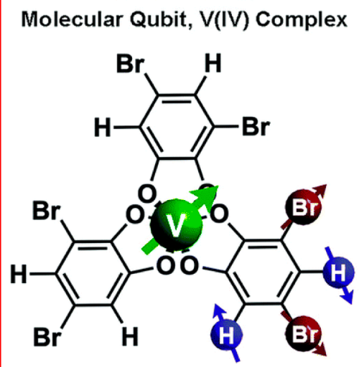
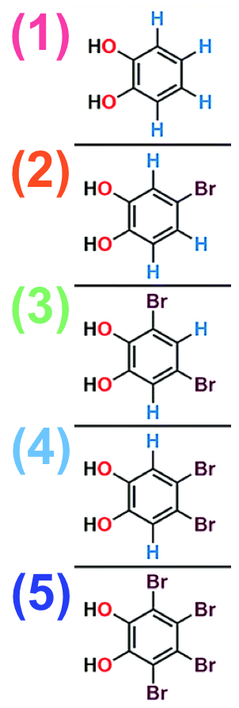
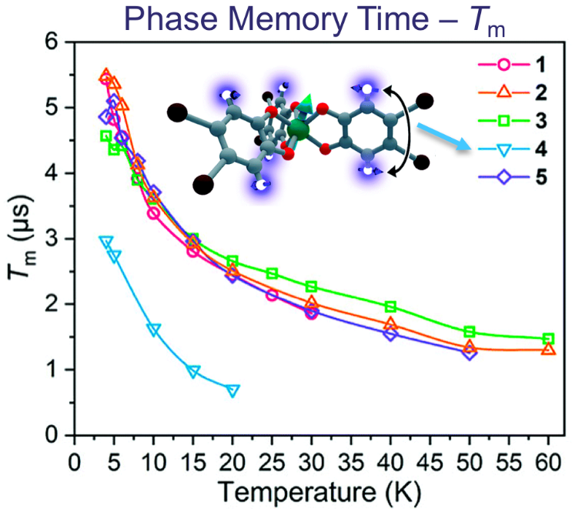
Nuclear Spin Patterning Controls Electron Spin Coherence
Cassidy Jackson¹, Chun-Yi Lin¹, Spencer Johnson¹, Johan van Tol² and Joseph Zadrozny¹
1. Colorado State University, Fort Collins; 2. National High Magnetic Field Laboratory, Tallahassee
Funding Grants: G.S. Boebinger (NSF DMR-1157490, NSF DMR-1644779);
J. M. Zadrozny (CHE-1836537, ACS PRF-60033-DNI3)
Achieving control of electron spin coherence in transition metal complexes, as measured by the quantum phase memory time, T_{m}, is an important goal in molecular spintronics.
In this study, users from Colorado State University provide the first evidence that nuclear-spin patterning in the ligand shell is an important handle to modulate T_{m} in magnetic molecules containing transition metal ions that are potential targets for next-generation quantum technologies. They synthesized and studied a series of five V^{IV} complexes with brominated catecholate ligands, [V(C₆H_{4−n}Br_{n}O₂)₃]²⁻ (with n = 0, 1, 2, and 4), where the ^{79/81}Br and ¹H nuclear spins are arranged in different substitutional patterns (see top and right-hand figures, where the top figure has the substitution pattern “3” as labeled in the figures on the right-hand side). High-field/frequency (120 GHz) pulsed electron paramagnetic resonance spectroscopic analysis of this series reveals a pattern-dependent variation in T_{m} for the spin-½ V^{IV} ion (see Figure, lower-left). Notably, it is shown that it is possible for two molecules (with substitutional patterns “3” and “4”) to have values of T_{m} that are markedly different (by a factor of two) despite having the same chemical composition.
NMR analyses of the protons on the ligand shell suggest that relative chemical shift, controlled by the patterning of nuclear spins, is an important underlying design principle. Having multiple protons with nearly identical chemical shifts will, ultimately, facilitate proton spin diffusion, giving rise to a shorter T_{m} for the bound metal ion.
(4)
Citation: Jackson, C.E.; Lin, C.; Johnson, S.H.; van Tol, J.; Zadrozny, J.M., Nuclear-spin-pattern control of electron-spin dynamics in a series of V(IV) complexes, Chem. Sci., 10 (36), 8447-8454 (2019) 10.1039/C9SC02899D
Facilities and instrumentation used: EMR program, 12.5 Tesla Pulsed EPR quasi-optic heterodyne spectrometer.

Slide 2
Nuclear Spin Patterning Controls Electron Spin Coherence
Cassidy Jackson¹, Chun-Yi Lin¹, Spencer Johnson¹, Johan van Tol² and Joseph Zadrozny¹
1. Colorado State University, Fort Collins; 2. National High Magnetic Field Laboratory, Tallahassee
Funding Grants: G.S. Boebinger (NSF DMR-1157490, NSF DMR-1644779);
J. M. Zadrozny (CHE-1836537, ACS PRF-60033-DNI3)
What is the finding? This study focuses on molecules containing transition metals that possess a single unpaired electron spin, for example, vanadium(IV) (see top figure). Such systems are of potential interest for next-generation quantum technologies. Electron spin resonance studies demonstrate that patterning of the organic groups on the periphery of the molecule with different atomic nuclei, e.g., protons (H) and bromine (Br) provides a handle on the quantum memory time, T_{m}, of the vanadium spin (see lower figure). Five different patterns of the peripheral organic groups are shown in the figures at right).
Why is this important? Achieving chemical control of the quantum coherence of electron spins in transition metal containing molecules is an important goal in the development of future quantum technologies. Atomic nuclei represent a stubborn source of magnetic noise that can dramatically shorten quantum memory times, hence the desire to be able to control such interactions chemically.
Why did this research need the MagLab? Many factors influence the quantum memory times (T_{m}) of electron spins in molecules. This study sought to isolate the influence of the atomic nuclei on the electron spin coherence, which necessitates measurements at high magnetic fields where the nuclear contribution dominates.
(4)
Facilities and instrumentation used: EMR program, 12.5 Tesla Pulsed EPR quasi-optic heterodyne spectrometer.
Citation: Jackson, C.E.; Lin, C.; Johnson, S.H.; van Tol, J.; Zadrozny, J.M., Nuclear-spin-pattern control of electron-spin dynamics in a series of V(IV) complexes, Chem. Sci., 10 (36), 8447-8454 (2019) 10.1039/C9SC02899D

