Slide 1
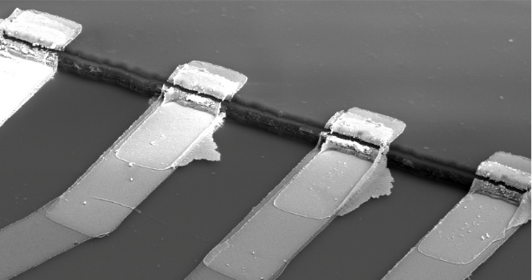
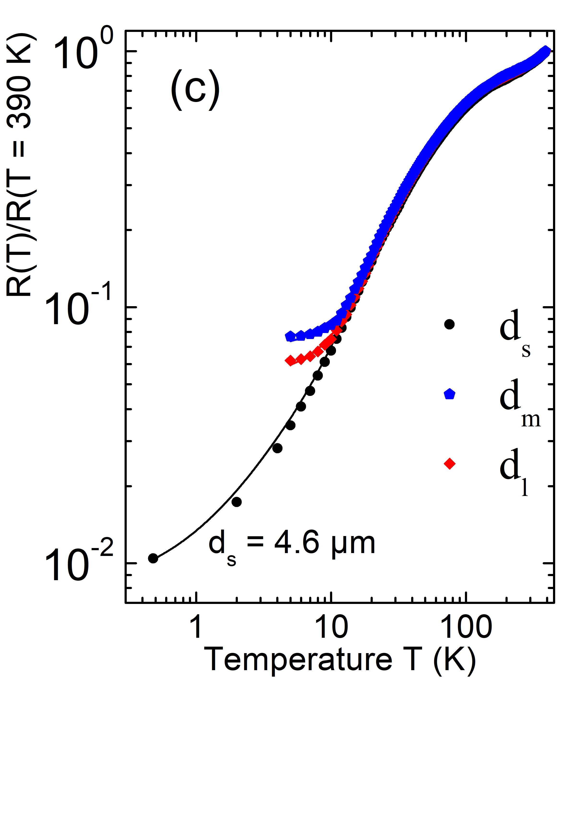
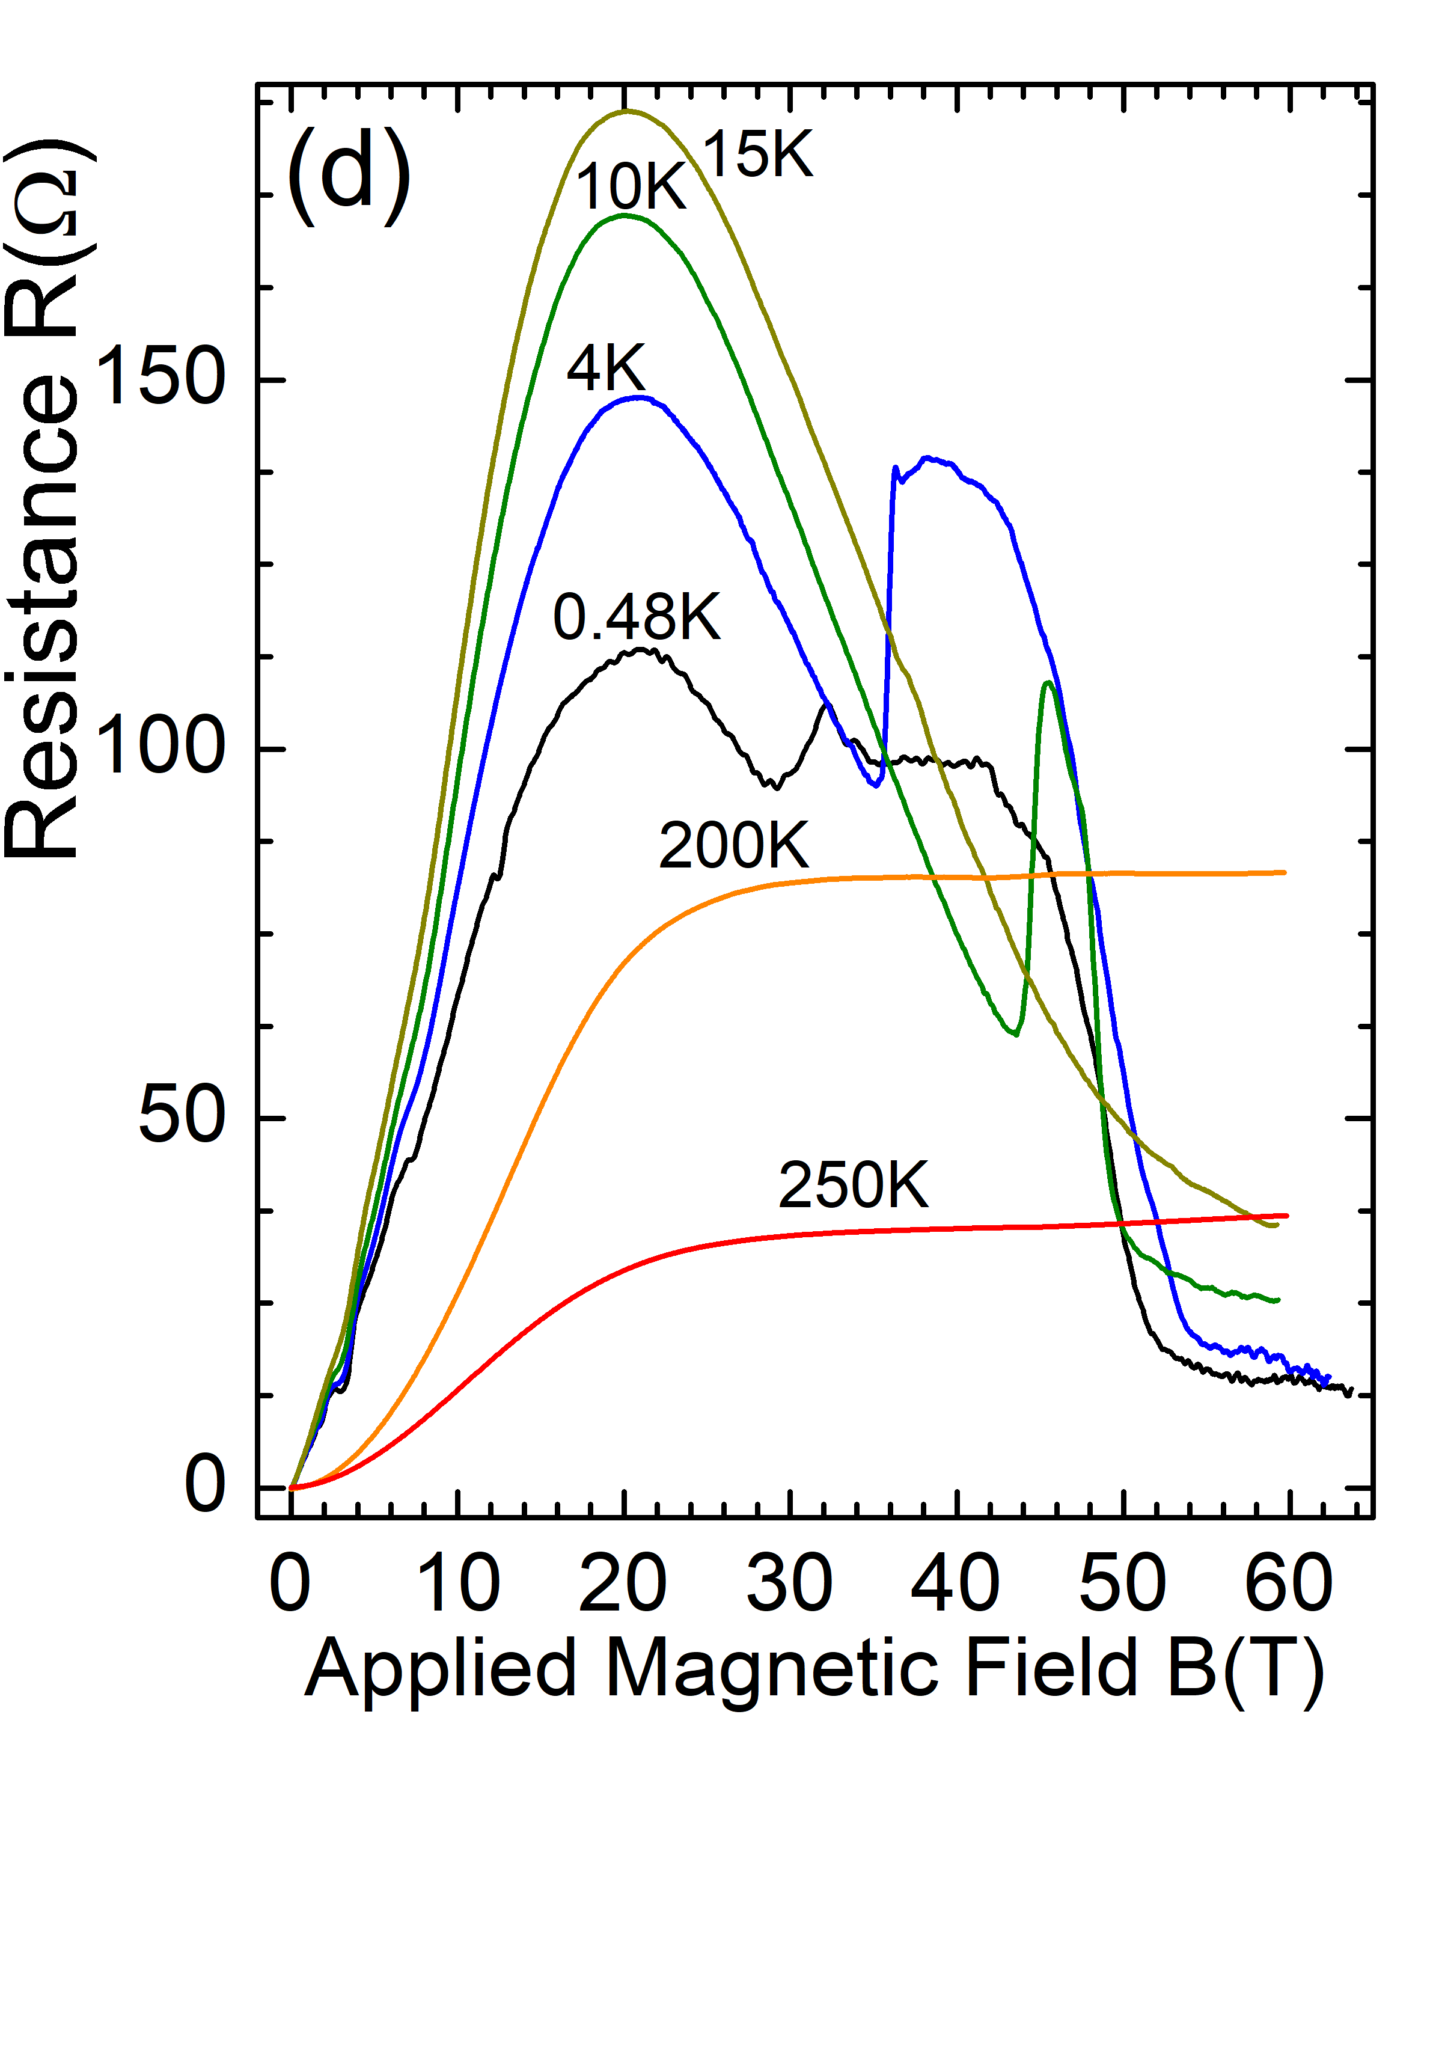
Record-Breaking Magnetoresistance measured in Natural Graphite
C. E. Precker¹, J. Barzola-Quiquia¹, P. D. Esquinazi¹, M. Stiller¹,
M. K. Chan², M. Jaime², Z. Zhang¹, and M. Grundmann¹,
1. Felix Bloch Institute, University of Leipzig, 04103 Leipzig, Germany; 2. LANL, Los Alamos, NM, USA
Funding Grants: G.S. Boebinger (NSF DMR-1157490, NSF DMR-1644779); M.J. & N.K.C. (U.S. DOE, BES “Science at 100T”); C.E.P., J.B-Q., P.D.E (DAAD 57207627, DFG ES 86/29-1 & 31047526)
The transport properties of ordered graphite samples are currently of interest because there is expected to be localized superconductivity and/or magnetic order due to the existence of “flat bands” localized at certain 2D interfaces normal to the c-axis. High-quality interfaces of large area are found between crystalline regions that have different stacking orders and/or different twist angles, labelled “interfaces” in (a).
In order to contact directly the embedded interfaces, MagLab users placed several electrodes at the edge (see (b)). The temperature dependence of the resistance (see (c)) shows a record-low value of R(4.8K)/R(390K) at the smallest electrode distance (d_{s}). The magnetoresistance (MR), the change of the resistance with magnetic field applied normal to the interfaces (see (d)) achieves record high values of ~100,000 at 0.48K and 21T and exhibits a giant magnetic anisotropy.
This MR of certain graphite interfaces exceeds in some temperature and field region the largest reported in any other solid. The results support the notion that granular super-conductivity is embedded at certain interfaces. To obtain the properties of these interfaces at T>100K, one further needs to minimize the parallel contribution of the semiconducting multigraphene matrix around the interfaces, which is the main origin of the field dependence observed at T>100K in (d).
(a)
(b)
Cr/Au electrodes
SiN_{x}
c-axis
c-axis
1µm
graphite edge
5µm
interfaces
Figure: (a) Scanning transmission electron microscopy image showing the internal structure of the sample with its interfaces. (b) Scanning electron microscopy image of part of the sample with Cr/Au electrodes on its edge.
(c) Temperature dependence of the normalized resistance of the sample at different voltage–electrodes distances localized at the same sample edge, as shown in panel (b). (d) Field dependence of the resistance at different temperatures for the shortest electrode distance, labelled “d_{s}” in panel (c).
Facilities and instrumentation used: NHMFL PFF & LANL, 65T short pulse magnet
Citation: Precker, C.E.; Barzola-Quiquia, J.; Esquinazi, P.D.; Stiller, M.; Chan, M.; Jaime, M.; Zhang, Z.; Grundmann, M.,
“Record-Breaking Magnetoresistance at the Edge of a Microflake of Natural Graphite”,
Advanced Engineering Materials 21 (12), 1900991 (2019) doi.org/10.1002/adem.201900991

Slide 2
Record-Breaking Magnetoresistance measured in Natural Graphite
C. E. Precker¹, J. Barzola-Quiquia¹, P. D. Esquinazi¹, M. Stiller¹,
M. K. Chan², M. Jaime², Z. Zhang¹, and M. Grundmann¹,
1. Felix Bloch Institute, University of Leipzig, 04103 Leipzig, Germany; 2. LANL, Los Alamos, NM, USA
Funding Grants: G.S. Boebinger (NSF DMR-1157490, NSF DMR-1644779); M.J. & N.K.C. (U.S. DOE, BES “Science at 100T”); C.E.P., J.B-Q., P.D.E (DAAD 57207627, DFG ES 86/29-1 & 31047526)
What is the finding? A record high value for magnetoresistance (MR), i.e. the change of the electrical resistance with magnetic field, has been found in natural graphite (see Figure), when the sensing electrodes are located at the edges of the sample. The results support the existence of highly-conducting two-dimensional (2D) interfaces (see (b)) located between highly ordered regions of graphene layers, shown schematically in (c).
Why is this important? Magnetoresistance (MR) in materials is of technological importance to the design of magnetic sensors and magnetic memory systems. Here we show that the MR of graphite can be increased at all temperatures if one manages to contact the interfaces appropriately. (b) The MR of graphite reported in the past is not intrinsic to the ideal graphite structure but depends on the internal interfaces and the location of the sensing electrodes. (c) The overall results suggest the huge MR results from the existence of granular superconductivity at certain 2D interfaces embedded between graphene planes in highly-ordered graphite samples.
Why did this research need the MagLab? The measurements were made over a broad temperature and magnetic field range, necessary for the comparison with published data and to ensure that the obtained signals were due to interfaces.
(a)
(b)
(d)
(c)
Figure: (a) Photo of a natural graphite sample. (b) Scanning transmission electron microscopy image showing the internal structure of the sample with its interfaces located between regions of different shades of gray. (c) Sketch how the electrodes are positioned at the edge of the sample in order to get the signal from an interface. The sketch shows the interface between an ABA… and ABCA… stacking orders as example. (d) A schematic representation of data showing the magnetoresistance (MR) reaching a ~10⁷% increase at sufficiently low temperatures (below 1K) and at 21T applied field.
Facilities and instrumentation used: NHMFL PFF & LANL, 65T short pulse magnet
Citation: Precker, C.E.; Barzola-Quiquia, J.; Esquinazi, P.D.; Stiller, M.; Chan, M.; Jaime, M.; Zhang, Z.; Grundmann, M.,
“Record-Breaking Magnetoresistance at the Edge of a Microflake of Natural Graphite”,
Advanced Engineering Materials 21 (12), 1900991 (2019) doi.org/10.1002/adem.201900991

