Slide 1
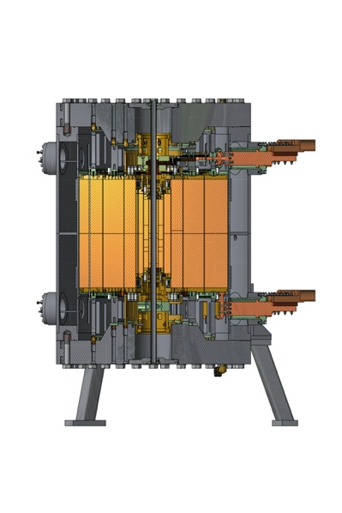
A Novel Safety System to Verify Absence of Voltage
on the MagLab’s 20 Kiloamp / 720 Volt Resistive Magnet Bus
J.A. Powell¹, S.T. Hannahs¹, T.P. Murphy¹, J.H. Smith¹, E. Stiers¹. K. Talley¹, S. Uppalapati¹
NHMFL, FSU
Funding Grants: G.S. Boebinger (NSF DMR-1157490, NSF DMR-1644779)
What is the development?
Because the MagLab’s resistive and hybrid magnets use high-current / high-voltage DC power supplies to energize our magnets, we must be absolutely sure that the power supplies are disconnected and isolated from the magnet before any maintenance or construction work begins on the magnets. The MagLab developed a new safety device (green box in the figure) to provide this capability without exposing workers to any sort of high voltage hazard.
Why is this important?
This new safety device enables technical work on magnet systems with uninsulated conductors by making certain that the power source is physically disconnected from the magnet.
Why did this research need the MagLab?
It is important for the MagLab to comply with safety standards from the Occupational Safety and Health Administration (OSHA). The MagLab scientific user facility combines state-of-the-art scientific instrumentation with industrial scale infrastructure to produce the highest magnetic fields in the world. This results in unique and extraordinary equipment needs, often requiring in-house technological developments due to a lack of commercial, off-the-shelf solutions. The skill and expertise of MagLab user facility engineers made the development of this one-of-a-kind safety system possible. This safety system passed an external expert review.
Magnet
Power Supply
(High Voltage)
Magnet Disconnects
Magnet
Power Bus
Test
Power Supply
and Voltmeter
(Low Voltage)
Figure: Schematic overview of a novel NHMFL safety system (green box). This system verifies that our magnet disconnects are open – so personnel can safely work on the magnet.
How does it work?
A test power supply applies a low voltage to the power bus and measures voltage on both sides of the magnet disconnect (purple arrow). This demonstrates that a voltage applied on the power bus does not appear on the magnet side of the open magnet disconnects.
The test device also performs a rigorous self-check to ensure that it is in full working order.
Facilities and instrumentation used: DC Field Facility.

