Slide 1
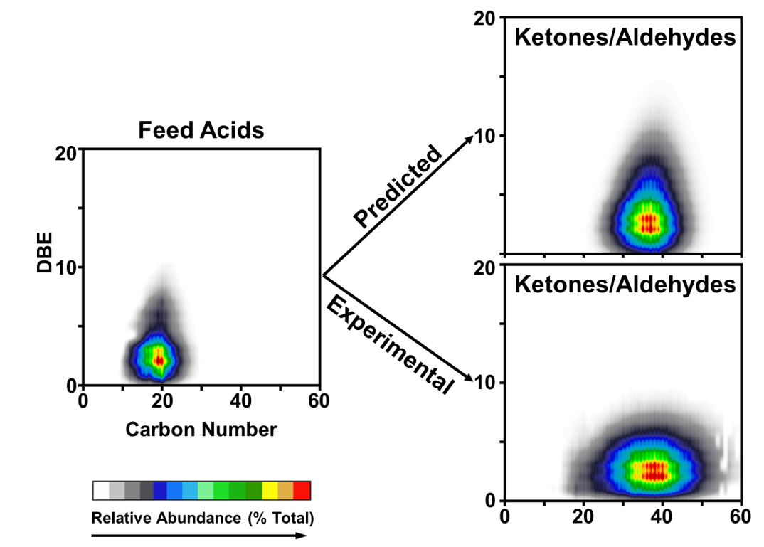
Understanding Oil Refinery Corrosion Caused by Acidic Crude Oils
Krajewski, L.C.^{1,2}, Robbins, W.K.², Corilo, Y.E.¹, Bota. G.⁴, Marshall, A.G.^{1,3}, and Rodgers, R.P.^{1,2,3}
ICR User Facility, National High Magnetic Field Laboratory 2. Future Fuels Institute (FFI) 3. Department of Chemistry and Biochemistry, Florida State University 4. Inst. for Corrosion and Multiphase Tech, Ohio University
Funding Grants: G.S. Boebinger (NSF DMR-1157490), R.P. Rodgers (FFI)
“Opportunity crudes” are crude oils available at discounted price due to higher concentration of sulfur and organic acids (naphthenic acids). Reactive sulfur (sulfur compounds that react with iron) and naphthenic acids cause corrosion in refineries at a cost of ~ $1 billion annually. However, the two types of corrosive species react in different ways. Sulfur reacts with iron to form oil-insoluble iron sulfide scale, whereas naphthenic acids react to form oil-soluble iron naphthenate. Iron naphthenate then decomposes at refining temperatures to yield an oil-soluble ketone and oil-insoluble ferrite and magnetite (Fe₃O₄). Importantly, the ketone composition reveals which specific acids initially reacted with iron to form the iron naphthenate. This is critical information, because corrosion rates do not correlate well with naphthenic acid concentration, suggesting that only a fraction of the naphthenic acids are reactive. Naphthenic acids are composed of tens of thousands of different species, so ultrahigh resolution mass spectrometry is required for the compositional analysis of the original unreacted naphthenic acids and the ketone products. We present here the first mass spectral analysis of both, and highlight potential applications in commercial refineries. Corrosion tests were conducted at Ohio University, and samples were sent to the MagLab for analysis.
Figure. (left) Molecular analysis of the feed naphthenic acids before the corrosion test provides the carbon number (x-axis) and “Double Bond Equivalents (DBE, the number of rings and double bonds to carbon, on the y-axis). The acids react with iron and then decompose to form the ketone corrosion products, so knowledge of the acid composition allows prediction of the corrosion ketone products, assuming that each acid is equally likely to react (top, right). The actual ketone corrosion products (bottom, right) are centered at the same carbon number as predicted, suggesting little dependence on carbon number, but are lower in DBE, which suggests lower DBE species are more reactive with iron.
Facilities: 9.4T passive Fourier Transform – Ion Cyclotron
Resonance (FT-ICR) Mass Spectrometer (MS)
Citation: Krajewski, L.; Robbins, W.K.; Corilo, Y.E.; Bota, G.;
Marshall, A.G.; Rodgers, R.P., “Characterization of Ketones Formed in the Open System Corrosion Test of Naphthenic Acids by Fourier Transform Ion Cyclotron Resonance Mass Spectrometry”, Energy Fuels 33 (6), 4946-4950 (2019) doi.org/10.1021/acs.energyfuels.9b00626

Slide 2
Understanding Oil Refinery Corrosion Caused by Acidic Crude Oils
Krajewski, L.C.^{1,2}, Robbins, W.K.², Corilo, Y.E.¹, Bota. G.⁴, Marshall, A.G.^{1,3}, and Rodgers, R.P.^{1,2,3}
ICR User Facility, National High Magnetic Field Laboratory 2. Future Fuels Institute (FFI) 3. Department of Chemistry and Biochemistry, Florida State University 4. Inst. for Corrosion and Multiphase Tech, Ohio University
Funding Grants: G.S. Boebinger (NSF DMR-1157490), R.P. Rodgers (FFI)
What is the finding? We show that corrosion in acidic crude oils depends on the specific structures of the acid molecules. Acids with fewer rings and double bonds in their structure are more corrosive.
Why is this important? “Opportunity crudes” are those crude oils available at discounted price due to higher concentration of organic acids (naphthenic acids). Naphthenic acids cause corrosion in the steel pipes of oil refineries at a cost of ~ $1 billion annually. The acids react with iron in the steel to form oil-soluble iron naphthenates, which decompose at refinery temperature to yield oil-soluble ketones and oil-insoluble iron and magnetite (Fe₃O₄). Each ketone is composed of the two acids that initially reacted with iron to form the iron naphthenate, so analysis of the ketones formed reveals which specific naphthenic acids reacted with iron. Not all acids are equally corrosive, so this knowledge can be used to provide more accurate oil pricing and better refinery strategy.
Why did this research need the MagLab? There are tens of thousands of different naphthenic acids, so the ultrahigh resolution mass spectrometers at the Maglab are required to resolve and identify the original unreacted naphthenic acids and the ketone products.
Figure. (left) Molecular analysis of the feed naphthenic acids before the corrosion test provides the carbon number (x-axis) and “Double Bond Equivalents (DBE, the number of rings and double bonds to carbon, on the y-axis). The acids react with iron and then decompose to form the ketone corrosion products, so knowledge of the acid composition allows prediction of the corrosion ketone products, assuming that each acid is equally likely to react (top, right). The actual ketone corrosion products (bottom, right) are centered at the same carbon number as predicted, suggesting little dependence on carbon number, but are lower in DBE, which suggests lower DBE species are more reactive with iron.
Facilities: 9.4T passive Fourier Transform – Ion Cyclotron
Resonance (FT-ICR) Mass Spectrometer (MS)
Citation: Krajewski, L.; Robbins, W.K.; Corilo, Y.E.; Bota, G.;
Marshall, A.G.; Rodgers, R.P., “Characterization of Ketones Formed in the Open System Corrosion Test of Naphthenic Acids by Fourier Transform Ion Cyclotron Resonance Mass Spectrometry”, Energy Fuels 33 (6), 4946-4950 (2019) doi.org/10.1021/acs.energyfuels.9b00626

