Slide 1
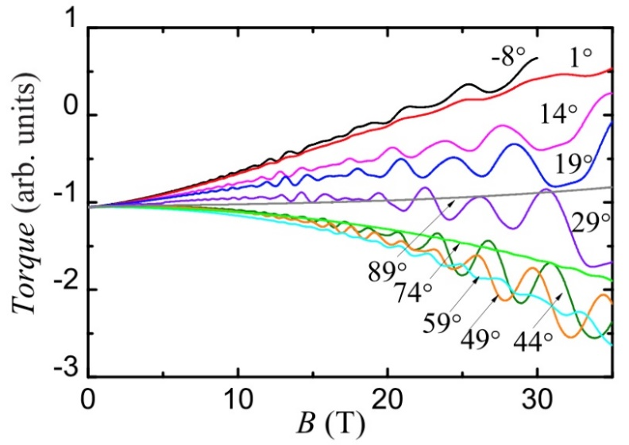
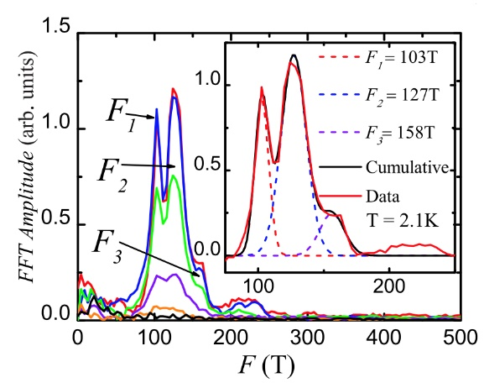
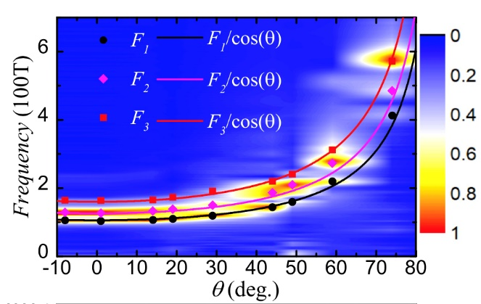
Exploring Topological Semimetals in High Magnetic Fields
Liu, J^{.1,} Liu, P.², Gordon, K.³, Emmanouilidou¹, E., Xing, J.¹, Graf, D.⁴, Chakoumakos, B.⁵, Wu, Y. ⁵,
Cao, H. ⁵, Dessau, D. ³, Liu, Q.^{2, 6}, Ni, N.¹
Univ. of California; 2. Southern Univ. of Science and Tech., China; 3. Univ. of Colorado, Boulder; 4. NHMFL; 5. Oak Ridge Nat’l Lab; 6. Peng Cheng Laboratory, China
Funding Grants: G.S. Boebinger (NSF DMR-1644779); N. Ni (DOE DE-SC0011978)
The experimental realization of topological semimetals within the past decade has stimulated a great deal of research owing to the observation of new quantum phenomena, some which may persist to temperatures approaching room temperature (300K). This robustness arises from topological protection and allows one to envision future quantum devices that become part of our everyday technology.
The key to understanding topological materials lies in determining how the electrons behave in the crystal structure and how they interact with one another. These experiments examined the quantum transport behavior and Fermi surface of the electrons in SrZnSb₂. The MagLab’s high magnetic fields enabled the shape of the Fermi surface to be measured along with the electron effective mass, which indicates the degree of influence of electron-electron interactions in the material. From these results, MagLab users determined that two of the four observed electron orbits on the Fermi surface are topologically non-trivial, likely because these charge carriers are Dirac quasiparticles.
This study combined extensive experimental work with first-principles calculations to determine if SrZnSb₂ is a topological material. Each new topological material studied puts the scientific community closer to the goal of room temperature quantum devices.
(a)
Figure: (a) Raw quantum oscillation data as the applied magnetic field is tilted away from the a-axis.
(b) Fast Fourier transform (FFT) of the raw data in (a) showing the three orbits versus temperature.
(c) Angular dependence of the three main orbits.
(b)
(c)
Facilities and instrumentation used: DC Field Facility, 35 T (cell 12), 9 T (SCM6).
Citation: Liu, J.Y.; Liu, P.F.; Gordon, K.; Emmanouilidou, E.; Xing, J.; Graf, D.E.; Chakoumakos, B.C.; Wu, Y.; Cao, H.B.; Dessau, D.; Liu, Q.H.; Ni, N.,
Nontrivial topology in the layered Dirac nodal-line semimetal candidate SrZnSb₂ with distorted Sb square nets, Phys. Rev. B, 100, 195123 (2019)
doi.org/10.1103/PhysRevB.100.195123

Slide 2
Exploring Topological Semimetals in High Magnetic Fields
Liu, J^{.1,} Liu, P.², Gordon, K.³, Emmanouilidou¹, E., Xing, J.¹, Graf, D.⁴, Chakoumakos, B.⁵, Wu, Y. ⁵,
Cao, H. ⁵, Dessau, D. ³, Liu, Q.^{2, 6}, Ni, N.¹
Univ. of California; 2. Southern Univ. of Science and Tech., China; 3. Univ. of Colorado, Boulder; 4. NHMFL; 5. Oak Ridge Nat’l Lab; 6. Peng Cheng Laboratory, China
Funding Grants: G.S. Boebinger (NSF DMR-1644779); N. Ni (DOE DE-SC0011978)
What is the finding? SrZnSb₂ was found to be a topological semimetal by using high magnetic fields to measure the shape of the Fermi surface and the strength of interactions between the electrons.
Why is this important? Topological semimetals and other topological materials comprise an exciting new area of research in condensed matter physics because they host a variety of quantum mechanical states which are observable on a macroscopic scale and are stable to high temperatures. Thus, topological materials raise the possibility of exploiting quantum mechanics to make devices with new functionalities that work at room temperature.
Why did this research need the MagLab? Measuring quantum oscillations allows scientists to measure how the electrons in a material interact with the crystalline structure and with each other. High magnetic fields are needed to fully explore the environment experienced by the conduction electrons in SrZnSb₂. As shown in Fig. (a), the oscillatory component of the signal grows exponentially with the magnetic field. The information gleaned from these measurements provides important insights into the source of the unique physics present in topological materials.
(a)
Figure: (a) Raw quantum oscillation data as the applied magnetic field is tilted away from the a-axis.
(b) Fast Fourier transform (FFT) of the raw data in (a) showing the three orbits versus temperature.
(c) Angular dependence of the three main orbits.
(b)
(c)
Facilities and instrumentation used: DC Field Facility, 35 T (cell 12), 9 T (SCM6).
Citation: Liu, J.Y.; Liu, P.F.; Gordon, K.; Emmanouilidou, E.; Xing, J.; Graf, D.E.; Chakoumakos, B.C.; Wu, Y.; Cao, H.B.; Dessau, D.; Liu, Q.H.; Ni, N.,
Nontrivial topology in the layered Dirac nodal-line semimetal candidate SrZnSb₂ with distorted Sb square nets, Phys. Rev. B, 100, 195123 (2019)
doi.org/10.1103/PhysRevB.100.195123

