Slide 1
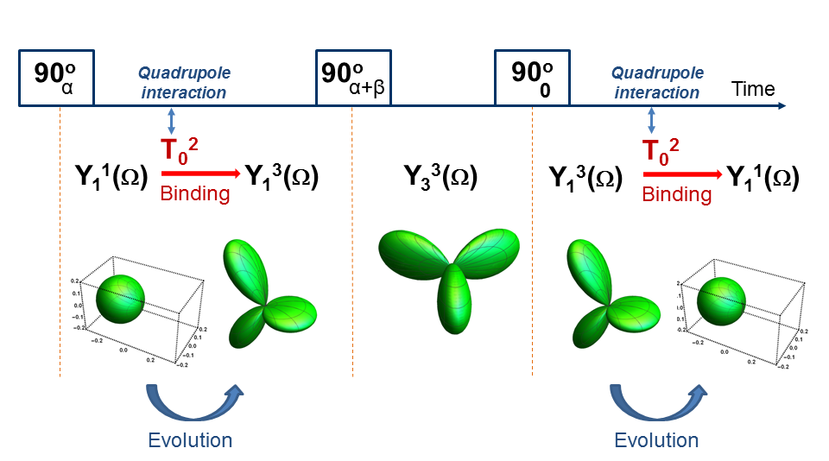
Analytical tool for in vivo magnetic resonance signals
Victor D. Schepkin
National High Magnetic Field Lab/Florida State University
Funding Grants: G.S. Boebinger (NSF DMR-1157490, NSF DMR-1644779)
Many scientists, including MagLab users, widely utilize triple quantum (TQ) magnetic resonance (MR) signals in their research. For in vivo experiments, such signals come mainly from sodium and potassium ions which interact with negatively charged groups of macromolecules, mainly proteins. MR signals appearing as a result of protein interactions indicate changes of intracellular ion content in vivo during diseases and drug administration. These signals can be efficiently extracted from other ions by using TQ effects. Note that the behavior of the MR magnetization in the presence of spin >1/2 is not possible to explain by the simple vector model routinely used for proton MR.
The computer based tool is presented to describe and visualize the results of MR signal evolution in vivo in multi-pulse MR experiments. The system of theoretical equations describes MR signal evolution exactly without any approximation and needs to be constructed only once, which is then valid for any interval in the pulse sequence as well as for any spin value. The theoretical calculations are illustrated using the power of “Mathematica” software (Wolfram Inc.) for traditional TQ radio frequency (RF) pulse sequence (see Figure). The results of calculations can be visualized, noting that MR magnetization must remain unchanged during a parity transformation, i.e. changing the sign of all coordinates.
Figure: The analytical tool is illustrated by visualization of the triple quantum (TR) magnetic resonance (RF) signals inside the traditional TQ RF pulse sequence. Spherical harmonics Y_{m}^{L}(Ω), which are presented also graphically (green color), represent the changes of nuclear magnetization for spin = 3/2, as created by RF pulses in the presence of the quadrupole interaction indicated by T₀². The central goal of the TQ pulse sequence is to create MR magnetization in the state of Y₃³(Ω). Note that all states of the magnetization Y_{m}³(Ω) for any “m” are not observable in experiments and can be represented only mathematically. At the end of the TQ pulse sequence the quadrupole interaction is needed again to evolve the unobservable state Y₁³(Ω) into observable MR magnetization state presented by Y₁¹(Ω).
Facilities: CIMAR, National High Magnetic Field Lab, Tallahassee, FL
Citation: Schepkin, V.D., Statistical tensor analysis of the MQ MR signals generated by weak quadrupole interactions.,
Zeitschrift fur Medizinische Physik, 29 (4), 326-336 (2019) doi.org/10.1016/j.zemedi.2019.03.002

Slide 2
Analytical tool for in vivo magnetic resonance signals
Victor D. Schepkin
National High Magnetic Field Lab/Florida State University
Funding Grants: G.S. Boebinger (NSF DMR-1157490, NSF DMR-1644779)
What is the finding? The computer based mathematical analysis and software is presented to describe and visualize the results of magnetic resonance (MR) experiments in the presence of in vivo ion binding.
Why is this important? The results of a variety of MR experiments can be predicted and described exactly for any combination of the RF pulses. A concise mathematical presentation of MR signals - including the complex signals from bound positively-charged ions, such as sodium and potassium - fosters efficient guidance for the development of diverse in vivo applications. The triple quantum signals have a special value by representing explicitly only bound ions, and because of this provide valuable intact physiological information about cell functioning both in vivo and in bioreactors. For example, in vivo changes of intracellular sodium can be measured during drug administration or diseases. The novel in vivo MR signal applications developed to date are encouraging, attracting strong interest among MagLab users and other scientists.
Why did this research need the MagLab? The ultra-high magnetic fields dramatically increase MR sensitivity allowing for the detection of novel MR signals from sodium and potassium. The MagLab provides expertise and an exceptional facility to conduct such research.
Fig. 1. The computer based analytical tool is illustrated by visualization of the TQ MR signals inside the traditional TQ RF pulse sequence used to detect bound ions. The shapes shown graphically (green color) represent the changes of nuclear magnetization in vivo for bound ions such as sodium and potassium. The central goal of the TQ pulse sequence is to create MR magnetization in the state indicated by Y₃³(Ω), which oscillates three times more quickly than MR signal from non-bound ions. Thus, the MR signal from bound ion can be efficiently separated and provide valuable physiological information about in vivo cell functioning.
Facilities: CIMAR, National High Magnetic Field Lab, Tallahassee, FL
Citation: Schepkin, V.D., Statistical tensor analysis of the MQ MR signals generated by weak quadrupole interactions.,
Zeitschrift fur Medizinische Physik, 29 (4), 326-336 (2019) doi.org/10.1016/j.zemedi.2019.03.002

