Slide 1
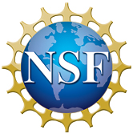
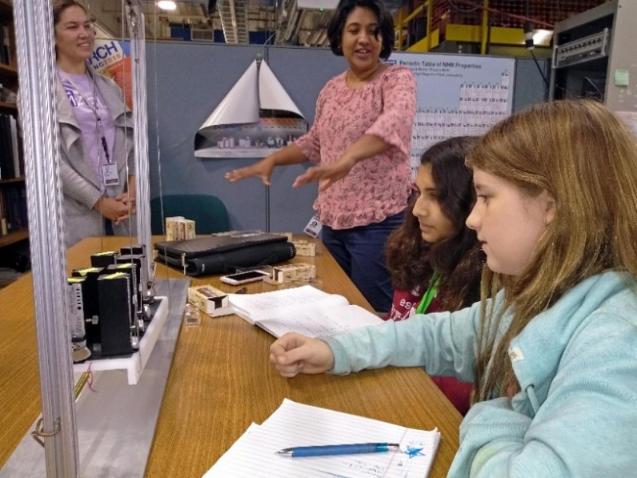
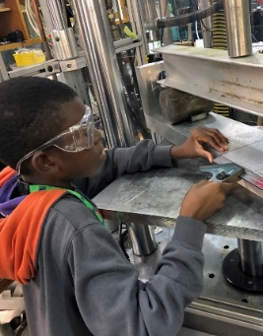
MagLab K-12 Education: Middle School Mentorship
R.M. Hughes, C.R. Villa, K.L. Roberts
Center for Integrating Research and Learning, National High Magnetic Field Laboratory
Funding Grants: G.S. Boebinger (NSF DMR-1157490, NSF DMR-1644779)
Why is this important? Over the past 20 years, the MagLab’s Middle School Mentorship Program has given over 200 middle school students a chance to conduct a research project with a MagLab scientist or engineer. For 14 weeks during the fall semester, 20 students come to the MagLab on Friday mornings to work alongside scientists, technicians, and engineers. During their time at the MagLab, the students participate in real-world scientific research and have an opportunity to preview STEM careers that they could pursue.
What is the new finding? In 2019, our mentorship program assessments showed a statistically-significant increase in the students’ self-efficacy, scientific literacy, and perceptions of science and engineering. This shows the positive impact the MagLab’s Middle School Mentorship programs have on students’ STEM confidence and interest. Additionally, 70.5% of parents indicated that their opinion of the MagLab had changed positively. One parent offered the following: “[My child] came away with an amazing array of new scientific vocabulary ... I had high expectations about this program [and] the results were better than I expected!”
Why did this research need the MagLab? The Middle School Mentorship program at the MagLab has provided mentorship to cohorts of students over a long period of time. This allows the MagLab’s Center for Integrating Research and Learning to study how research opportunities and mentoring benefit middle school youth. The NSF and the MagLab share a common interest in developing a better understanding of the components of a positive mentoring experience, especially for middle school students who are at a crucial developmental age.
Right: Mentors look on as their middle school students finish setting up their experiment (Photo Credit: Kristen Coyne).
Below: A student works on a mechanical fatigue test (Photo credit Bob Walsh).
Facilities and instrumentation used: Applied Superconductivity Center, Magnet Science & Technology, Ion Cyclotron Resonance, Condensed Matter Science, Geochemistry, Nuclear Magnetic Resonance, and Electromagnetic Resonance.

