Slide 1
Molecular Magnetic Building Blocks
J.-L. Liu^{1,2,3}, K.S. Pedersen^{1,4}, S.M. Greer⁵, I. Oyarzabal^{1,6}, A. Mondal^{1,7}, S. Hill⁵, F. Wilhelm⁸, A. Rogalev⁸, A. Tressaud², E. Durand², J.R. Long⁹, R. Clérac^{1,2}
1. CRPP, Bordeaux; 2. Univ. Bordeaux; 3. Sun Yat-Sen Univ.; 4. TU Denmark; 5. FSU & NHMFL; 6. Univ. Basque Country; 7. IIS Bangalore; 8. ESRF Grenoble; 9. UC Berkeley & LBNL
Funding Grants: G.S. Boebinger (NSF DMR-1157490, DMR-1644779); J.R. Long (NSF CHE-1800252); R. Clérac (ANR & CNRS)
The fundamental coordination chemistry of 4d and 5d transition metal ions remains much less explored and underdeveloped in comparison to their lighter 3d analogs. Recent results showing the promise of heavier transition metal ions in advanced molecule-based magnetic materials has sparked interest in engineering their physical properties, notably their magnetic anisotropy.
This study reports the first transition metal complexes featuring mixed fluorine and cyanide ligands, namely trans-[M^{IV}F₄(CN)₂]²⁻ (where M = Re, Os). These complexes were isolated using a novel synthetic approach relying on silicon-mediated fluoride abstraction (see top of Figure). A strong and significant enhancement of the magnetic anisotropy for the Re^{IV} complex, as compared to the parent [ReF₆]^{2–} anion, is demonstrated by combined analysis of high-field electron paramagnetic resonance (HF-EPR) spectroscopy (see lower Figure) and magnetization measurements.
This ligand-field engineering methodology paves the way toward the realization of new transition metal complexes featuring extremely strong magnetic anisotropy, complexes that could serve as useful building-blocks for the design of high-performance molecule-based magnetic materials.
Re, Os )
EPR Intensity (arb. units)
Figure. (top) Synthetic approach for targeted substitution of fluoride ligands for cyanide, yielding trans-[M^{IV}F₄(CN)₂]²⁻, starting from M^{IV}F₆. (lower) HF-EPR spectrum (203.2 GHz & 5 K), with the inset showing peak positions deduced from measurements at several frequencies (*, ^ & # denote impurity signals).
Facilities and instrumentation used: EMR Facility (15/17T SC magnet and spectrometer).
Citation: J.-L. Liu, K.S. Pedersen, S.M. Greer, A. Mondal, S. Hill, F. Wilhelm, A. Rogalev, A. Tressaud, E. Durand, J.R. Long, R. Clérac,
Access to Heteroleptic Fluorido-Cyanido Complexes with a Large Magnetic Anisotropy via Fluoride Abstraction, Angew. Chem.
(online March 2020); https://doi.org/10.1002/anie.201914934

Slide 2
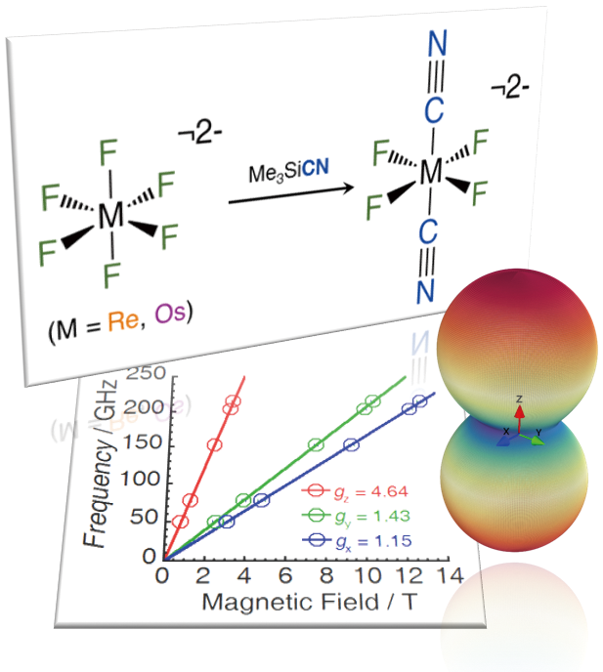
Molecular Magnetic Building Blocks
J.-L. Liu^{1,2,3}, K.S. Pedersen^{1,4}, S.M. Greer⁵, I. Oyarzabal^{1,6}, A. Mondal^{1,7}, S. Hill⁵, F. Wilhelm⁸, A. Rogalev⁸, A. Tressaud², E. Durand², J.R. Long⁹, R. Clérac^{1,2}
1. CRPP, Bordeaux; 2. Univ. Bordeaux; 3. Sun Yat-Sen Univ.; 4. TU Denmark; 5. FSU & NHMFL; 6. Univ. Basque Country; 7. IIS Bangalore; 8. ESRF Grenoble; 9. UC Berkeley & LBNL
Funding Grants: G.S. Boebinger (NSF DMR-1157490, DMR-1644779); J.R. Long (NSF CHE-1800252); R. Clérac (ANR & CNRS)
What is the finding? This study reports the first transition metal molecules featuring both fluorine and cyanide ligands (see “branches” attached to the metal atom (M) in the molecules at the top of the figure). A strong and significant enhancement of the non-uniformity of the magnetism, the “magnetic anisotropy” for the trans-[Re^{IV}F₄(CN)₂]²⁻ complex (shown in the upper right) was discovered by combined high-field magnetization and electron paramagnetic resonance (EPR) spectroscopy (see lower Figure).
Why is this important? This research highlights an efficient new strategy for synthesizing molecular building blocks based on heavier transition metals that feature relatively large magnetic moments and very strong magnetic anisotropy. Such building blocks may form the basis for future high-performance magnetic materials used in high-density information storage applications.
Why did this research need the MagLab? EPR provides a direct measure of magnetic anisotropy, evidenced by the different steepness of the red, green, and blue lines in the lower figure. Magnetic anisotropy gives rise to broad EPR spectra that require very large magnetic fields in order to resolve all of the relevant details. For this reason, the measurements had to be performed at the MagLab’s Electron Magnetic Resonance facility.
Figure: (top) Schematic of the new silicon-mediated replacement of fluorine atoms, resulting in the magnetic building block molecule shown at upper right. (bottom) Frequency vs magnetic field plot from which the much stronger magnetism along the z-axis (the steeper red line) can be deduced for the molecule with spin S = ³/₂ and “M” representing a Rhenium atom.
Facilities and instrumentation used: EMR Facility (15/17T SC magnet and spectrometer).
Citation: J.-L. Liu, K.S. Pedersen, S.M. Greer, A. Mondal, S. Hill, F. Wilhelm, A. Rogalev, A. Tressaud, E. Durand, J.R. Long, R. Clérac,
Access to Heteroleptic Fluorido-Cyanido Complexes with a Large Magnetic Anisotropy via Fluoride Abstraction, Angew. Chem.
(online March 2020); https://doi.org/10.1002/anie.201914934

